Slide 1
On Belonging
Dr. Özge Savaş
Social and Community Psychology
Bennington College

Slide 2
Three Conditions of Belonging
We are interdependent as humans
True multiculturalism requires an effort from all sides
Institutional/structural factors and cultural inclusion simultaneously determine sense of belonging

Slide 3
LANGUAGE JUSTICE
ACCESS TO HEALTH CARE
EDUCATION
AFFORDABLE HOUSING
BELONGING
CIVIC ENGAGEMENT
EMPLOYMENT & JOB SECURITY
TRANSPORTATION
FOOD SECURITY
FAMILY TIES
SOCIAL NETWORKS

Slide 4
ESTEEM
prestige and feeling accomplished
BELONGING
love & relationships
SAFETY
shelter &security
PHYSIOLOGICAL
Food, water, warmth, rest…etc
SELF-ACTUALIZATION
“to become everything one is capable of becoming”
(Maslow, 1943)

Slide 5
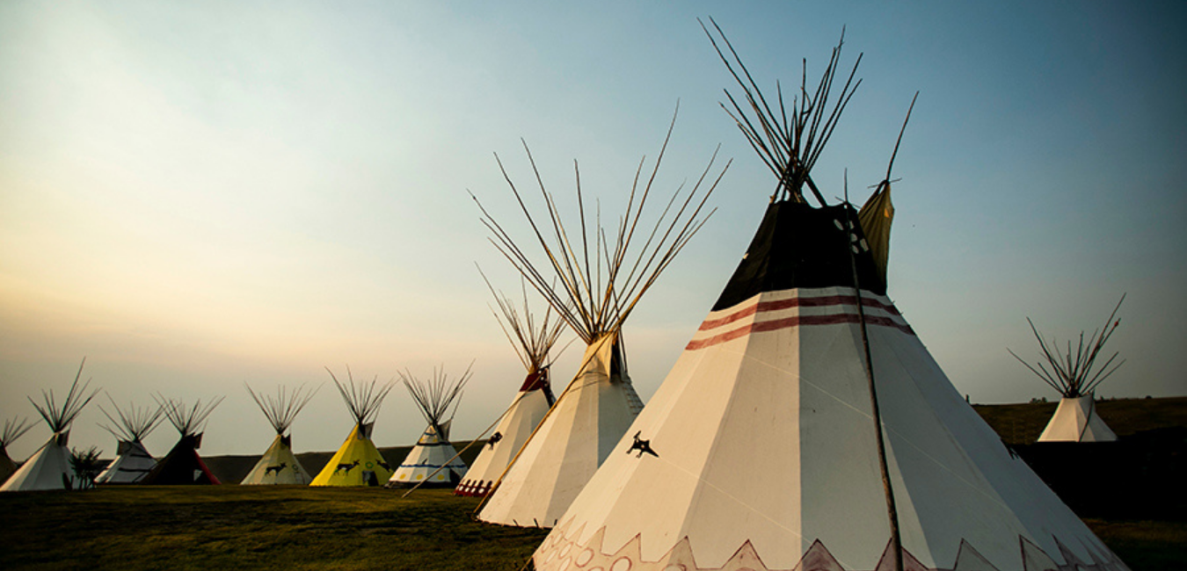
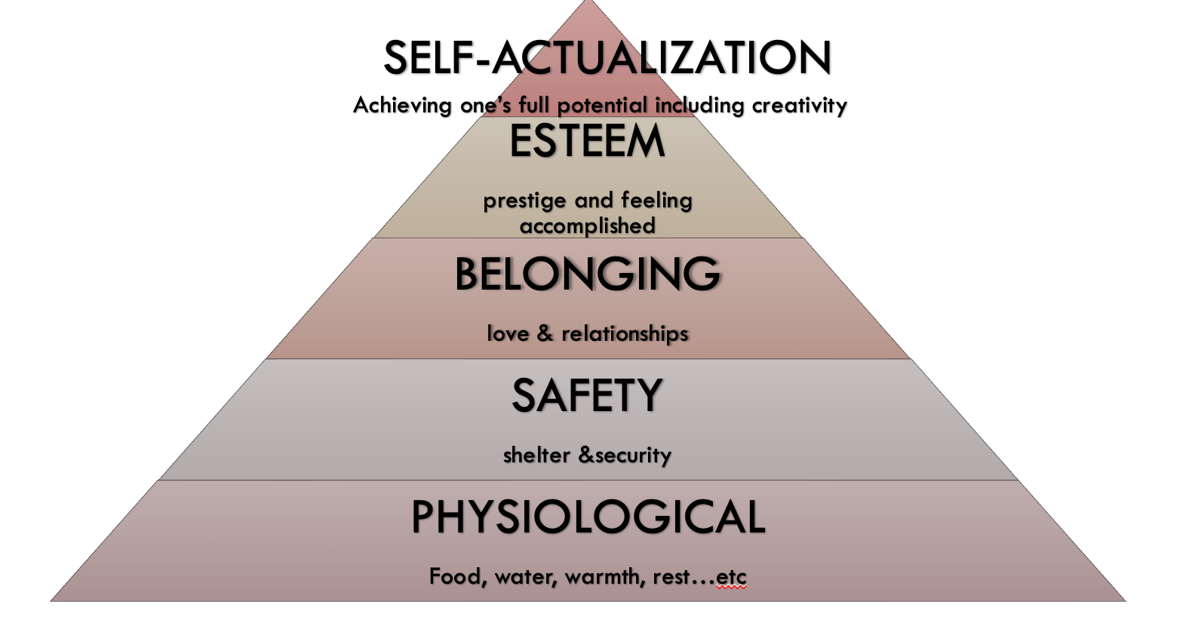
CULTURAL PERPETUITY
COMMUNITY ACTUALIZATION
SELF-ACTUALIZATION
(Blackfeet Nation)

Slide 6
2021
2018

Slide 7
DEFINITIONS
“A refugee is someone who is unable or unwilling to return to their country of origin owing to a well-founded fear of being persecuted for reasons of race, religion, nationality, membership of a particular social group, or political opinion.”

Slide 8
“THREE DURABLE SOLUTIONS”
VOLUNTARY REPATRIATION
LOCAL INTEGRATION
RESETTLEMENT

Slide 9
RESETTLEMENT
The selection and transfer of refugees from one country in which they have initially sought protection to a third country which has agreed to admit them as refugees.
1% of the total are flagged for resettlement
Medical needs
Reunification
Women and children at risk

Slide 10
HOW DOES RESETTLEMENT WORK?
United Nations Higher Commissioner for Refugees – UNHCR (Global level)
Voluntary Organizations -VOLAGs (Federal level)
Resettlement Agencies (State level)

Slide 11
HOW DOES RESETTLEMENT WORK?
GLOBAL
United Nations High Commissioner for Refugees (UNHCR) assessment
Initial interview with UNHCR
Assignment based on country quotas
The United States: Eight-step vetting process
18-24 months until the process is completed

Slide 12
HOW DOES RESETTLEMENT WORK?
FEDERAL
FUNDING:
State Department’s Bureau of Population, Refugees, and Migration
Office of Refugee Resettlement (part of U.S. Department of Health and Human Services)
Self-generated resources
Church World Service
Episcopal Migration Ministries
Ethiopian Community Development Council
Hebrew Immigrant Aid Society (HIAS)
International Rescue Committee
Lutheran Immigration and Refugee Service
U.S. Committee for Refugees and Immigrants
United States Conference of Catholic Bishops
World Relief

Slide 13
HOW DOES RESETTLEMENT WORK?
STATE
US Committee for Refugees and Immigrants (USCRI)
Ethiopian Community Development Council (ECDC)

Slide 14
Cash assistance
Food stamps
Rent subsidy
Initial reception and placement
Apply for assistance
Medical assistance

Slide 15
“… the social and economic ability of an individual, a household or a community to meet essential needs (including protection, food, water, shelter, personal safety, health and education) in a sustainable manner and with dignity. Self-reliance, as a programme approach, refers to developing and strengthening livelihoods of persons of concern, and reducing their vulnerability and long-term reliance on humanitarian/external assistance.”
"Self-reliance provides the basis for whatever comes next - whether it is resettlement, local integration or repatriation and reintegration."
(UNHCR, 2005, p.7)

Slide 16
“The mission of the State Refugee Office is to promote and provide a safe and welcoming home for refugees and immigrants, and to promote their full participation as self-sufficient individuals and families in the economic, social, and civic life of Vermont.”
State of Vermont- Agency of Human Services

Slide 17
Affordable housing
Employment & Job Security
Food (in)security

Slide 18
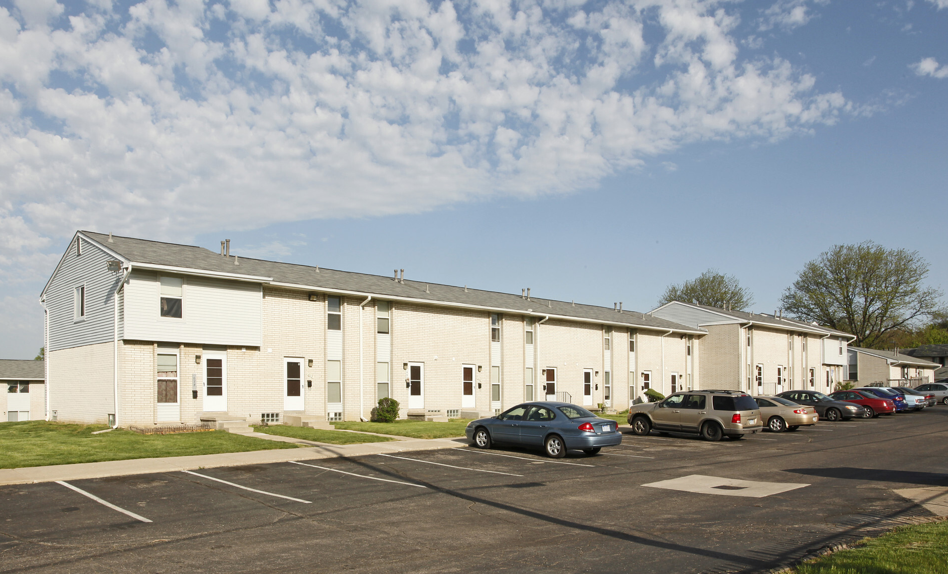
“BENEFITS CLIFF”

Slide 19
Refugees at HOME
Language Learning
Transportation
At Home
Lack of Transportation
Monocultural
Lack of English Learning Opportunities

Slide 20
Refugees at WORK
Language Learning
Employment
At Work
Overworked
and
Underpaid
Monocultural
Lack of English Learning Opportunities

Slide 21
STIGMA
Health
Food (in)security
Job (in)security
Precarity at Work
Health
problems
Food (in)security
Internalized stigma

Slide 22
STIGMA
Employment
Social Networks
Isolation
Isolation from other refugees
Fractures in community
Policing each other
Internalized stigma

Slide 23
Three Conditions of Belonging
We are interdependent as humans
True multiculturalism requires an effort from all sides
Institutional/structural factors and cultural inclusion simultaneously determine sense of belonging
Notes:
Interdependence as equally important as independence
Excessive focus on self-reliance can be harmful and not productive
Facilitating strong relations/communities with co-ethnics
how not to create hierarchies and competition among refugee community.
True multiculturalism:
Showing genuine curiosity in their culture, and them as a person
Honor the desire to explore/interact with domestic cultures
If they are here, it is very likely that they want to learn and explore
Not only the with the mainstream/dominant Anglo culture, but also other diasporic cultures such as Latinx/Hispanic culture, Black/African
Creating infrastructure to enable capabilities
Housing, transportation, Multiple and different Language Learning opportunities, Children’s education
Health care, Legal assistance
Civic Engagement

Slide 24
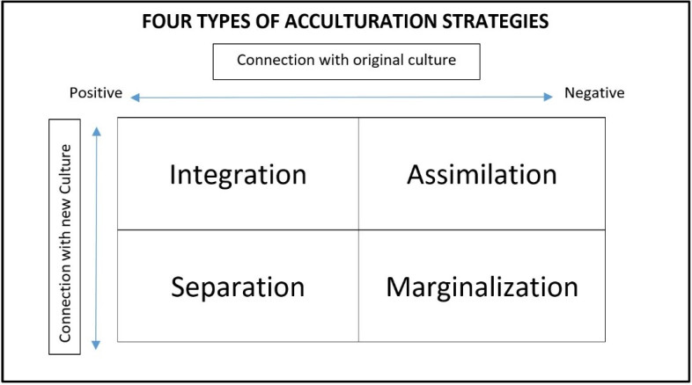
Negotiating Belonging…
Notes:
Older models of acculturation identified four possibilities for immigrants and refugees. These were integration, assimilation, separation and marginalization.
Among these “integration” was identified as the most desirable outcome. Integration happens when a migrant is able to maintain their heritage culture while also adopting aspects of the new culture. Ideally, individuals use their creativity in integrating the two cultures and this creates a blend.
Assimilation, as we know, is the case when the individual adopts aspects of the new culture, while distancing themselves from their heritage culture. So, they assimilate to the new culture.
The third possibility is separation, in this case the individual rejects the new culture or separates themselves from it while fully maintaining their heritage culture. An example of this would be immigrants who live in ethnic enclaves with little to no interaction with the dominant culture.
The fourth possibility is marginalization. what happens in this case is that the individual rejects both the new culture and the heritage culture. They do not maintain relationships or interactions with people from either groups, or they reject both cultures.

Slide 25
LANGUAGE JUSTICE
ACCESS TO HEALTH CARE
EDUCATION
AFFORDABLE HOUSING
BELONGING
CIVIC ENGAGEMENT
EMPLOYMENT & JOB SECURITY
TRANSPORTATION
FOOD SECURITY
FAMILY TIES
SOCIAL NETWORKS

Slide 26
Email ozgesavas@bennington.edu
Website https://belonging-lab.com
ÖZGE SAVAŞ, Ph.D.
Bennington College, VT

