Slide 1
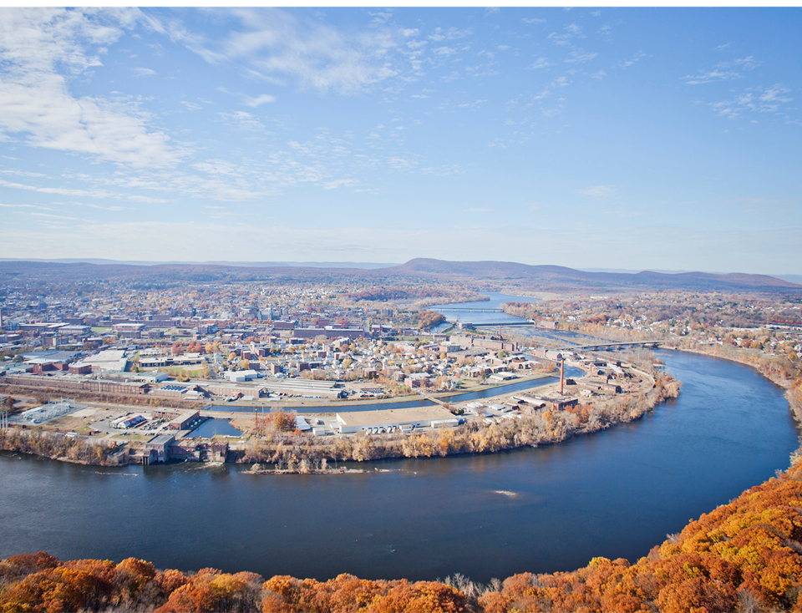
Mayor Alex B. Morse
Southern Vermont Economic Development Summit
May 30, 2018
Growing People, Partnerships, and Potential

Slide 2
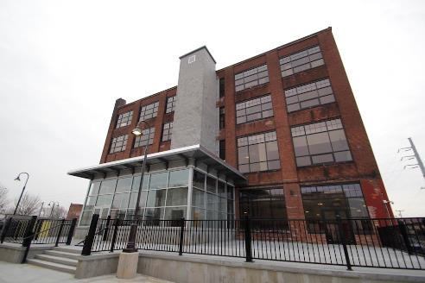
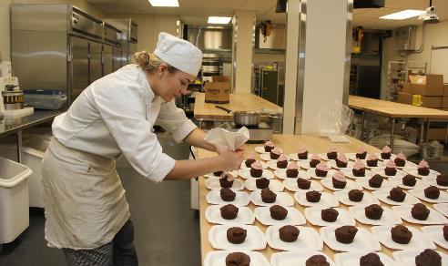
Outline of Topics
Challenges
Opportunities
Innovation Economy
Public/Private Partnerships
Indicators
New Industries
Questions

Slide 3
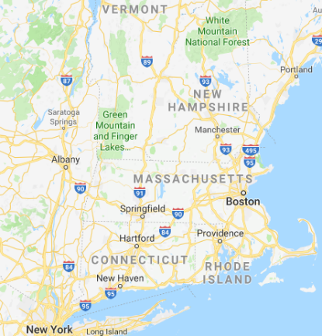
Location & Background
Birthplace of Volleyball
Population: 40,700
48% Latino, mostly Puerto Rican
1st planned industrial city in
the United States, nicknamed the “Paper City.”
Had the most millionaires per capita in the United States in the 1920s.
Now considered one of the “lowest income” cities in MA
Holyoke
Notes:
manufacturing cluster in W. Mass

Slide 4
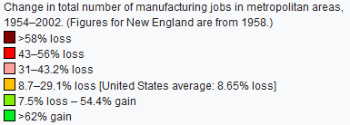
Notes:
But pulp mills moved out: to the northwest with better access to raw materials
Other mills, such as throughout the region, moved south
This is a map of changes in manufacturing employment between the 1950’s and the early 2000’s. Holyoke is in the middle of the bright red in Massachusetts.

Slide 5
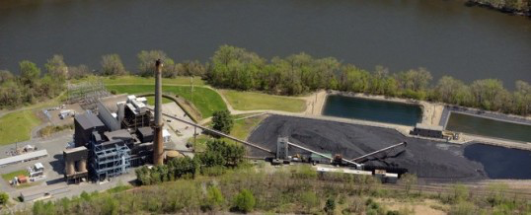
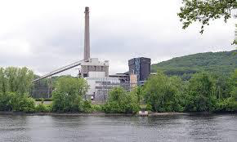
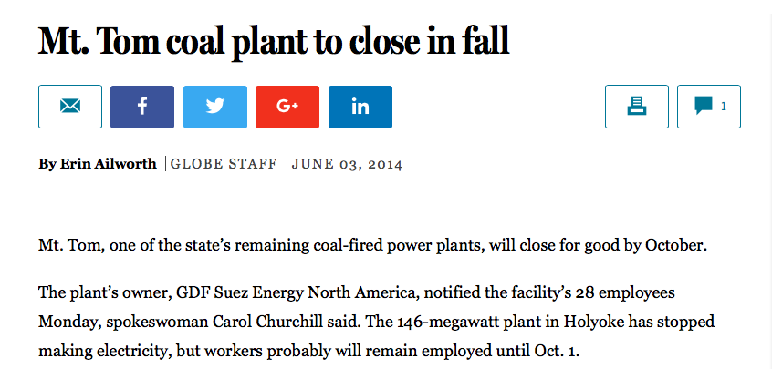
Mt. Tom Coal Plant Closure
2012-2014
Notes:
manufacturing cluster in W. Mass

Slide 6
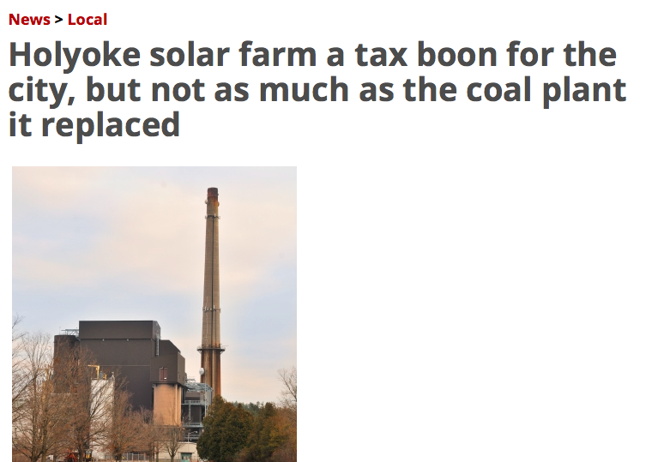
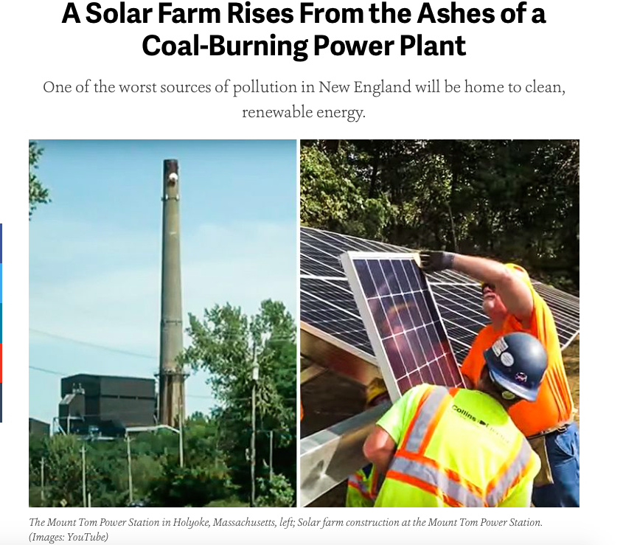
Notes:
manufacturing cluster in W. Mass

Slide 7
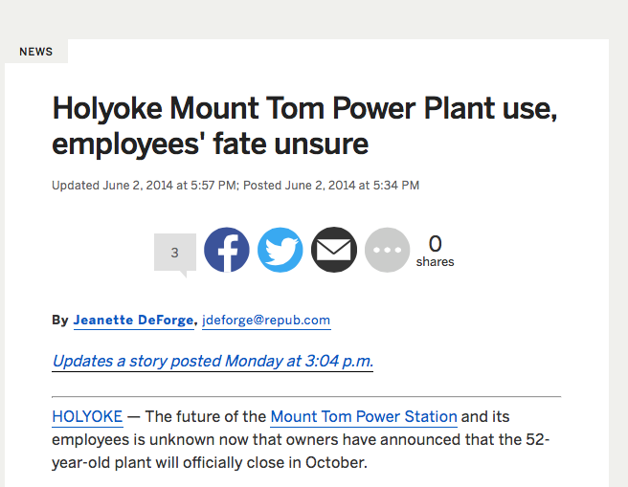
Tax Impact of Coal Plant Closure
Taxes Paid to the City
2009: $1.7 million
2011: $1.3 million
2013: $573,149
2014: $315,416
Today: $146,000
Notes:
manufacturing cluster in W. Mass

Slide 8
Tax Impact of Coal Plant Closure
Notes:
manufacturing cluster in W. Mass

Slide 9
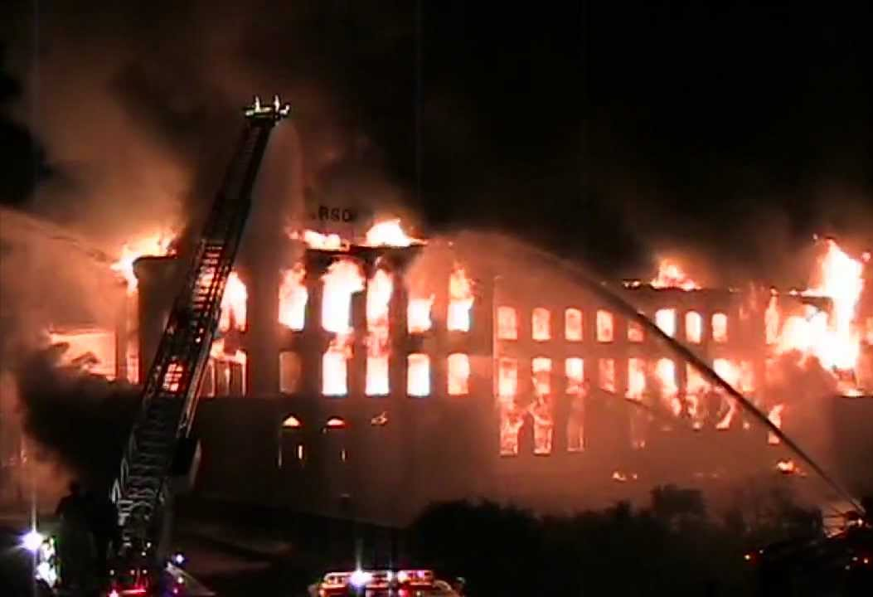
Parsons Paper
Fire in 2009, $2 Million EPA Cleanup finished in 2010 - Estimated ~$3.5 Million pad-ready prep project
$250,000 in funds for pre-development secured in 2014;
$2 million from the state Brownfield Fund through MassDevelopment;

Slide 10
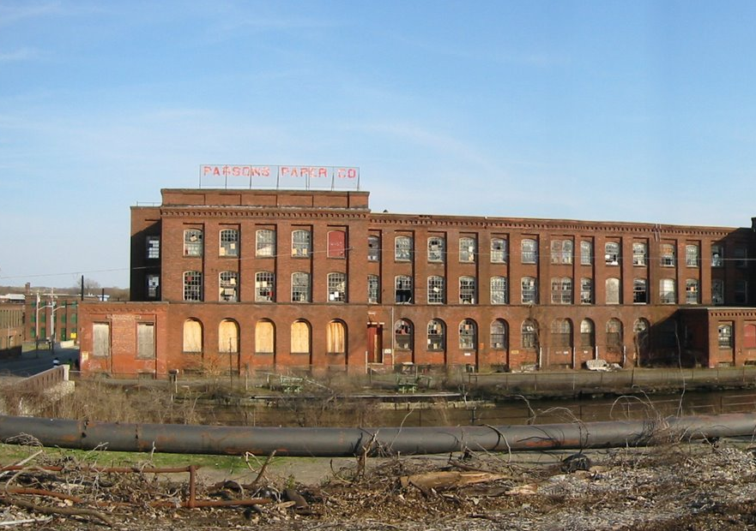
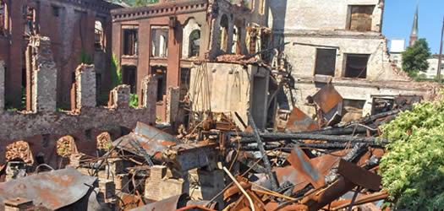
Parsons Paper
$1 Million capital investment by the Holyoke Gas & Electric, which secures an easement on the site for potentially 2.5 MW of hydroelectric generation;
$400,000 capital loan from the Holyoke Economic Development and Industrial Corporation, to be paid from the sale proceeds of the land to AEGIS Energy Services;
City also provided its most aggressive tax incentive schedule in its history: 100% property tax exemption for 10 years.

Slide 11
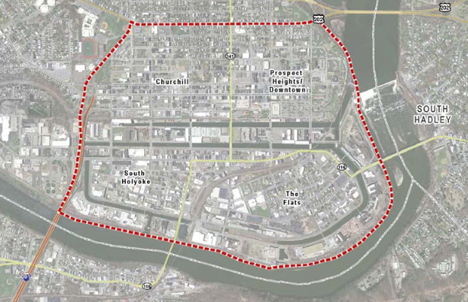
Urban Renewal Plan

Slide 12
Site Readiness Work/assistance to get Vacant Mill Space Rehabilitated and Occupied
Approx. 1.5 Million Sq. Ft.
Approx. 750,000 Sq. Ft.
→ Pre-development rehab studies
→ Tax Incentives
→ Land Sales
→ Haz-Mat Cleanup

Slide 13
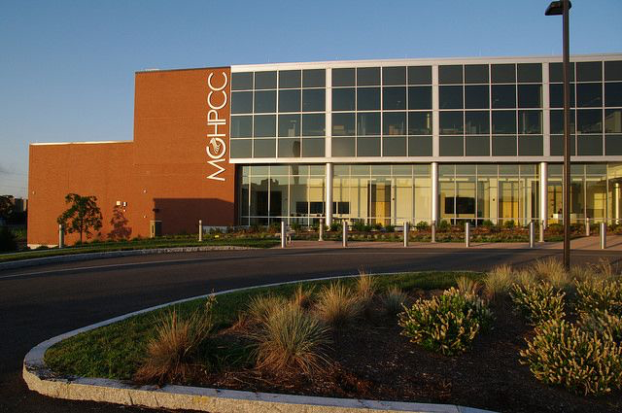
Holyoke Innovation District
$100 million project
Public/Private Partnership
Harvard, Northeastern, MIT, Boston University, UMass Amherst
CISCO, EMC
Created the Innovation District Task Force

Slide 14
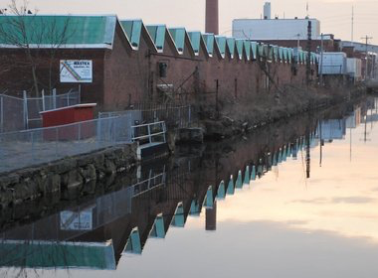
Holyoke Innovation District

Slide 15
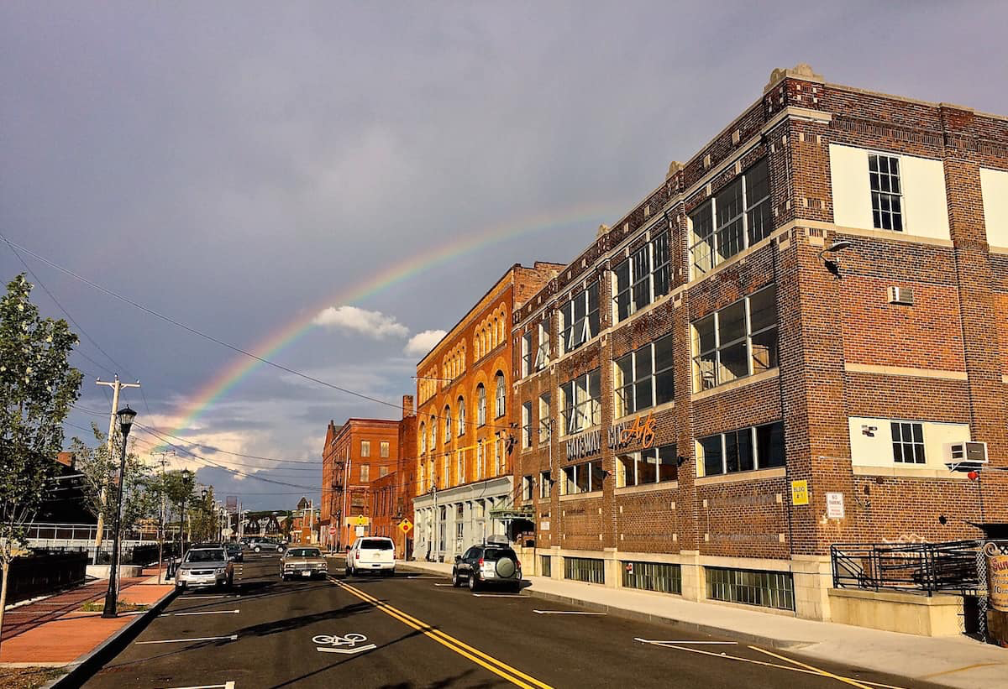
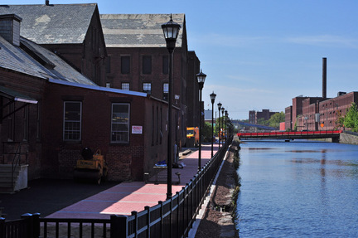
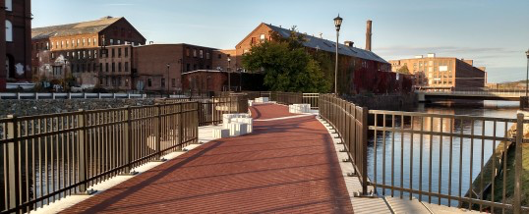
Holyoke Innovation District: Canal Walk & Race Street

Slide 16
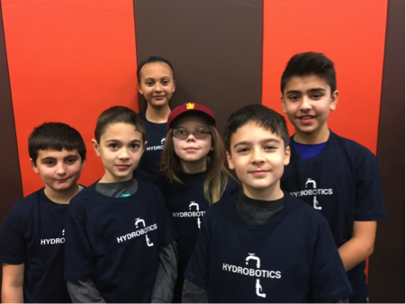

Slide 17
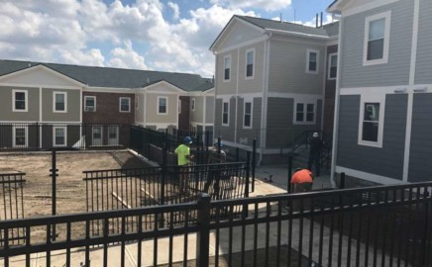
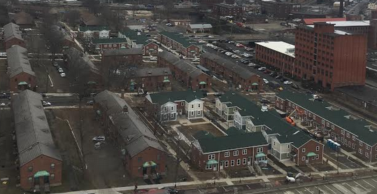
Lyman Terrace
City of Holyoke
Holyoke Housing Authority
The Community Builders
Residents
$60 million project
32 families have returned to renovated units

Slide 18
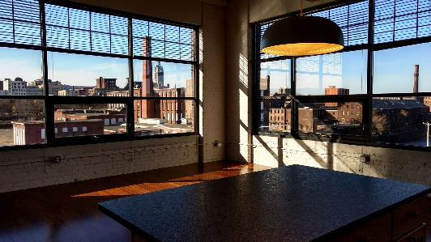
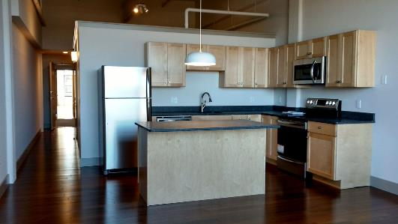
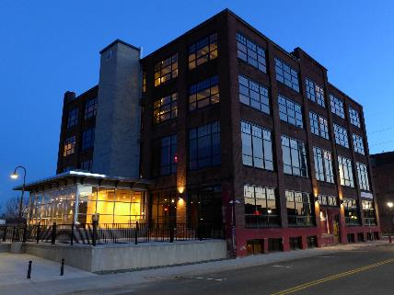
Cubit Building
18 market rate loft-style rental apartments
Fully occupied

Slide 19
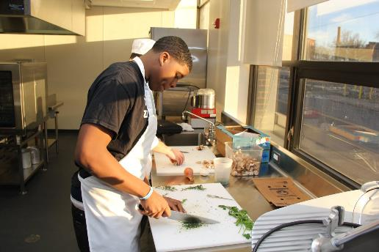
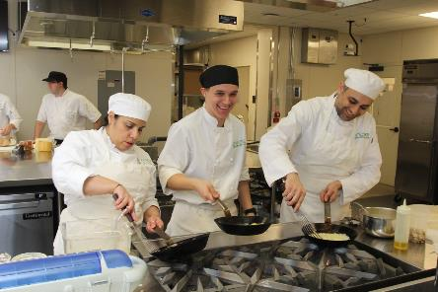
HCC’s MGM Culinary Arts Institute
$7.5 million training facility
5 kitchens
EDA Grant, state/city funds
50 Holyoke residents annually get free training

Slide 20
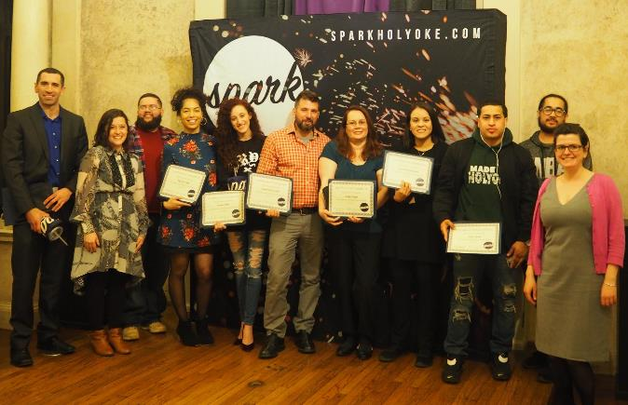
SPARK: Holyoke
Launching local entrepreneurs
9 week class, held 3 times a year
90 graduates
41 businesses
100 jobs created

Slide 21
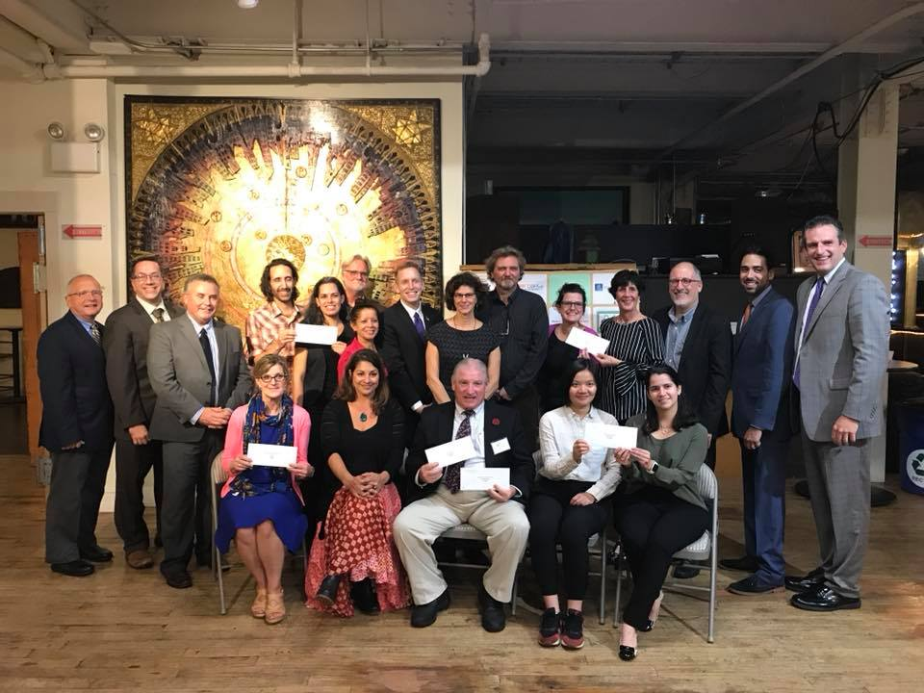
SPARK incubator
Received $64,545 from Collaborative Workspace Program
Opening co-work space on High Street this spring

Slide 22
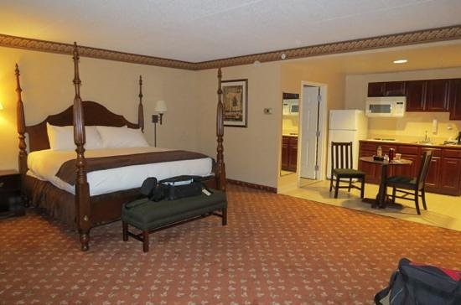
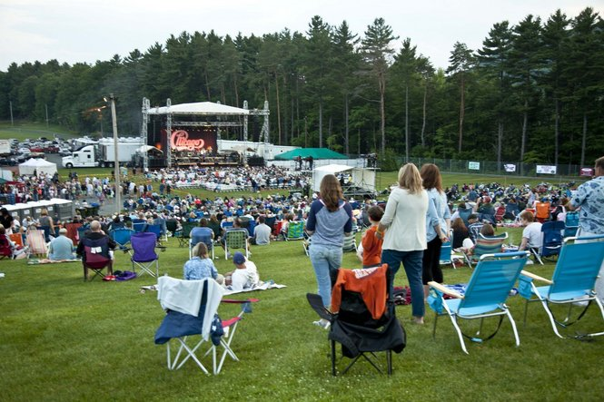
Industry Section Expansion – Tourism Assessment Plan
Prepare to mitigate and/or complement entertainment and hospitality impact of MGM in Springfield
Look at local assets, opportunities to scale them up, ID challenges and next steps
Funding source identified, expected to start this year
Launching Bike Share program in late June

Slide 23
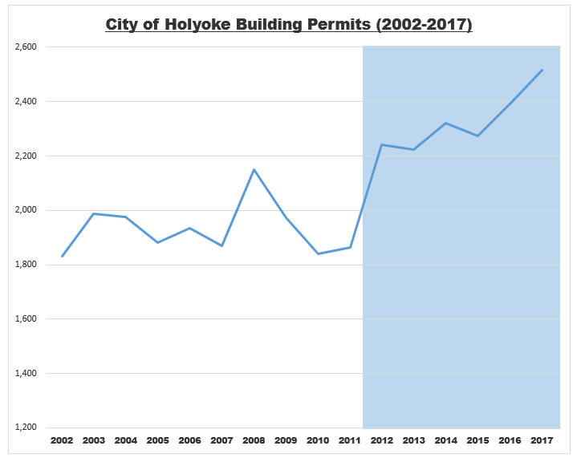
New Construction

Slide 24
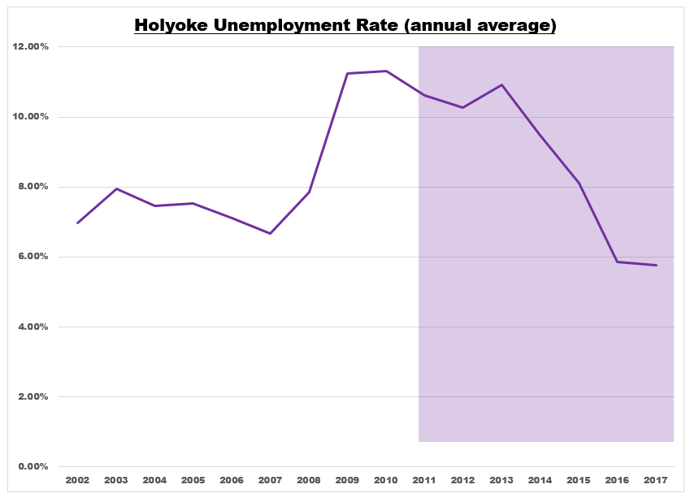
Unemployment Rate

Slide 25
New Housing
Totals over 500 new units

Slide 26
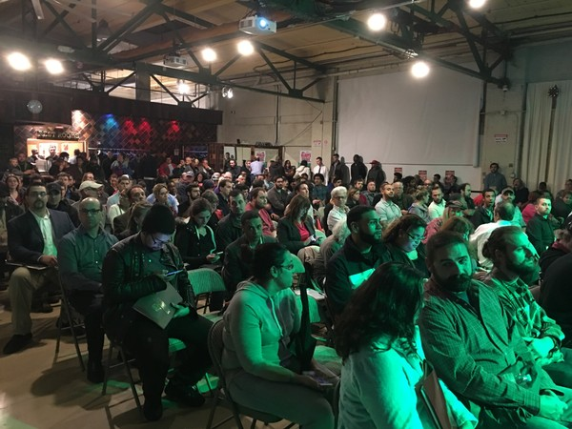
Recreational Marijuana
Economic Opportunity
Jobs
Revitalize vacant mill space
Increase municipal revenue
Economic Cluster

Slide 27
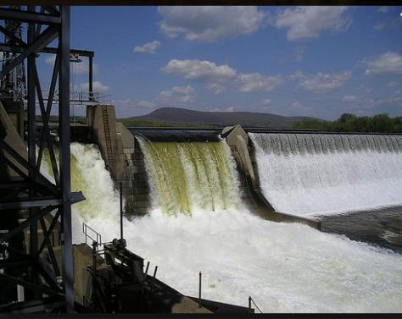
Holyoke’s Competitive Advantage
Location
Utility costs
Available space
No moratorium - allowed in IG zones

Slide 28
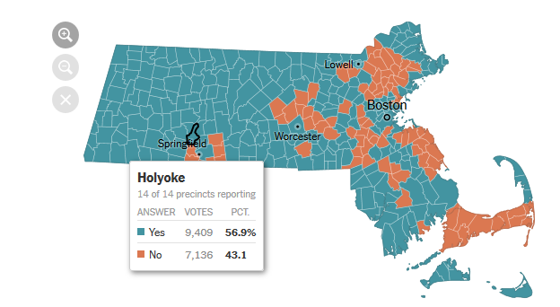
Political support
Source: The New York Times
k’adjgkljd;lksajdkljs;ajdk;gldjkas;sjdk;sadfdsasdfdsasdfdsadfdsasdfdsa
Notes:
57% of residents voted in favor of the marijuana ballot question, higher than the 53.7% support state-wide.

Slide 29
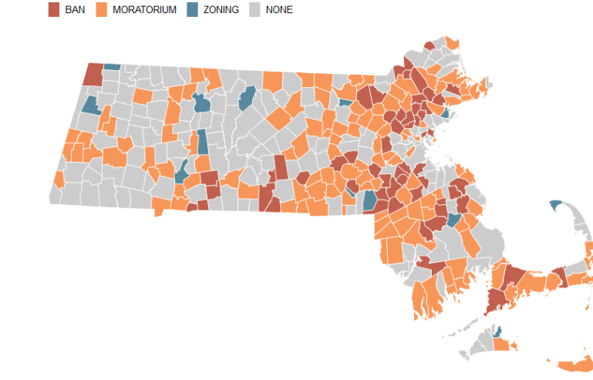
Local Restrictions
Source: Boston Globe
Notes:
One of the first municipalities to adopt a comprehensive recreational/medical marijuana zoning ordinance in the Commonwealth

Slide 30
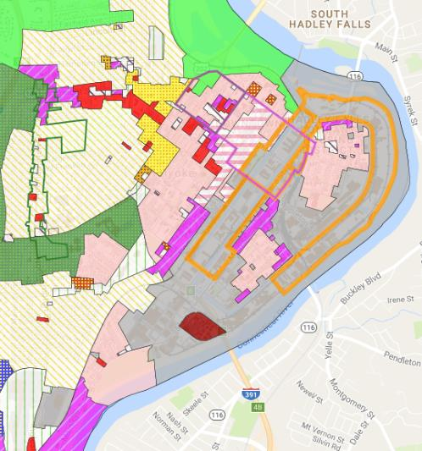
Zoning and Special Permit Process

Slide 31
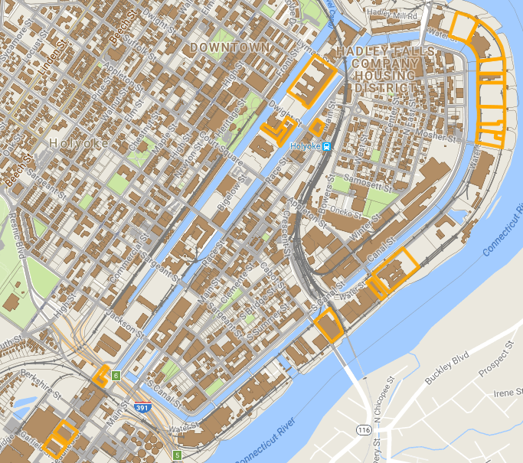
Recent Updates
Marijuana
Real Estate
Interest in
IG Zone

Slide 32
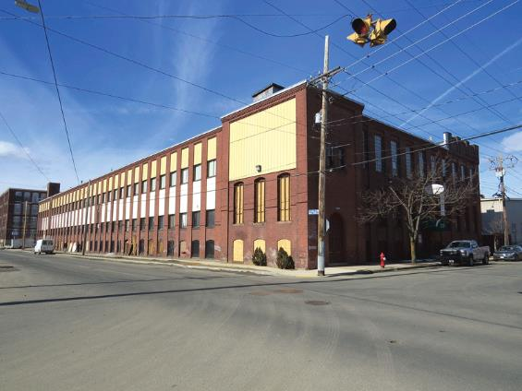
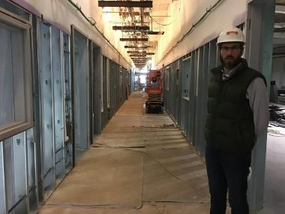
28 Appleton Street

Slide 33
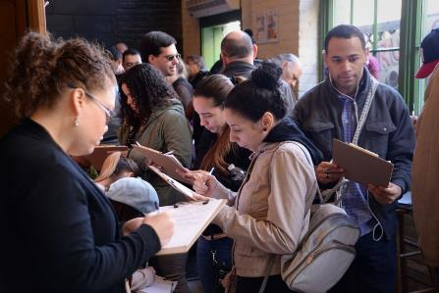
CORI Job Fair

Slide 34
Questions?
Contact: morsea@holyoke.org

