Slide 1
COMPREHENSIVE ECONOMIC DEVELOPMENT STRATEGY CELEBRATION
CEDS VITAL PROJECTS ANNOUNCEMENT
2019 Southern Vermont Economy Summit

Slide 2
2019 Southern Vermont CEDS

Slide 3
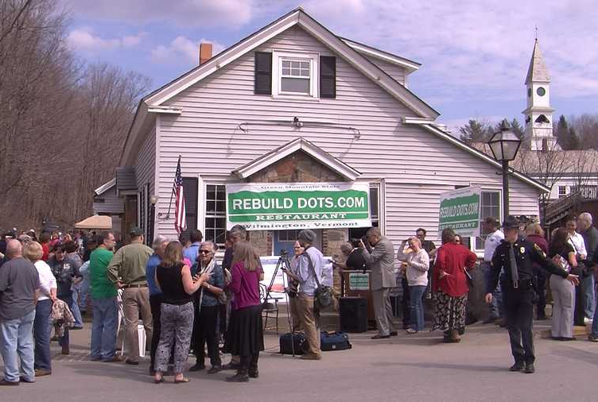
PRECEDENT
IRENE
RESPONSE
ZONE
ASSESSMENT

Slide 4
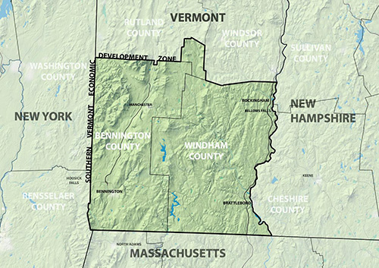
A NEW ZONE
TWO
COUNTIES
COMMON
PRIORITIES

Slide 5
ONE REGION
80,000
PEOPLE
CRITICAL
MASS

Slide 6
5-YEAR CEDS
ACTION
ORIENTED
EDA
SUPPORTED

Slide 7
TEAM
PROJECT
GUIDANCE
LOCAL
OVERSIGHT

Slide 8
process
16
PERSONAL
INTERVIEWS
8
SECTOR-LED
FOCUS GROUPS
15
PUBLIC INPUT
SESSIONS

Slide 9
VISION
In 2030, Southern Vermont will be home to a resilient, creative, and inclusive community in which businesses and people thrive and prosper.

Slide 10
VALUES
Welcoming
Forward Thinking
Healthy
Outstanding

Slide 11
GOALS
STRENGTHEN
BUSINESS
SUPPORT
PEOPLE

Slide 12
objectives
INCREASE POPULATION
INFRASTRUCTURE
Improve Physical
Enhance Social
Expand Business
BUILD ECONOMIC CAPACITY

Slide 13
2019 VITAL PROJECTS

Slide 14
SUBMISSIONS
71
PROJECTS
47
ORGS

Slide 15
SUBMISSIONS
24 SINGLE-TOWN
18 MULTI-TOWN
29 REGION-WIDE

Slide 16
committee
Kayla Becker
Catamount Connections
Drew Bryenton
Commonwealth Dairy
John Burnham
Kimpton Taconic
Jim Martinez
Tri State Area FCU
Elisabeth Marx
Vermont Community Fdn.
Chris Parker
Town of Vernon
Kelly Clarke
Centerline Architects
Eric DeRoucher
Southern Vermont Chamber
Gary Fox
Town of Rockingham
Eilidh Pedersen
Brattleboro Memorial
James Salerno
Hale Mountain Research
Melissa Trainor
School for Intl. Training
Cor Trowbridge
Brattleboro Community TV

Slide 17
VITAL PROJECTS

Slide 18
ViTal Projects
OLD SCHOOL ENRICHMENTCOUNCIL
Old School Community Center

Slide 19
ViTal Projects
BENNINGTON REDEVELOPMENT GROUP
Putnam Block Phase II

Slide 20
ViTal Projects
WINDHAM REGIONAL COMMISSION
Extending Mass. Rail Expansion to Vermont

Slide 21
ViTal Projects
WINDHAM REGIONAL COMMISSION
Village Water & Wastewater Assessment

Slide 22
ViTal Projects
BRATTLEBORO DEVELOPMENT CREDIT CORPORATION
SoVermont Marketing & Recruitment Program

Slide 23
ViTal Projects
STARTUP 802 THE LIGHTNING JAR INSTIG8VT
Startup Consortium

