Slide 1
“Sparks to Shovels” Southern Vermont Economy Summit May 2022
Jessica Martin,
Executive Director

Slide 2
A little bit of history
“Precision Valley”
Machine tool industry (Jones & Lamson (1888); Fellows Gear Shaper (1896); Bryant Chucking Grinder (1909); Lovejoy Tool Company (1916)
Created highly specialized parts for weapons, consumer products including tools, vehicle components (passenger vehicles, trains, airplanes)
#7 on Hitler’s US bombing list
“Cradle of Inventions”
Steam excavating machine (1848), splint basket (1858), jointed doll and doll carriages/accessories (1858) Joel Ellis
Spring loaded clothespin (1853, David Smith)
Sheep shearing machine (1864, AJ Fullam)
Woolen mills (Parks and Woolson, 1829; Slack Shoddy Mill, 1871
More recent claims to fame
Albert Gutterson (Summer 1912) Gold Medal Olympian, Long Jump
Stellafane Observatory (1920, Russell Porter)
Home of The Simpsons (yes, those Simpsons) 2007

Slide 3
What happened?
Lost over 3,000 high-paying manufacturing jobs between 1980 and closure of main machine tool businesses in 2002
Demographics have flipped
Late 1960’s VT’s highest per-capita income
Currently 27% households receive VT public assistance
Grand List stagnant, despite recent housing boom; 2021 average home $176K
Commercial growth challenging due to lingering brownfield issues
Over 500,000 sq ft (that we know of) of contamination still need to be addressed to get key commercial sites usable

Slide 4
What was Springfield’s “spark”?
Vision of Town Manager to “reinvent” Springfield from machine tool industry
Asked for business and community input
Applied for Better Connections Grant to create Springfield’s Main Street Master Plan
This Photo by Unknown Author is licensed under CC BY-NC-ND

Slide 5
Main Street Master Plan Focus Points

Slide 6
What have we accomplished so far?

Slide 7
Light the falls

Slide 8
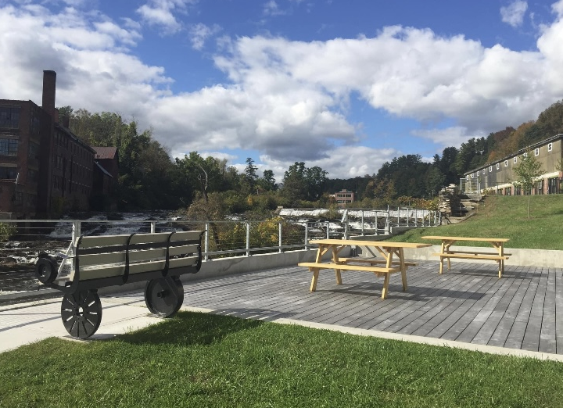
Connect with the river

Slide 10
What have we accomplished so far?

Slide 11
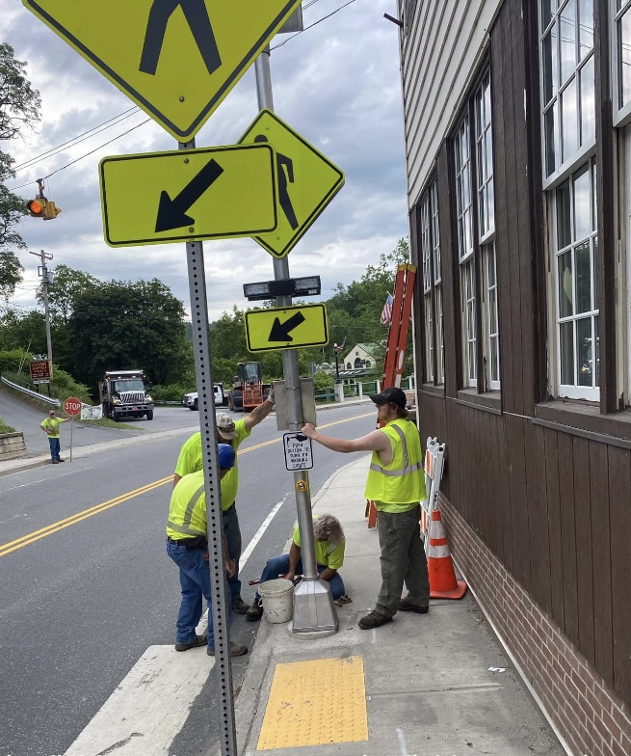
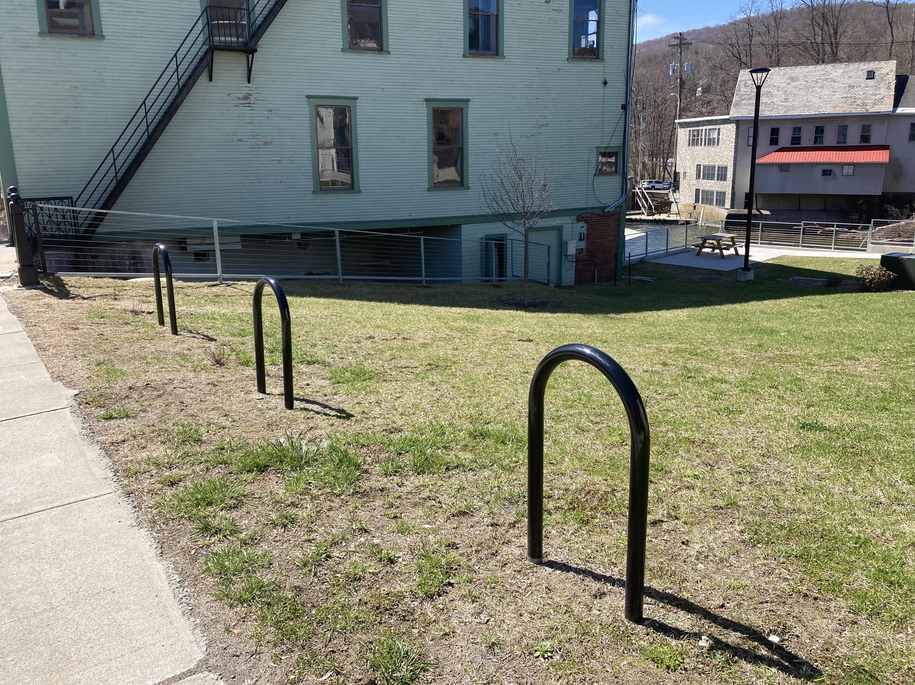
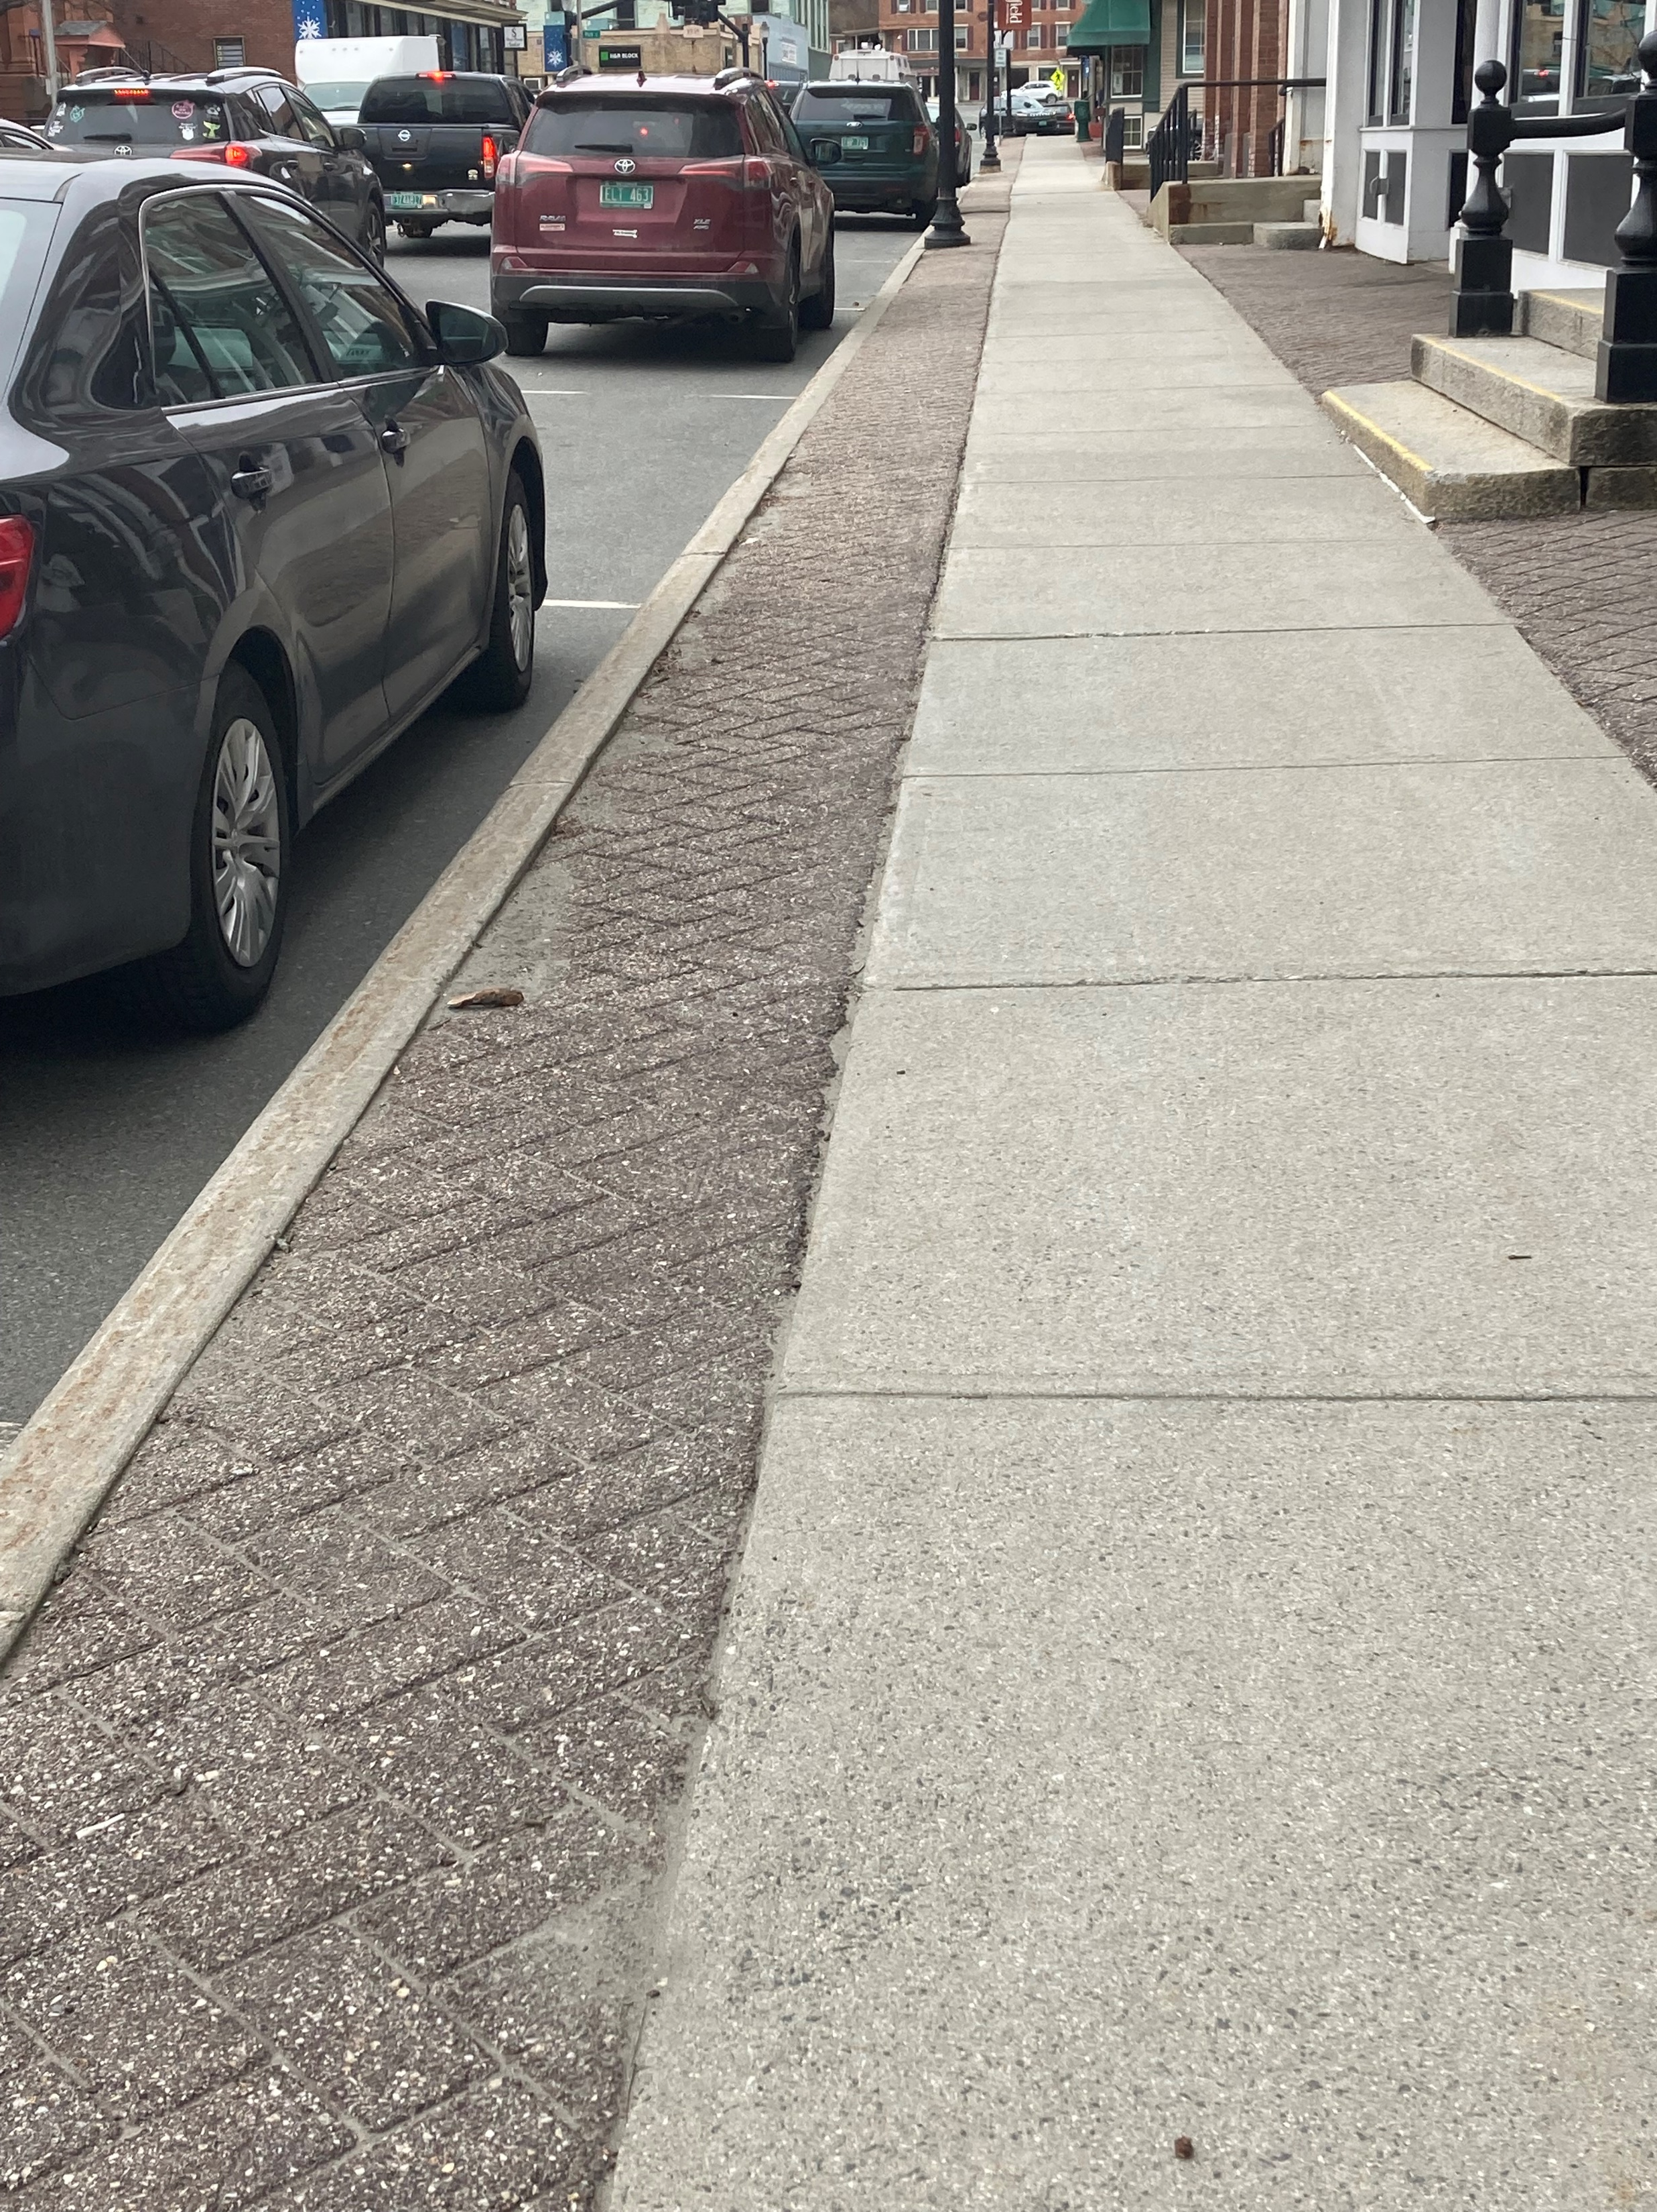
Pedestrian/bicycle safety and walkable/bikeable downtown
Wider sidewalks
Bike Racks and
Bike Lane Signage
Safer Crosswalks

Slide 12
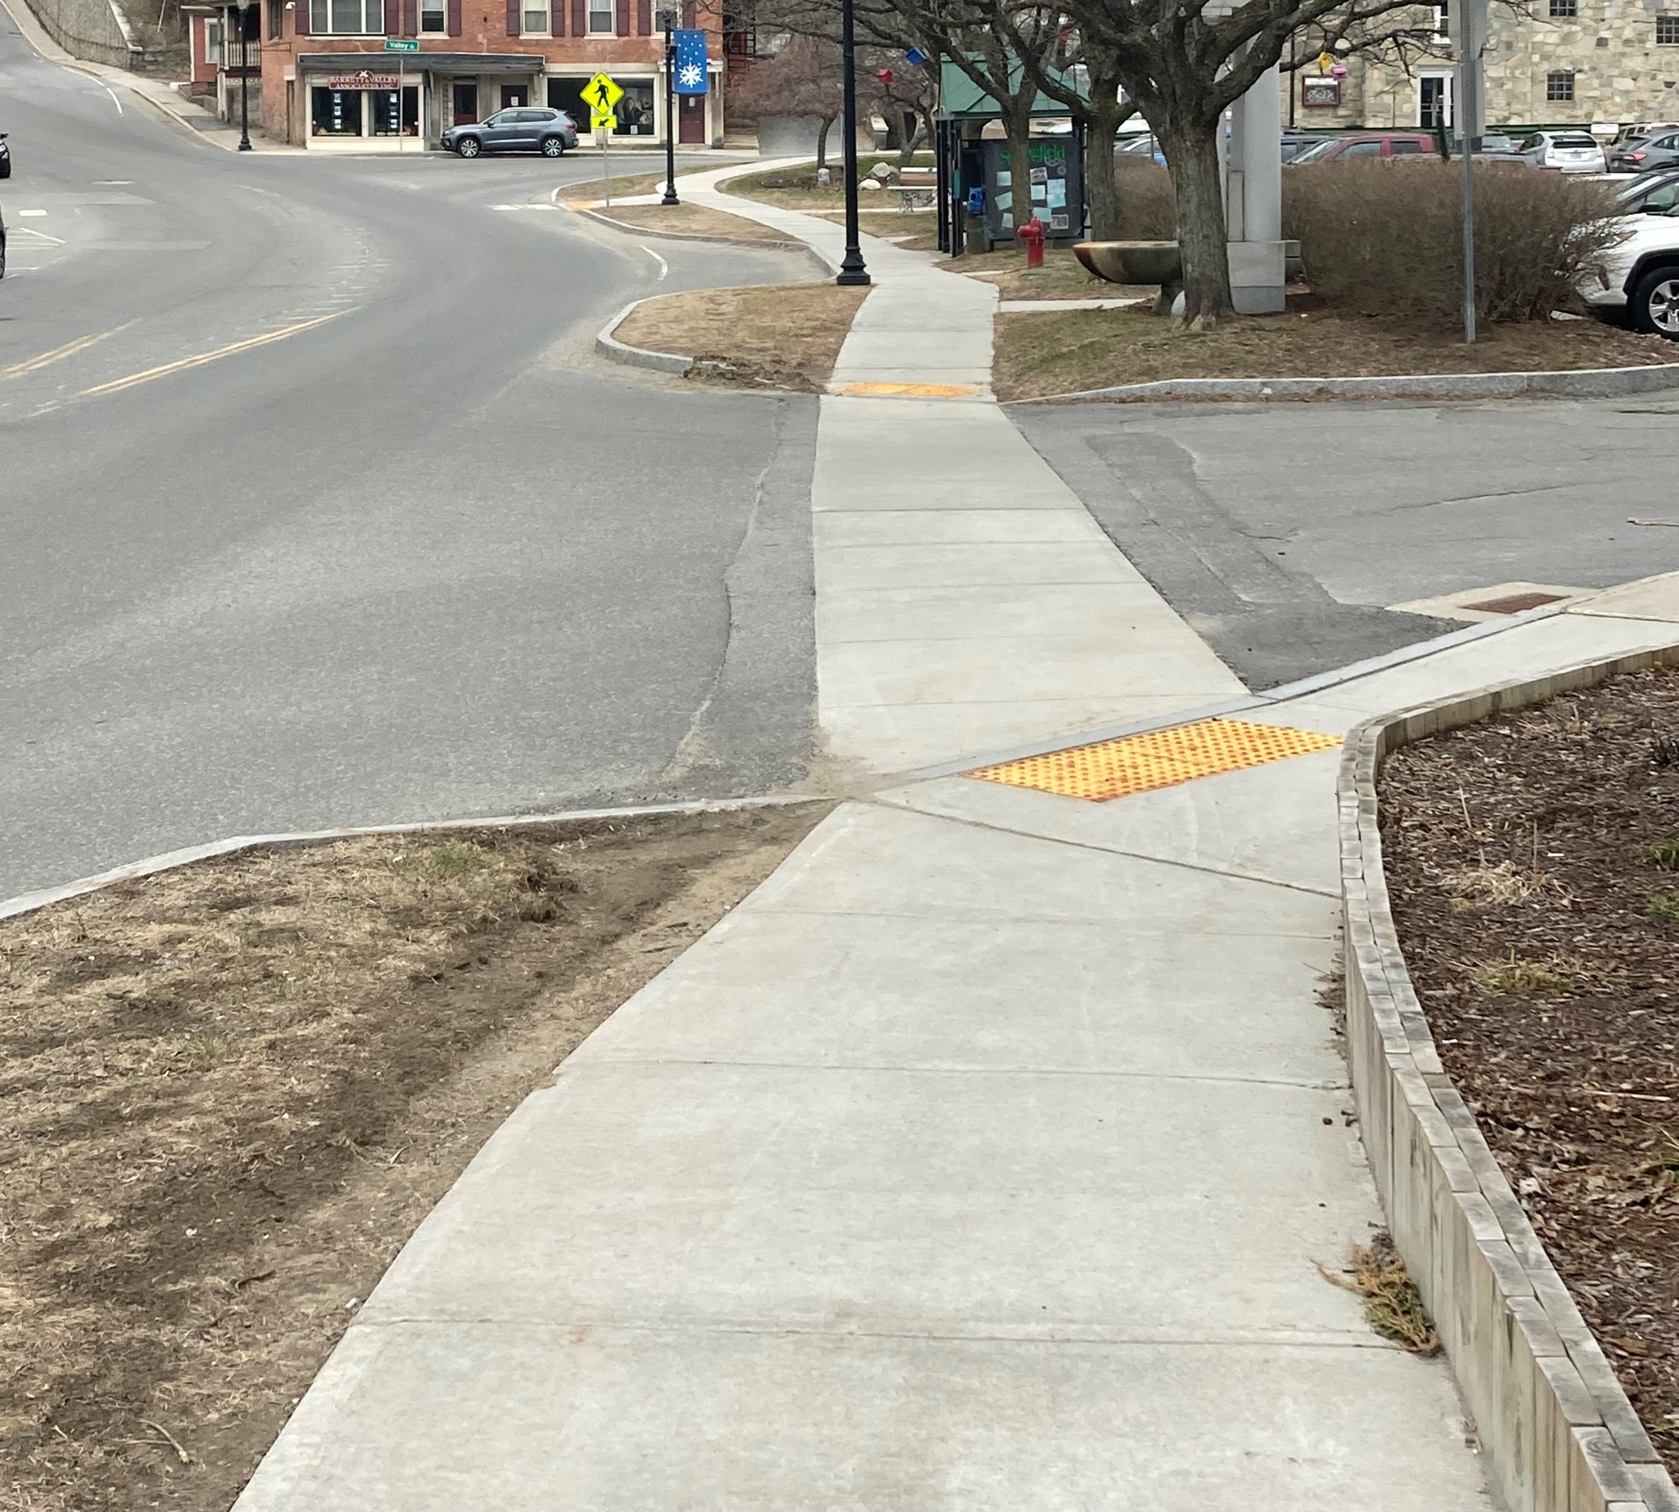
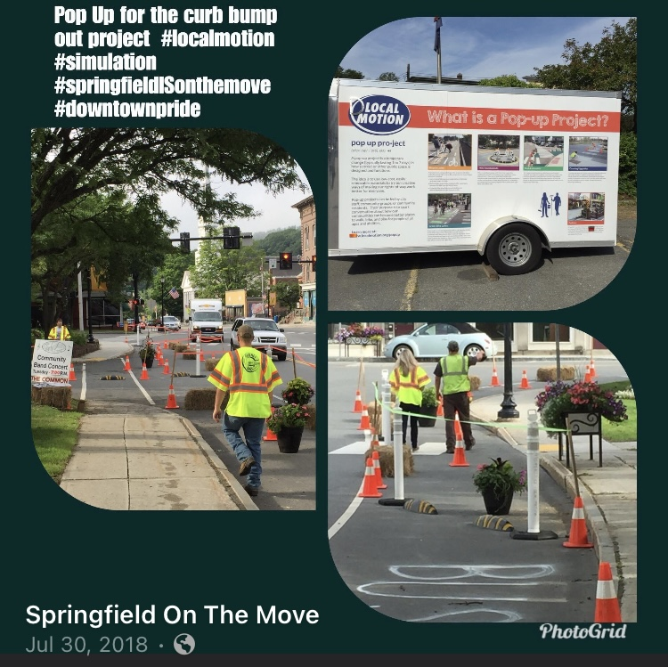
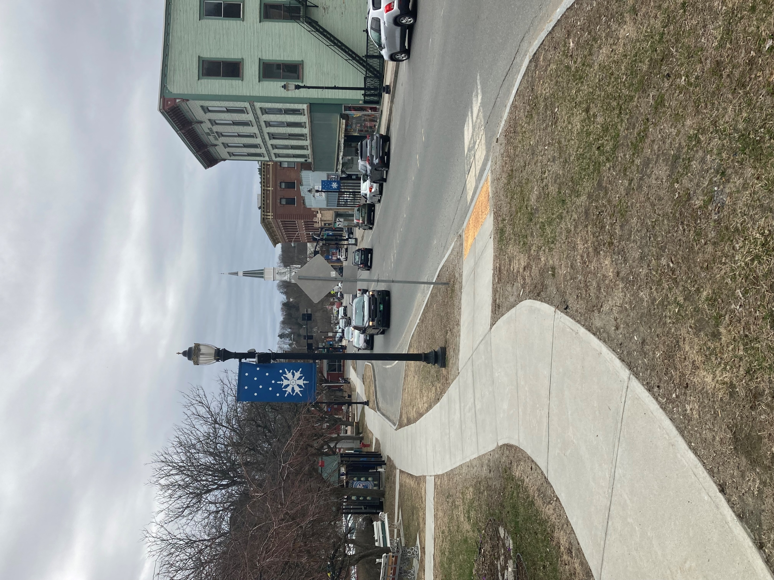
Traffic calming

Slide 15
What have we accomplished so far?

Slide 16
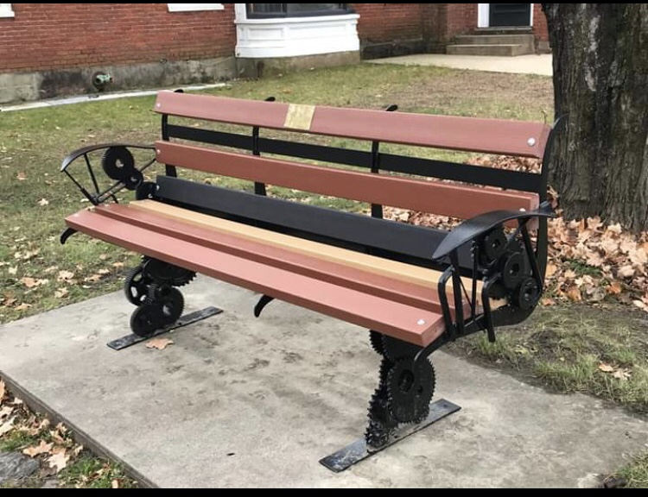

Slide 17
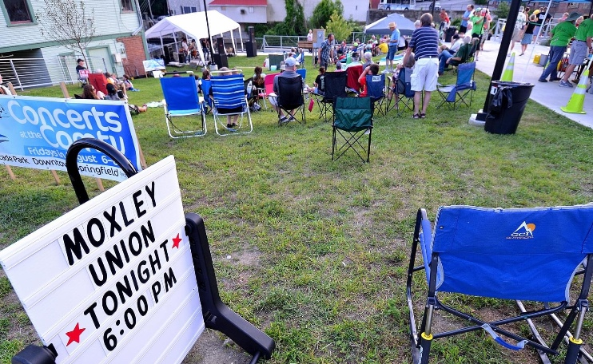

Slide 18
Light the alleyways

Slide 19
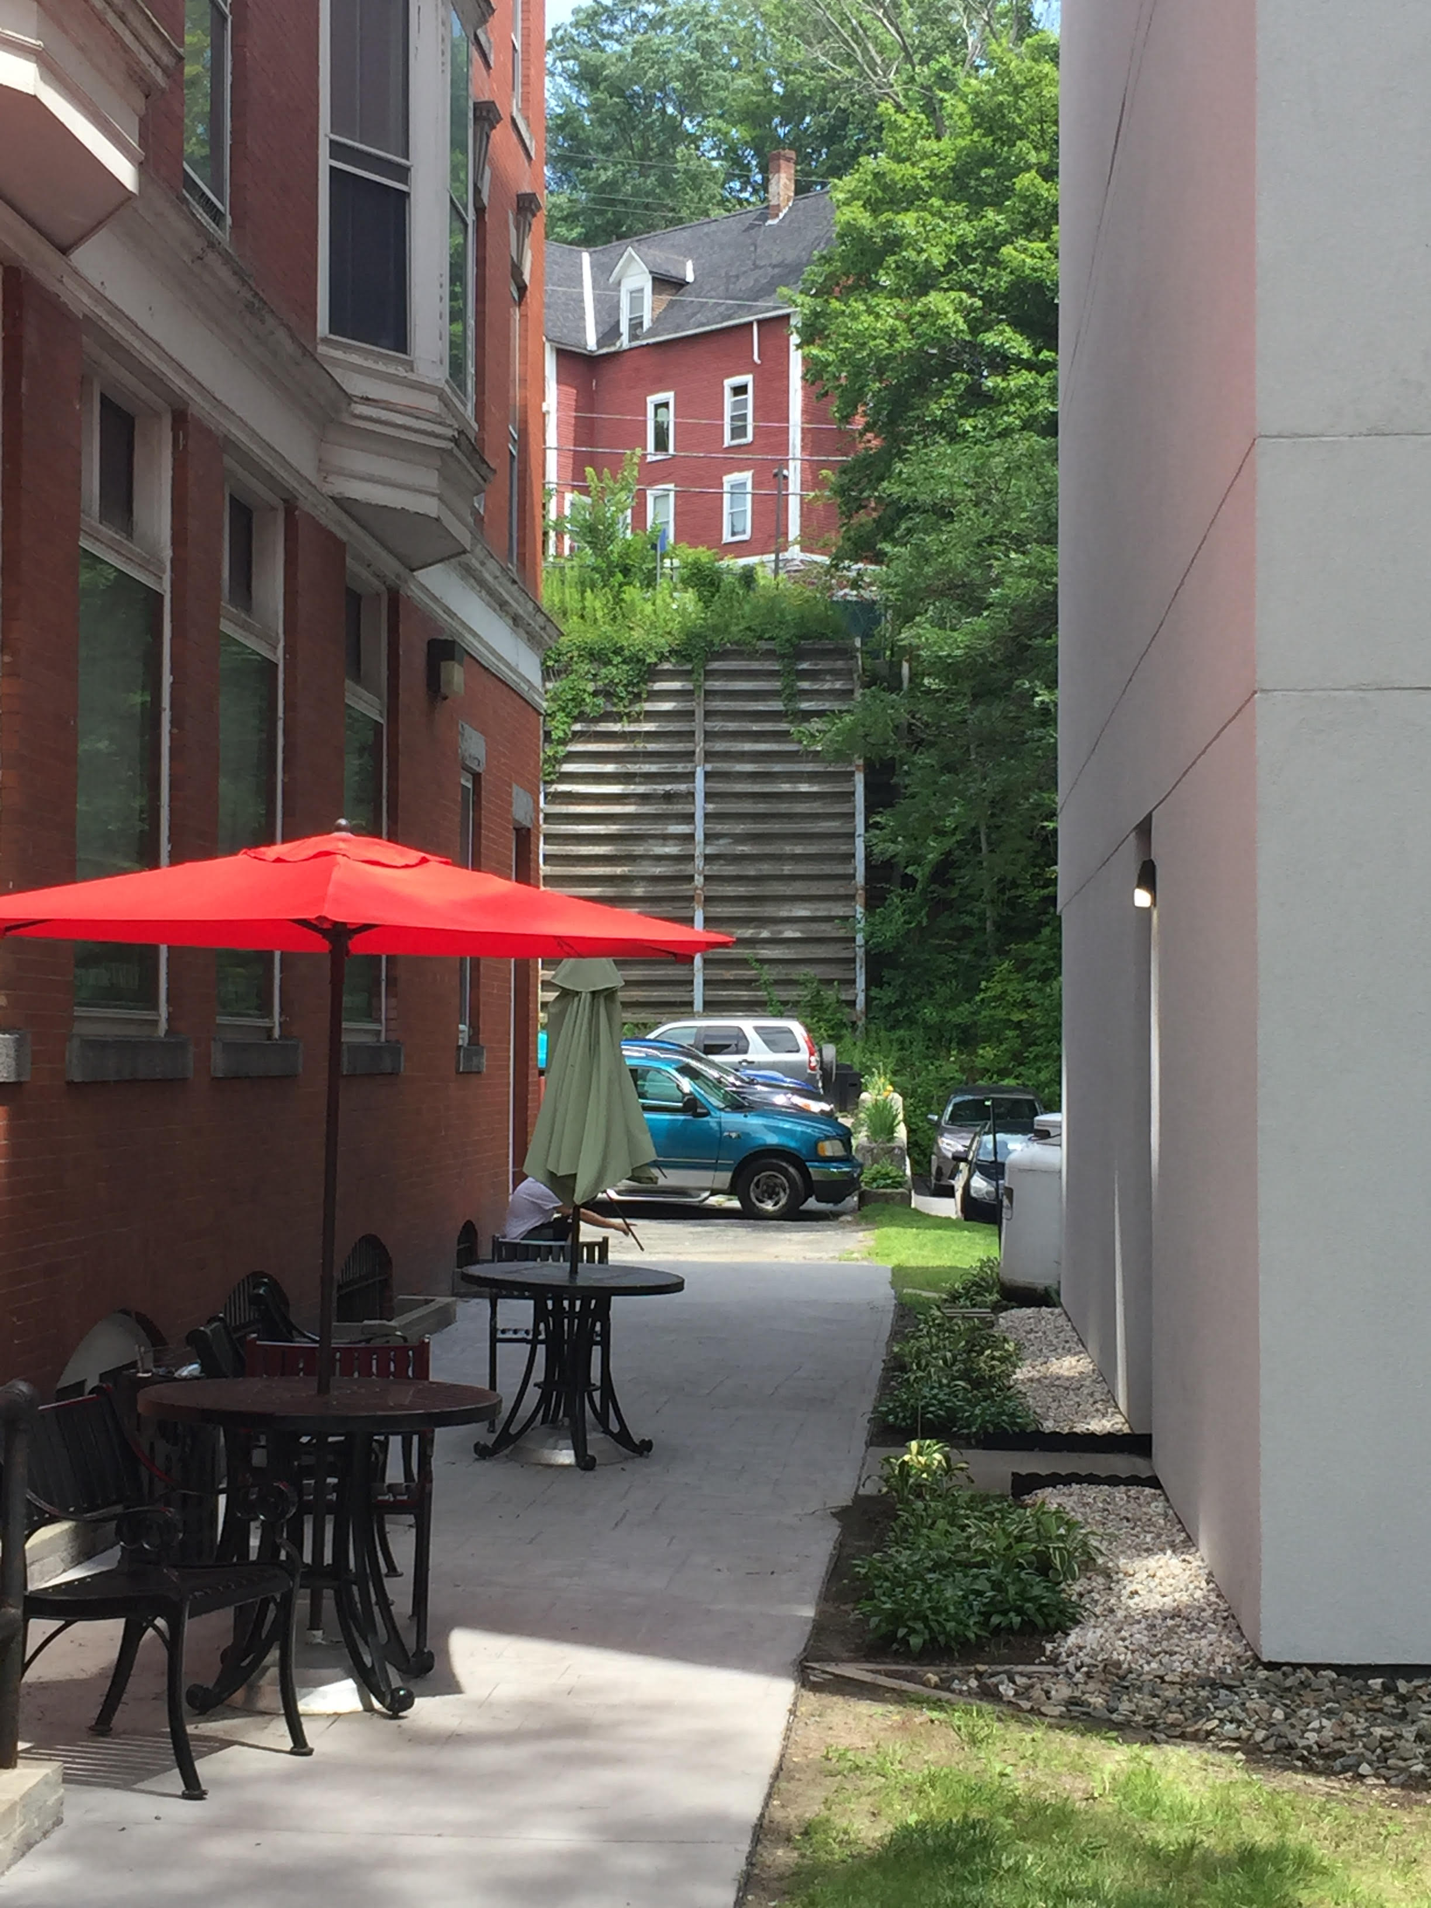

Slide 20
What have we accomplished so far?

Slide 21
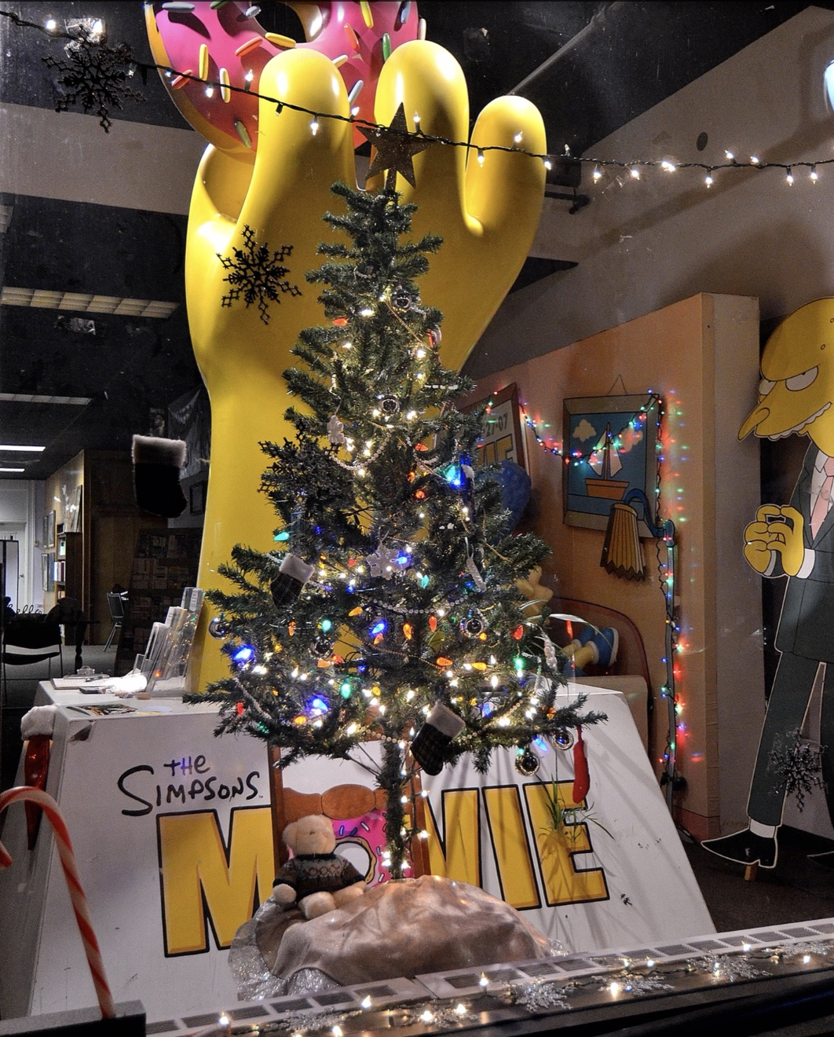
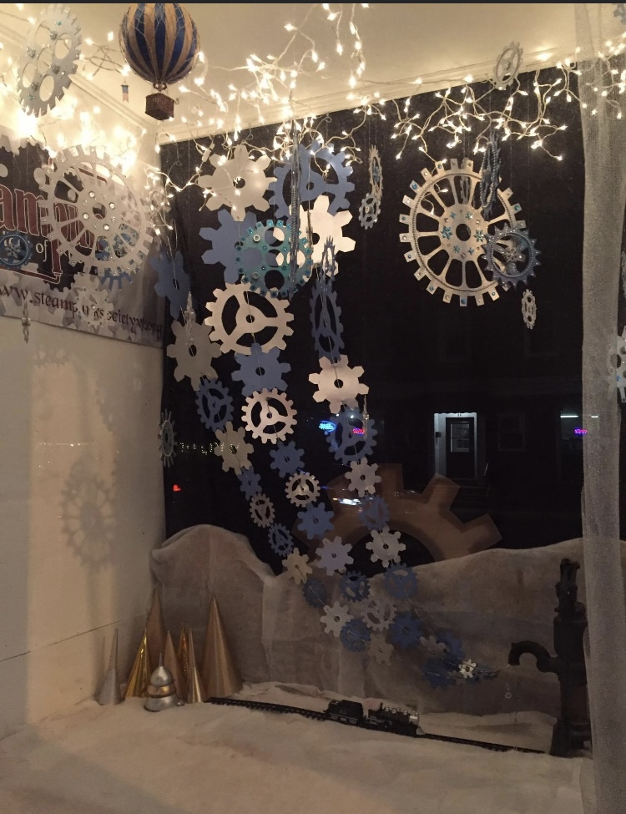

Slide 22
What have we accomplished so far?

Slide 28
What have we accomplished so far?

Slide 29
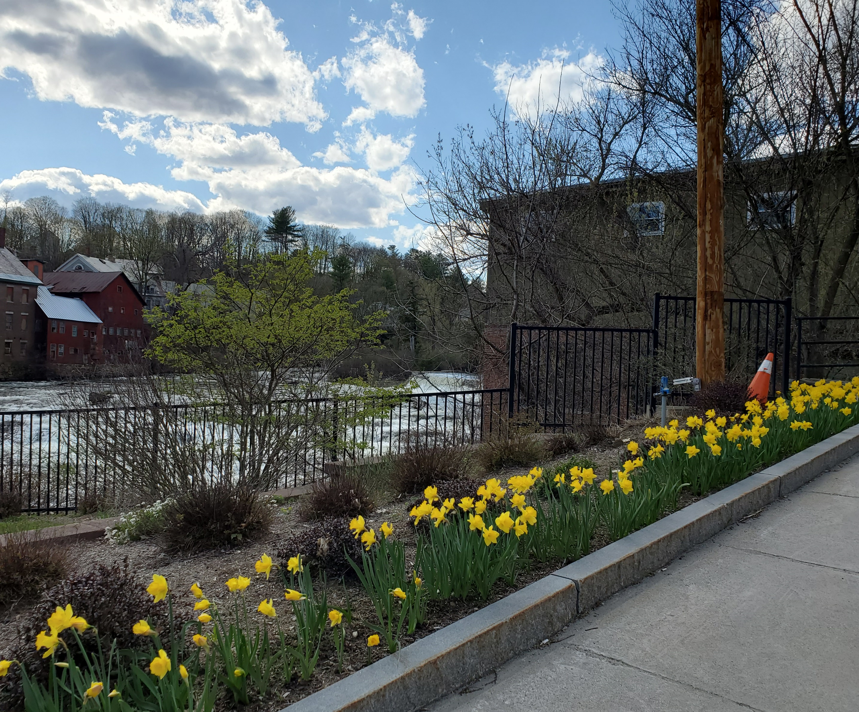
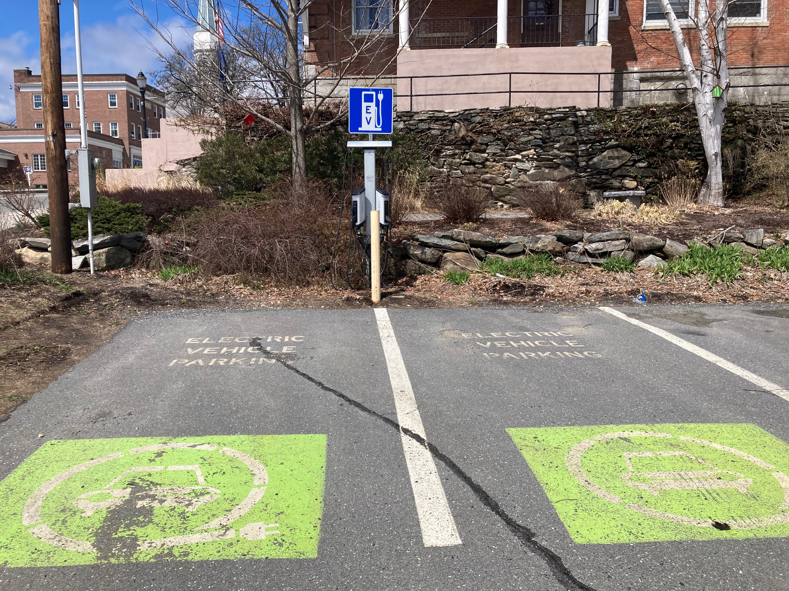
Becoming green

Slide 30
What have we accomplished so far?

Slide 31
Who are our key partners?
Town Manager
Town of Springfield (Public Works, Public Safety, Planning/Zoning, Library, Senior Center, Parks & Recreation)
Selectboard
Springfield Housing Authority
Springfield Regional Development Corporation
Mt Ascutney Regional Commission
Springfield On The Move
Local Businesses
Local Organizations
Citizens
Springfield Regional Chamber of Commerce
Property Owners
Springfield School District and
River Valley Tech Center
Springfield Art and Historical Society

Slide 32
What are our challenges?
Property owner or manager
Brownfield/hazardous materials and clean up
Resistant to change
Funding

Slide 33
Property owner/manager

Slide 34
Possible solutions for property owners and managers
Find out WHY the property owner isn’t able to maintain the property
Ask to help keep windows clean, decorated, pertinent leasing info displayed
Refer potential tenants
Refer potential purchaser (include Town and RDC)
Multiple investors ?
Opportunity Zone ?
Strengthen/help enact helpful ordinances
Code enforcement (Town)
Additional legal action (Town)

Slide 35
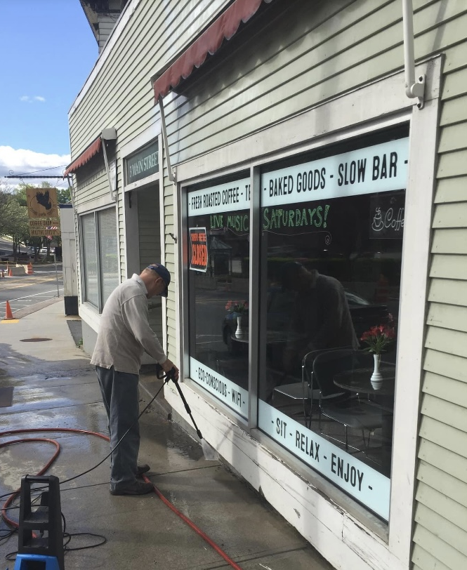
Work together

Slide 36
and KEEP working together to get the project finished.

Slide 37
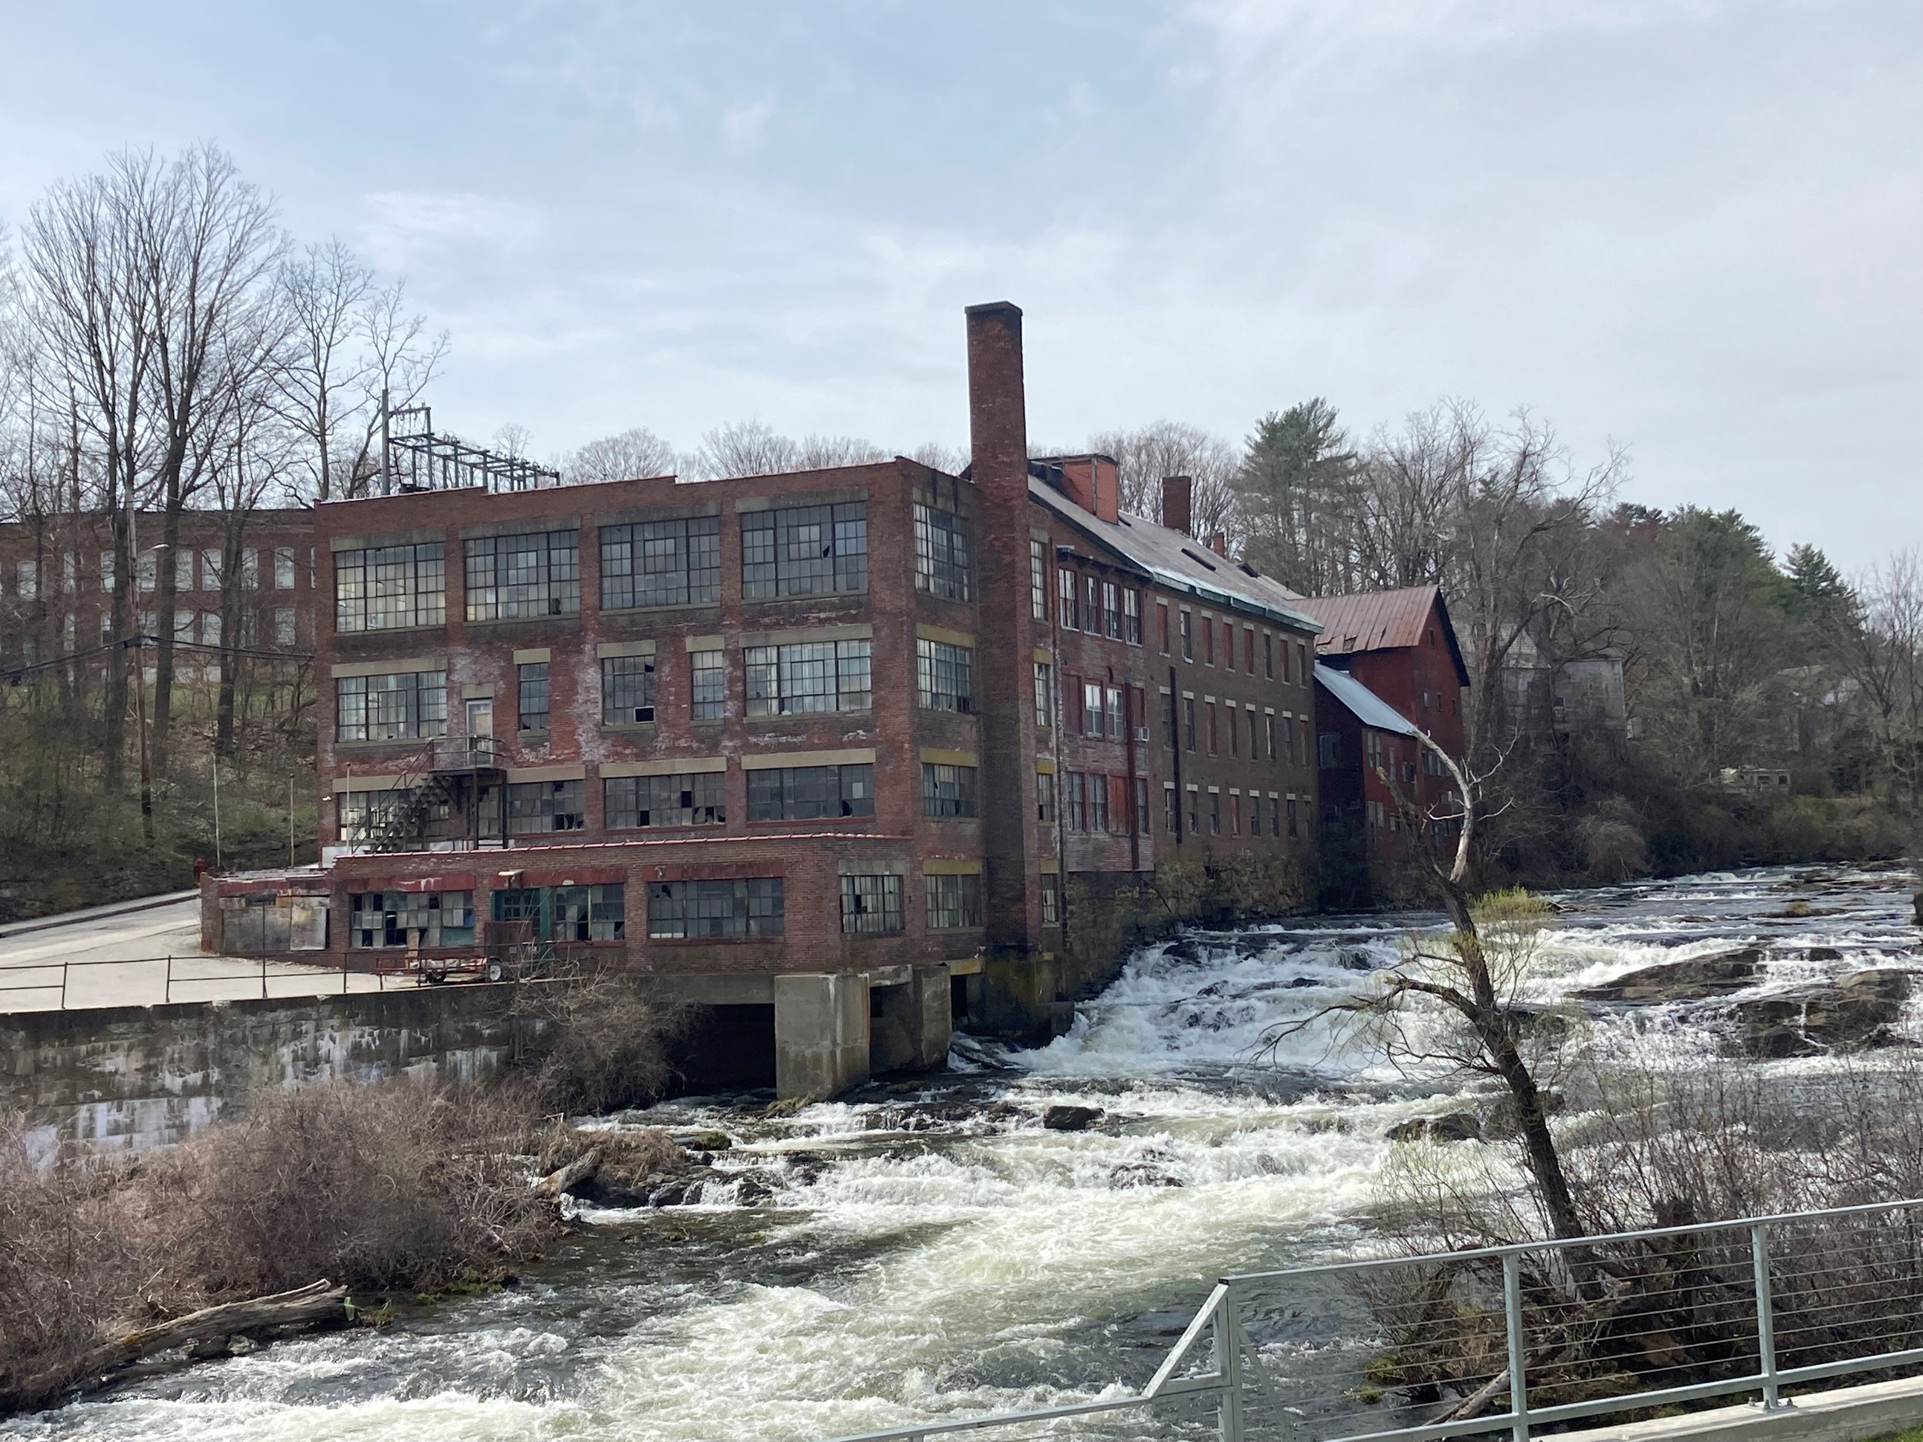
Brownfield and hazardous materials and clean up

Slide 39
What are other tools in our toolbox?
Think outside the box for funding opportunities or creative funding ideas
Woolson Block commercial spaces
“Pop Up” businesses and/or fundraisers
Work with property owners/businesses on projects they like that would benefit the community
Help with permit process
Involve student organizations or non-profits to decorate empty store fronts and property owner pays electricity
Be diligent about including key partners
Be sure to give recognition and appreciation
Potential fiscal agent for projects
Springfield Food CoOp Relocation Project
Commercial grade espresso machine
Beautification
Reasonable expectations for volunteers
Attend meetings (selectboard, planning/zoning, committee, etc) to know what else is going on
Know your community

Slide 40
THANK YOU!

