Slide 1
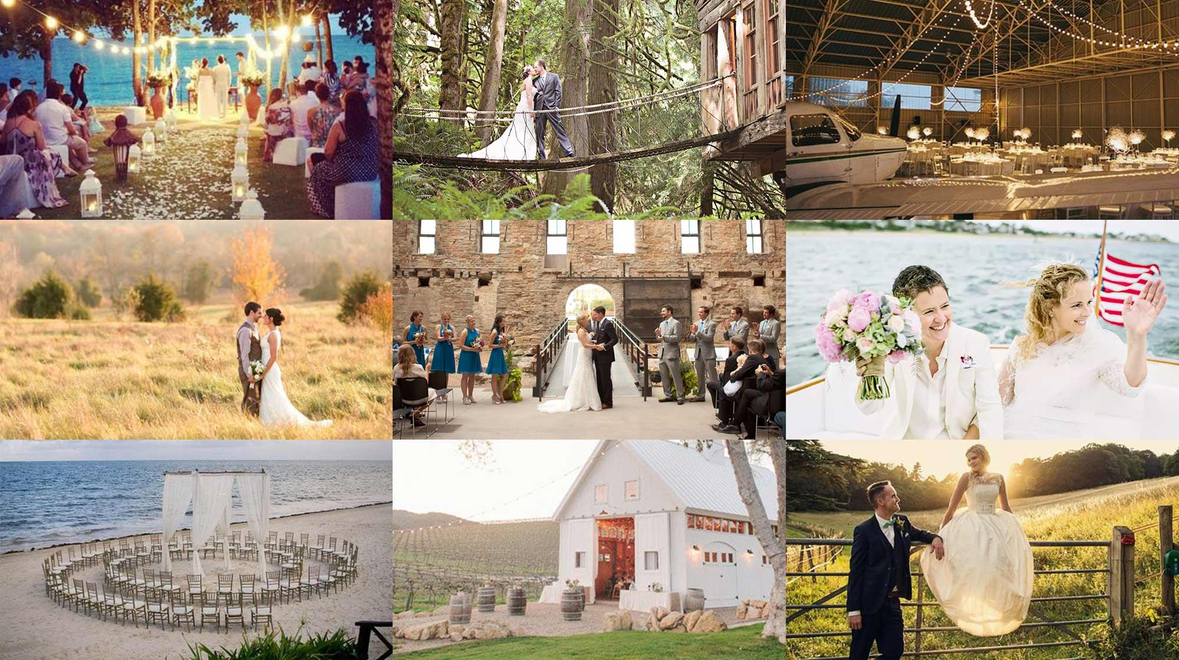
Notes:
How many weddings did you got to last year? There are 2.4 million weddings good venues especially unique venues are in very.

Slide 2
U.S. Wedding Venue Market
$16
$6
$234
Billion
Billion
Million
Current Venutopia Market Share
Total Available U.S Market
Unique Venue U.S. Market
Source: XO Bridal Study & theweddingreport.com

Slide 3
Financial Projections
$1,890,000
$8,400,000
$33,600,000
$147,000,000
2019
2020
2021
2023
45 venues
20 bookings/year/venue
900 bookings
100 venues
40 bookings/year/venue
4000 bookings
200 venues
80 bookings/year/venue
16,000 bookings
500 venues
140 bookings/year/venue
70,000 bookings

Slide 4
How it works
We attract
& onboard couples
Coordinate vendors for events
Collect Money
Owners keep 70% of booking fee

Slide 5
Rural Competitive Advantage
Access to people
People truly want you to succeed
Close Proximity to cities without the overhead
Living wage is far less, and lifestyle is awesome

Slide 6
Competitive Advantage
24/7 customer service
We build and market communities not just venues.
Established Relationships
On demand labor (independent contractors)

Slide 7
What Can We Do Better
Establish a mentorship program in towns
Access to capital and fundraising
Networking Opportunities
Make people jealous
Create Entrepreneurial Hubs
Work with local colleges

Slide 8
Resources
https://ruralimpacthub.com/

Slide 9
How We Get & Grow Venues

Slide 10
A-Team
Kevin Parada
Raik Soster
Yana Moskaleno
George Black
CEO
Took company 0-100 real quick
Full Stack Developer
Turned vision into code.
UI/UX Designer
Turned vision into beauty and made the product fun to use.
Chief of Training
Created a market ready venue training program in 4 weeks
Notes:
Goerge and I have 20 yrs event logistics and coordination
10 yrs in hospitality training & Marketing

Slide 11
Revenue Model
$600
+
30%
$2100
=
Management Fee
Commision
Per Transaction
We charge couples a flat fee of $600.00 for customer support.
We charge the Venue
30% commision on each rental
($5K - $10K)
Assume 20 transactions per venue in year 1

Slide 12
Competitive Analysis
Company | Pricing & Available Dates | Venue Planning Tools | Venue Training & On Demand Labor | Provide Insurance for Venues | 24/7 Customer Service
Venutopia
Mayflower Venues
Wed-Spot

Slide 13
Competition
Direct:
Indirect:

Slide 14
Fixed Cost
Fixed Cost | June 2018 | August 2019
Customer Service Rep | $3,000 monthly single employee | $9,000 monthly 3 employees
Marketing | $2500 | $5,000
Variable Costs | June 2018 | August 2019
Venue Payments | $15,000 | $112,500
Insurance Payments | $1000.00 | $10,000

Slide 15
Pie in Sky
Become market leader 1 billion in revenue

Slide 16
Bride & Groom Pains
Time consuming
No pricing transparency
No Available dates
No customer service
Notes:
Don’t forget to add the wait Cost very expensive 49% got married 200 miles or more from where they lived at the time of their wedding.

Slide 17
Solution
Saves Time
Pricing Transparency
Available Dates
Customer Service

Slide 18
What we offer brides
What we offer venue owners
We help couples find unique venues they can virtually tour and book in a fraction of the time.
We offer a secondary income stream by renting your venue.

Slide 19
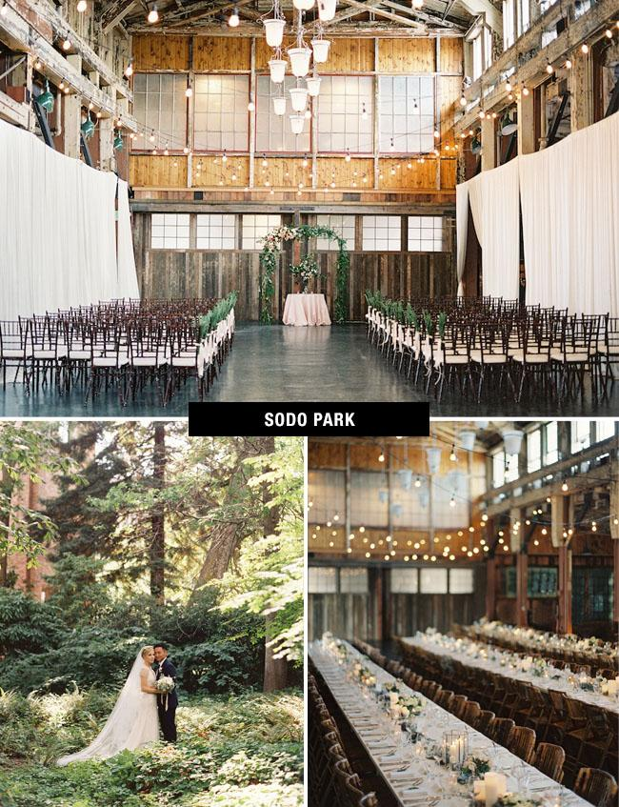
How We Keep Venues
Customer Support
Field Q&A
Training

Slide 20
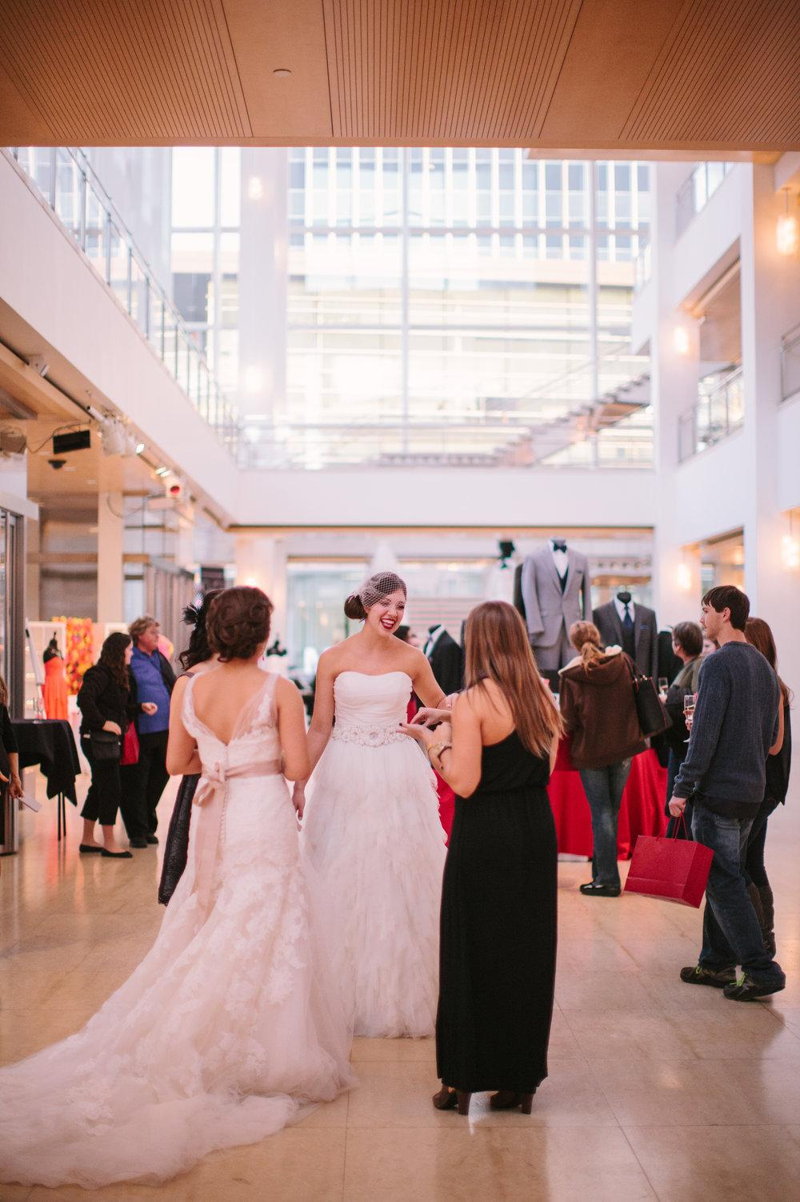
How We Get Couples
Wedding Shows
Digital Marketing
Referrals
Notes:
Common Mistakes:
Insubstantial evidence that the channels listed are the right ones for reaching the target market. “We’ll market on Facebook because our customers are there.” This is a big assumption! Are they sure their customers are on Facebook? Is there any proof others have used facebook to reach these same customers cost-effectively?
Guessing at the metrics based on casual observations or quick googling vs getting clear evidence from other entrepreneurs who successfully use/used this channel to sell similar products.
Assuming there are no deciders/influencers.

Slide 21
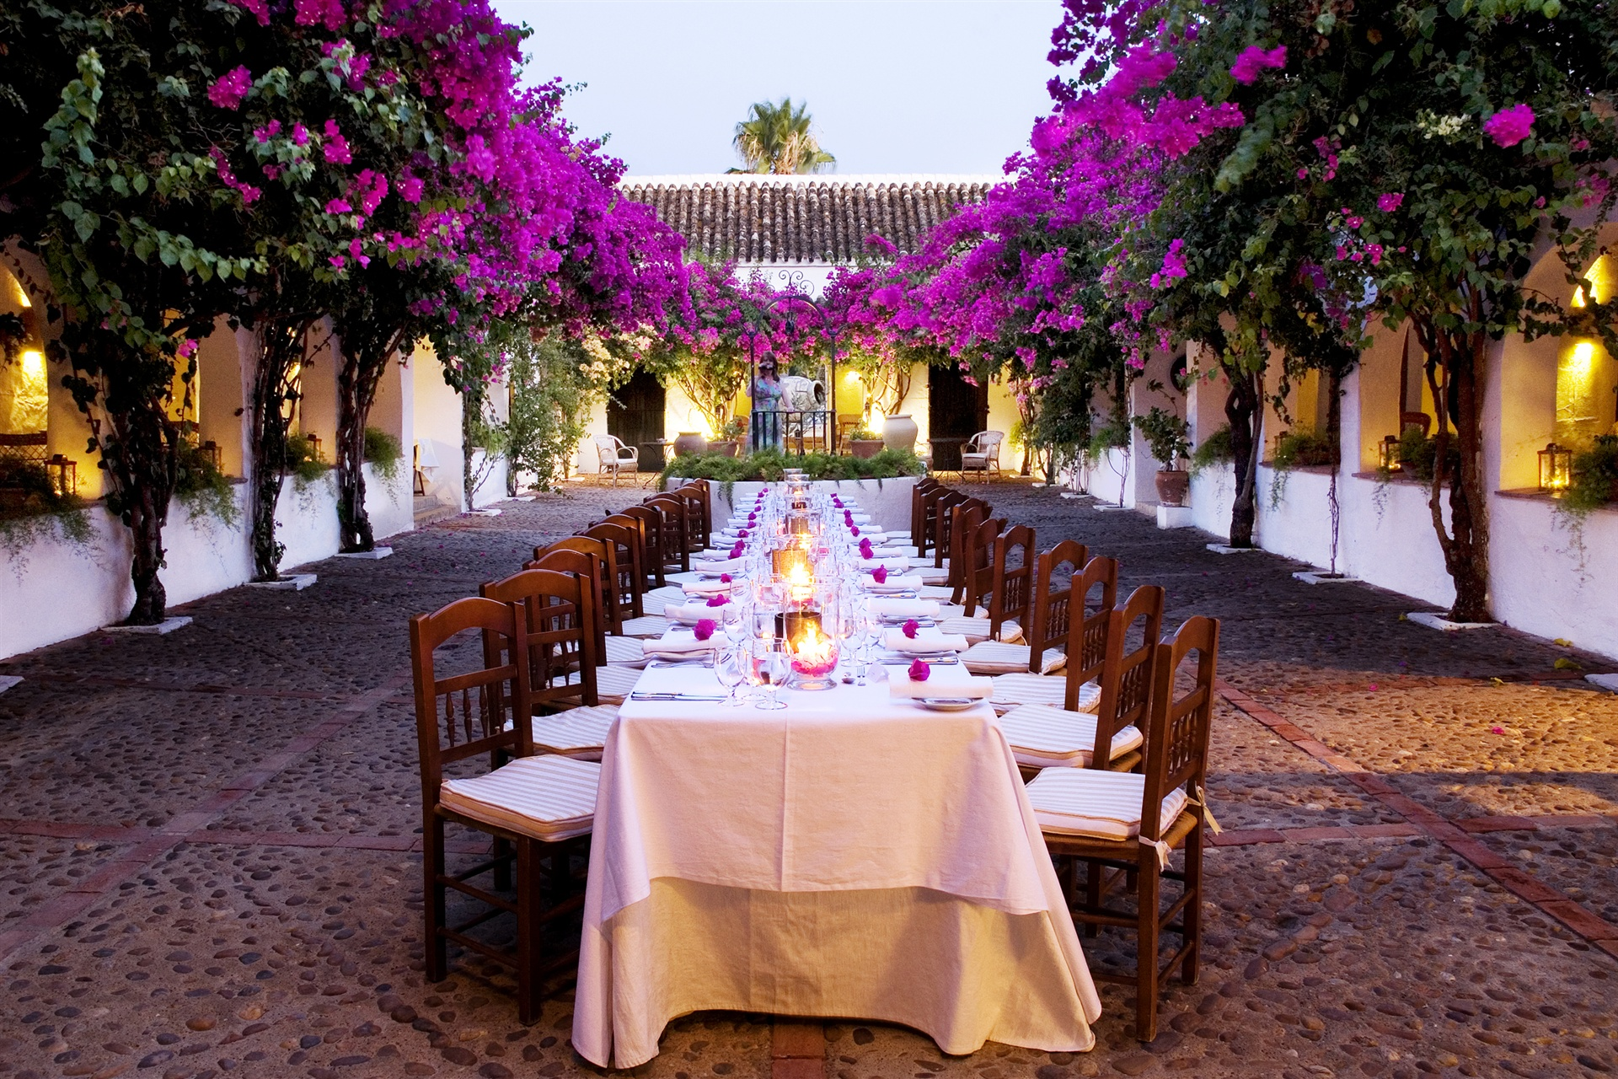
Grow
Experiences
Honeymoons
Sales Reps
Artificial Intelligence

Slide 22
Money
Customer acquisition Cost - $200
Venue Acquisition cost - $500
Cash On Hand $80,000
Burn Rate $6,500
Runway 12 months

Slide 23
Appendix

Slide 24
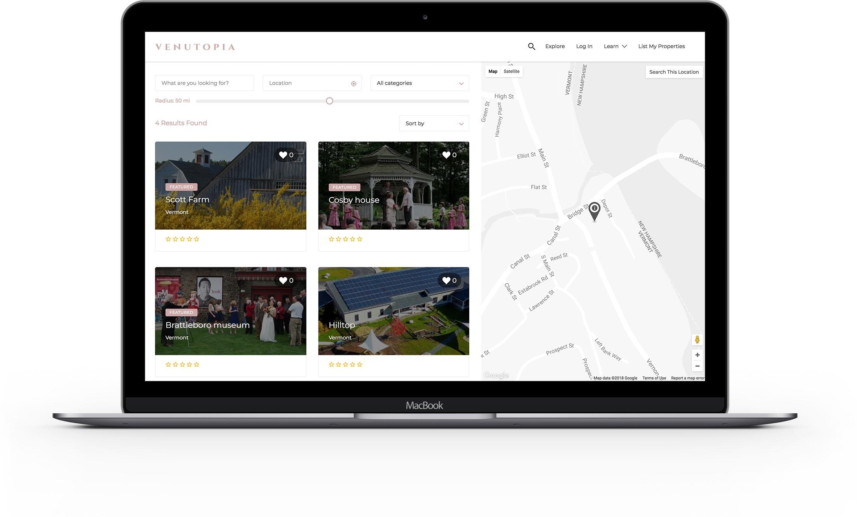
Product Status
Functioning prototype
Beta launch June 20th

Slide 25
Who We Need
We are immediately looking for a Chief Operating Officer
Text- 860-500-0963
Notes:
I took them from competition Our paying customers are ‘xxx and we make money by yyy

Slide 26
A platform that helps people to list, find, and rent unique event and wedding locations.
Notes:
How many weddings did you got to last year? There are 2.4 million weddings good venues especially unique venues are in very.

Slide 27
Our Venue Customer
Millennial
Adventurous
Non Traditional
Notes:
Degree 77% Adv 27%
Income 67k-90K
Employed 84%
Wedding Spend

Slide 28
Our Venue Customer
Expensive Maintenance
Age 45-65 High Property Taxes

Slide 29
A platform that allows people to list, find, and rent unique event and wedding locations.
Notes:
When is the last time you went to a wedding? 8-9: I can make these fit the theme!
10: Does this chart need a graphic? Its just a place holder for a graph for now
17: Stays green? Yes Im feeling it I might have to change font color back to black for projection
24: Are you leaving this in the deck? I am leaving 24 in deck
25: Is this staying, if so I can style this one too yes stays for Q&A

Slide 30
Types of Venues
Working Farm
Forrest
Orchard
Gardens
Airport Hangar
Library
Beach
Boat
College/ School
Summer Camp
Vineyard
Ruins
Island
Hacienda
Brewery
Library
Historic Building
Theatre
Flower Garden
Industrial Building
Notes:
Solution Value Prop One Minute- full hd video drone tours, pricing transparency, availbility, no cookie cutter, having ahuman who can offer suggestions, venues

