Slide 1
Southern Vermont Economic Development Summit
Tech and the Rural Economy
Matthew Barlin
May 30, 2018

Slide 2
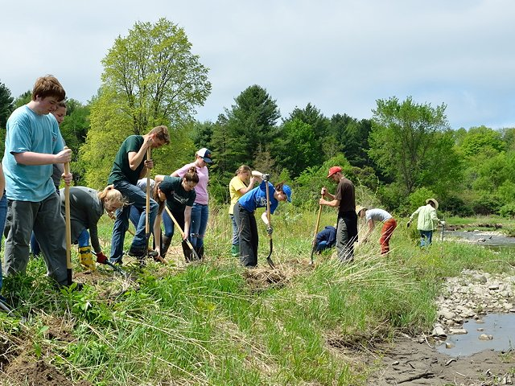
Strength in Numbers
POWER OF THE COMMUNITY
POWER OF THE INDIVIDUAL

Slide 3
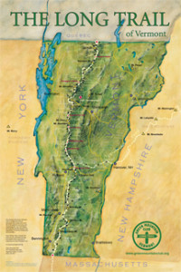
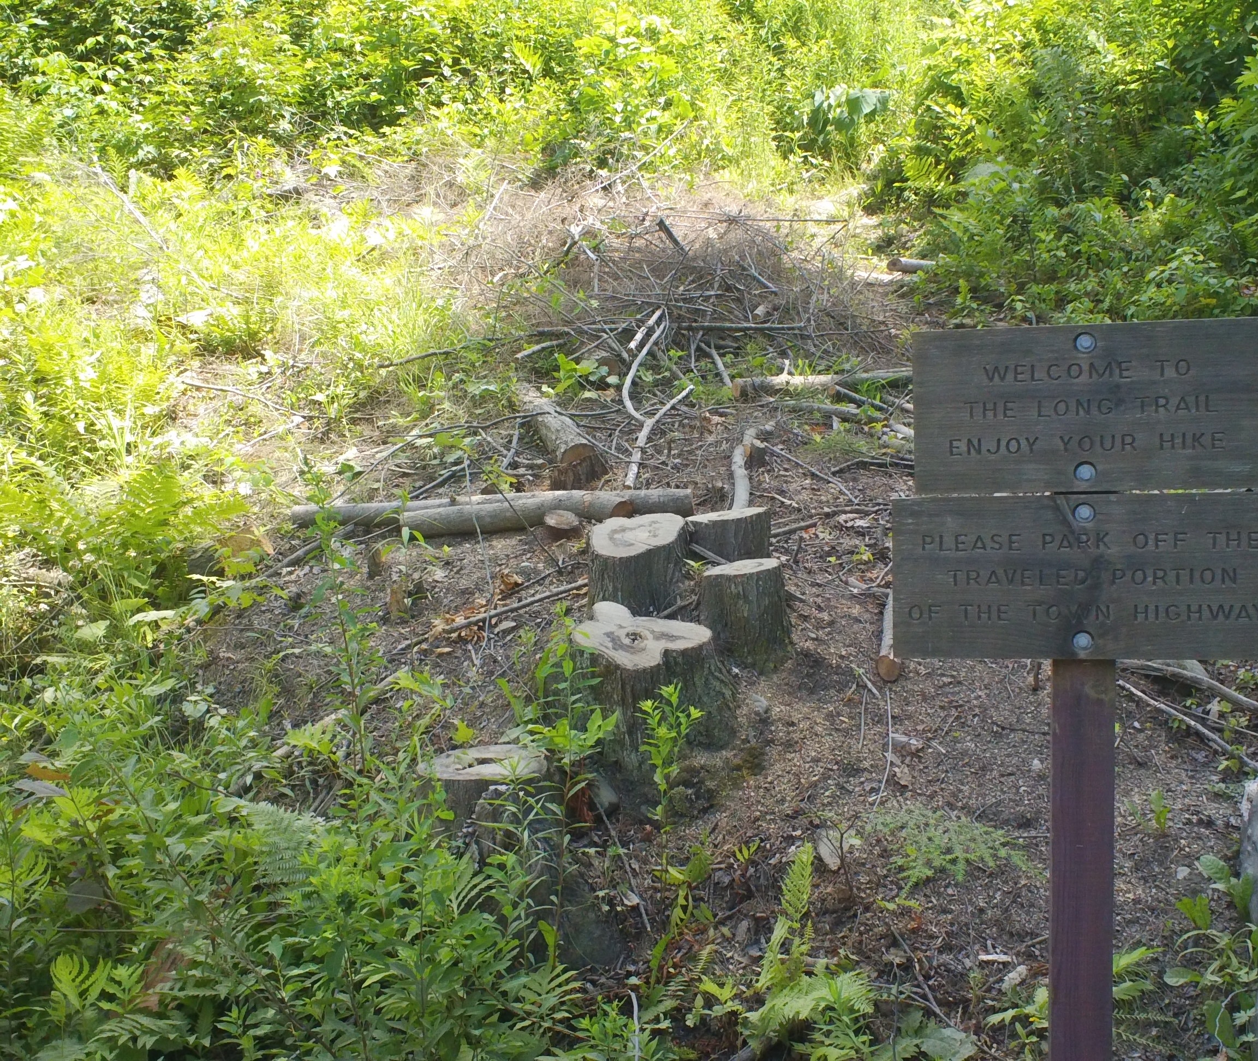
Finding the balance: A story in 3 parts

Slide 4
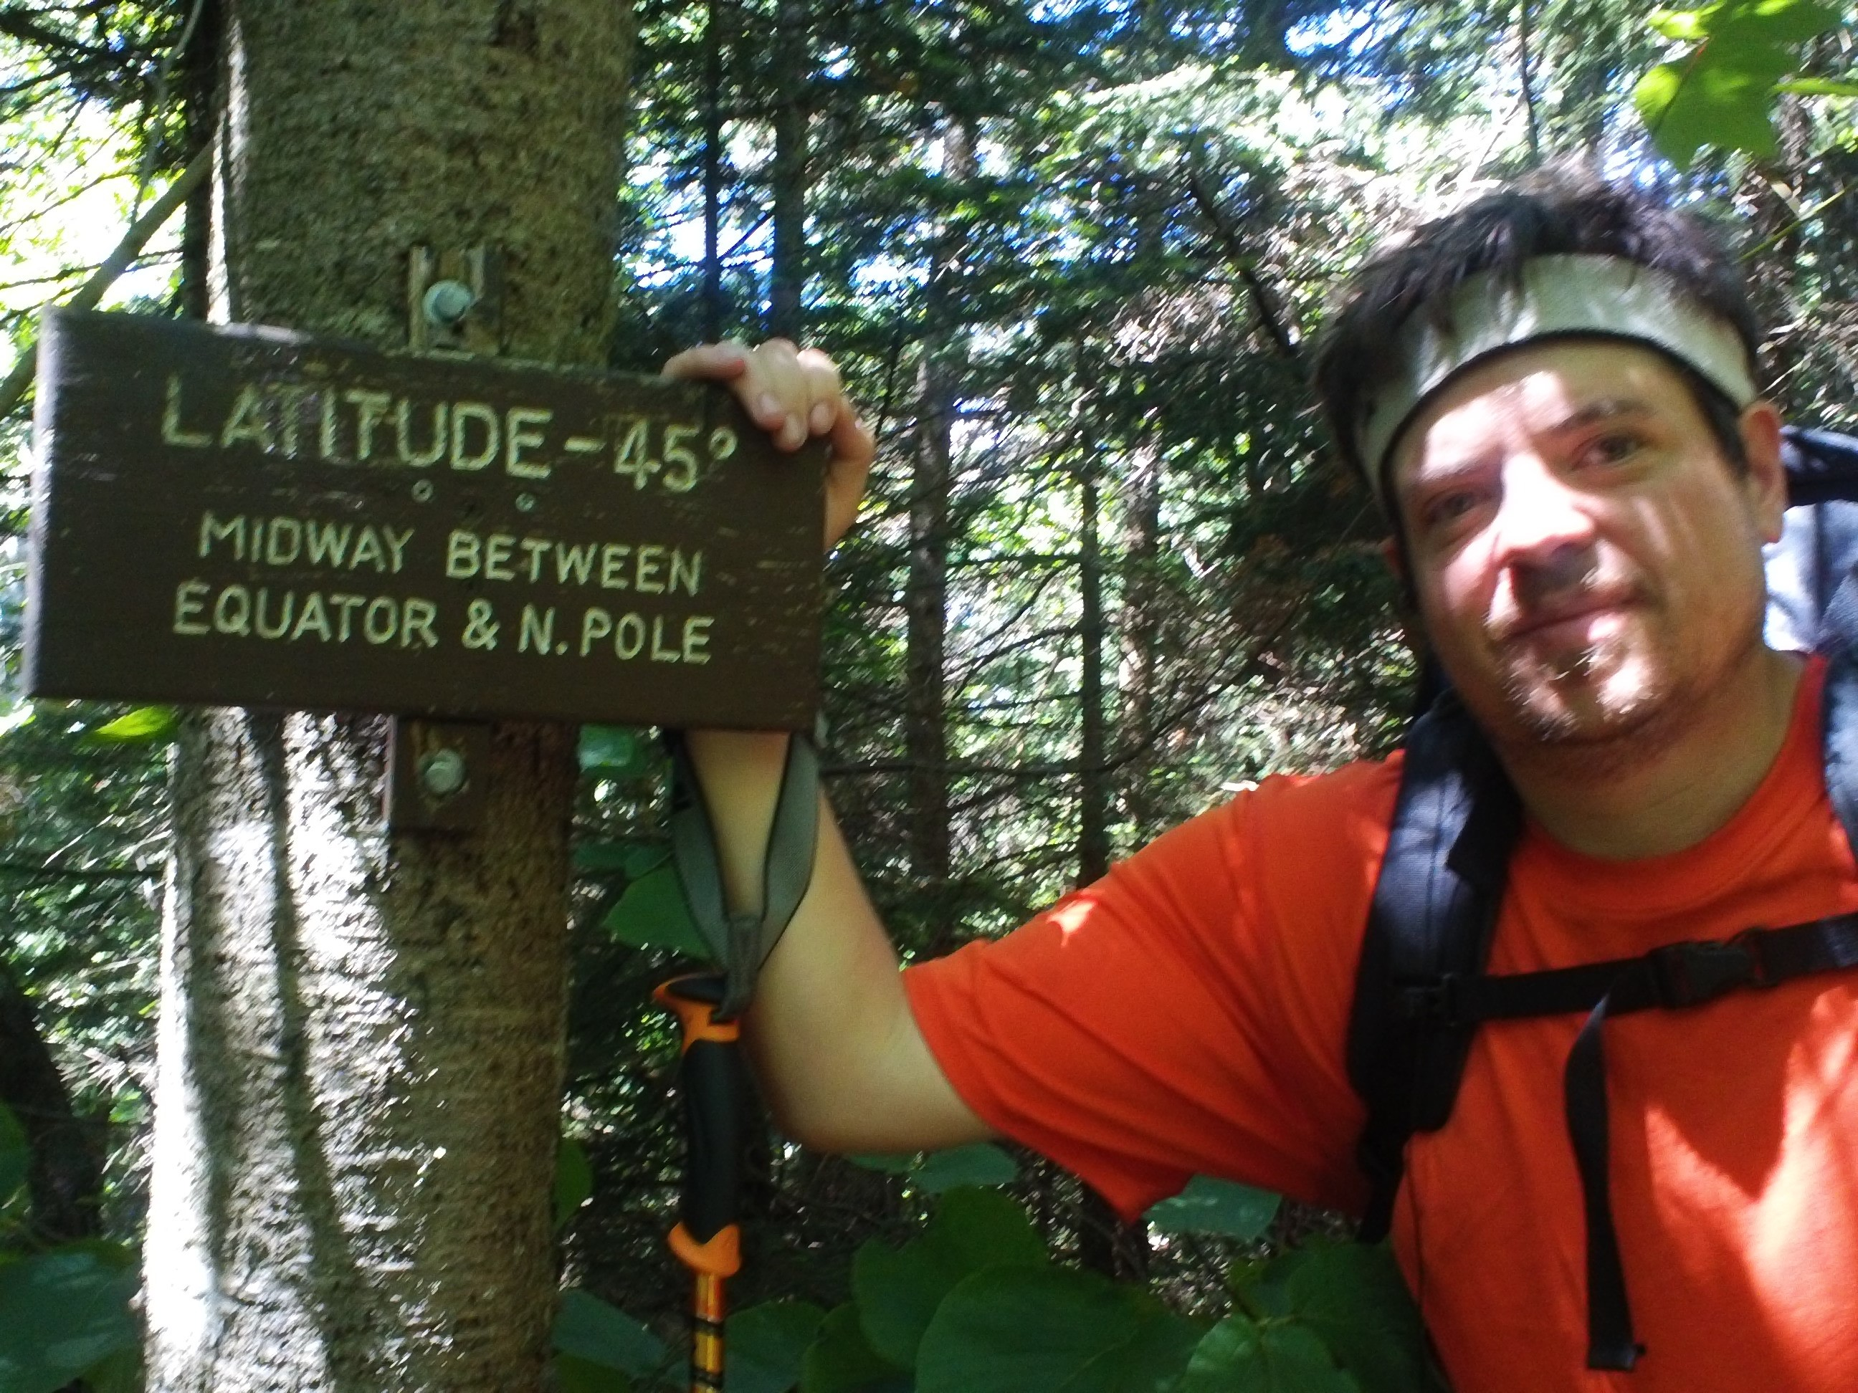
Finding the balance: A story in 3 parts

Slide 5
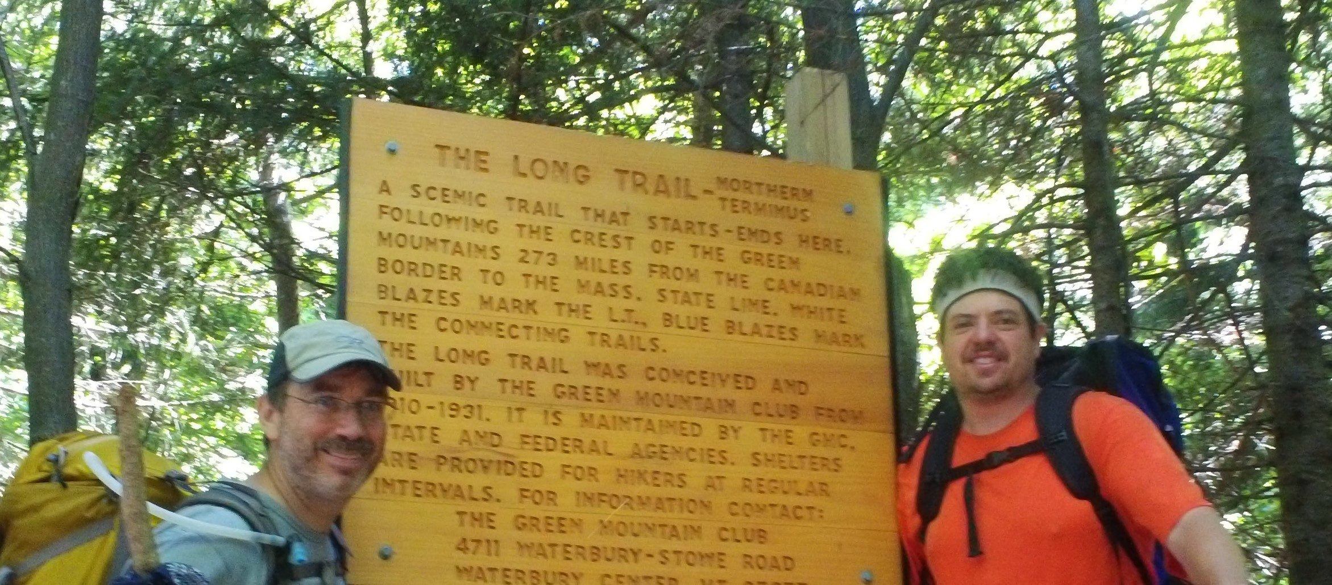
Finding the balance: A story in 3 parts

Slide 6
Is Blockchain an Answer?
Decentralized Ledger Technology
Verifiable, Immutable Transactions
Bitcoin is only one instance, original idea not current
Many more new networks coming
Reduce fees, friction, and third-party costs

Slide 7
Is Blockchain an Answer?
Decentralized Ledger Technology
Verifiable, Immutable Transactions
Bitcoin is only one instance, original idea not current
Many more new networks coming
Reduce fees, friction, and third-party costs

Slide 8
If Blockchain is the Answer? Are we ready?
The Classic Solutions
Connectivity
Electricity

Slide 9
What We Really Need?
BUILD THE NETWORK
INVESTMENT
EDUCATED TALENT
More of the Classics,
THESE ONES MATTER
ACADEMIA

Slide 10
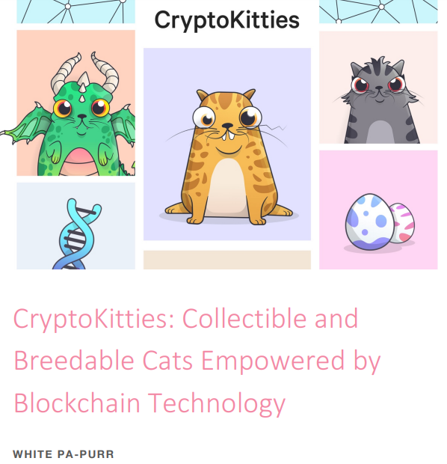
Building a Community: Solutions for a Better World
http://tokenengineering.net/
Sweetbridge, Inc

