Slide 1
Infusing Tech Into The SoVT Brand
NEW GROUND CREATIVE | 802.257.5827

Slide 2
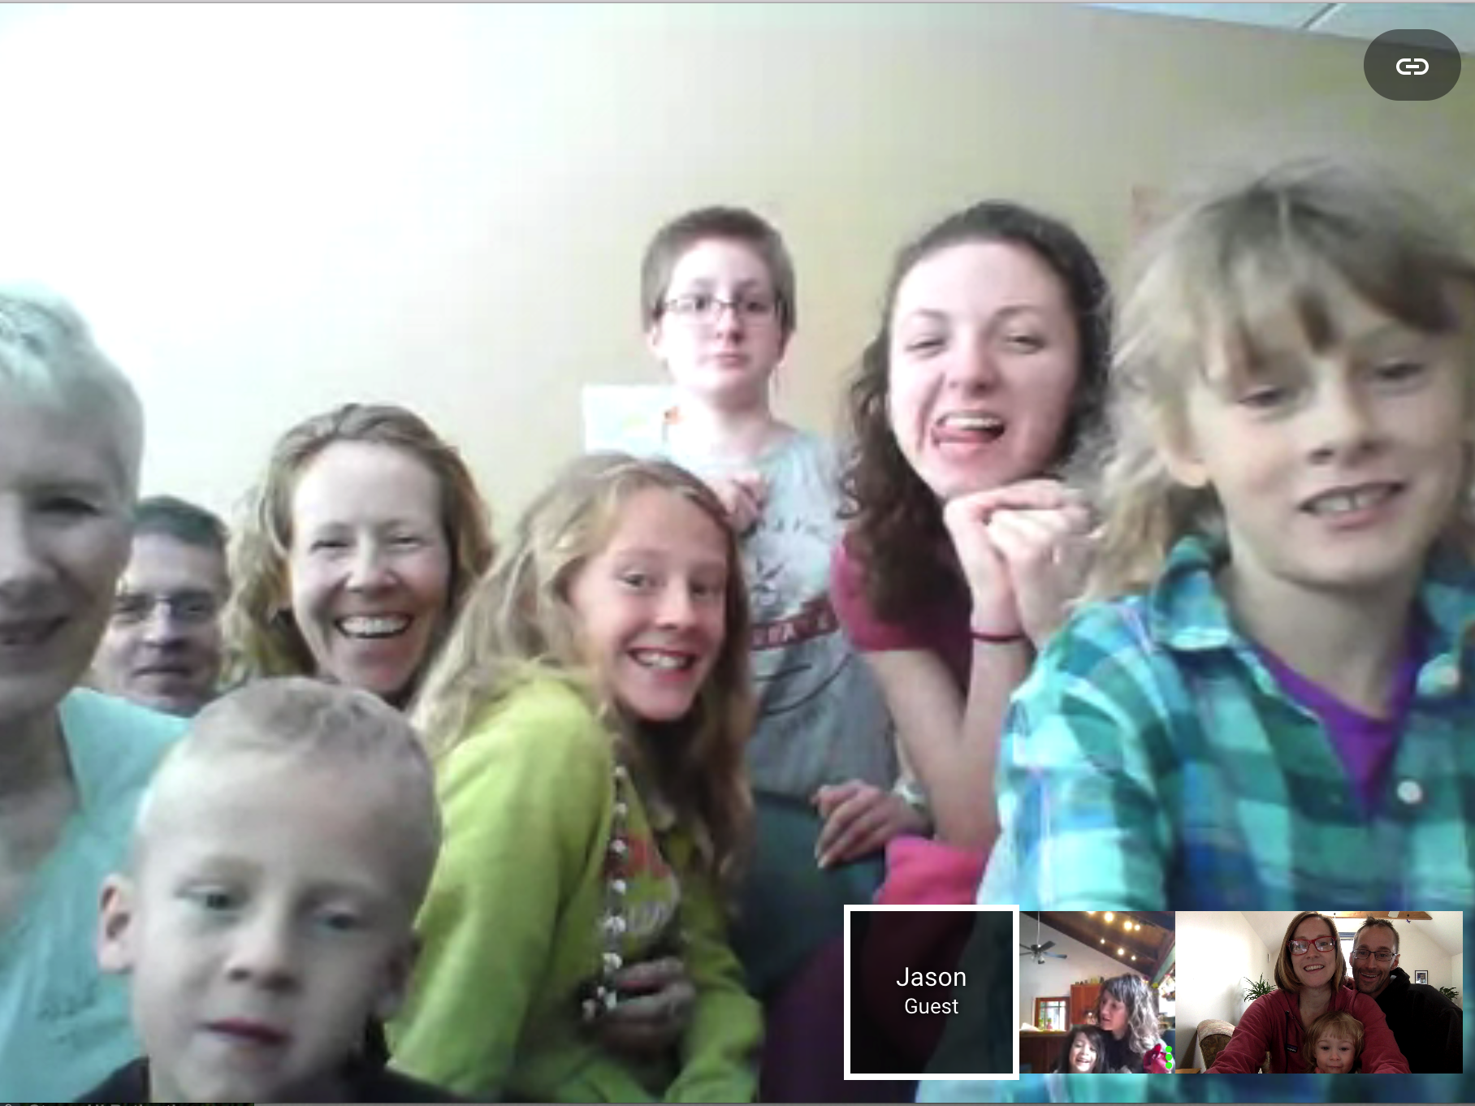

Slide 5
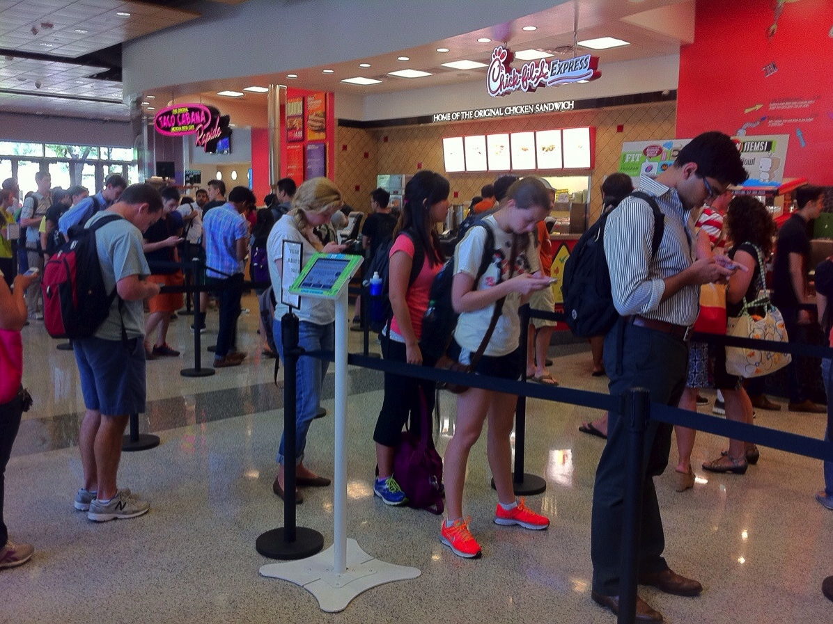
Source: InnerChi Fitness

Slide 8
Source: Abigail Mnookin.

Slide 10
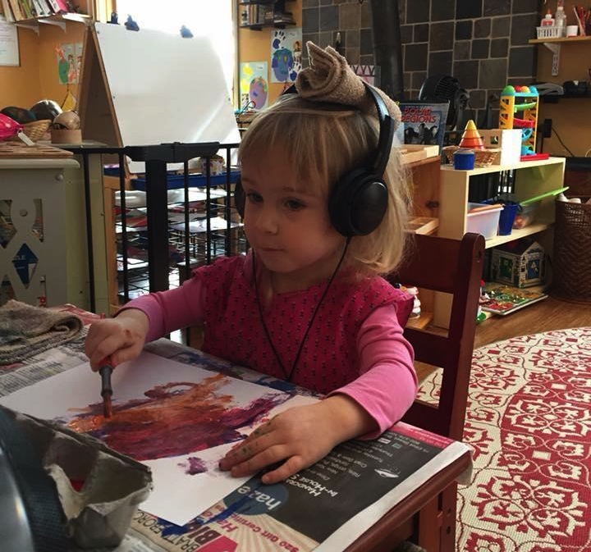
NEW GROUND CREATIVE | 802.257.5827

Slide 11
Tech & SoVT Brand: Strategic. Inclusive. Fun. Visual
NEW GROUND CREATIVE | 802.257.5827

