Slide 1
The Idea Fund
Empowering people to alleviate poverty.
LOCAL RESOURCES • LOCAL IDEAS • LOCAL SOLUTIONS

Slide 2
Bennington & Poverty
Source: Data from the US Census Bureau’s 2016 American Communities Survey Estimates.
Notes:
Poverty Line: (+$4320 per person) 1 $12,140
2 $16,460
3 $20,780
4 $25,100

Slide 3
Investors
Local Businesses contribute money to the Idea Fund.
Fundraising
The IF team recruits new investors and maintains those relationships.
The Fund
Grants are awarded by the Board.
Applications
Completed applications are presented to the Board.
The Board
Seven local community members with specific expertise.
Project Support
The IF team works with applicants to develop ideas, strengthen projects, and submit applications.
IDEAS
Community members submit ideas.

Slide 4
Projects
Fast Track
Car Repairs & Transportation
Education & Internships
Unforeseen Expenses
Fast Track
Community Impact
Start Ups
Notes:
We believe the people who live in this community best know what their community needs, so we give cash directly to the do-ers and change-makers.

Slide 5
Projects
Knock Out Victory Gym
$2,500 | Capital Investments
New Business
Created 2+ PT Jobs
Leveraged IF Investment for additional $17.5K
Community Impact
Start Ups
Notes:
We believe the people who live in this community best know what their community needs, so we give cash directly to the do-ers and change-makers.

Slide 6
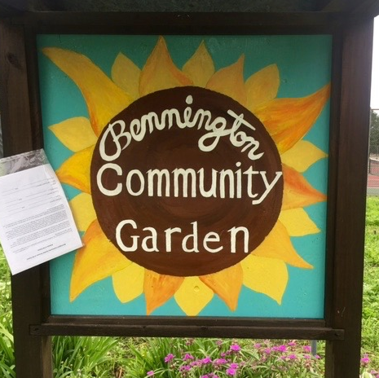
Projects
The Bennington Community Garden
$1,225 | Growing the Garden
Community-led
Provides to the Kitchen Cupboard
In food insecure neighborhood
Community Impact
Notes:
We believe the people who live in this community best know what their community needs, so we give cash directly to the do-ers and change-makers.

Slide 7
Idea Fund & Rural Communities
Photo by Jeremy Bishop on Unsplash
Notes:
Customizable
Scalable
Leverage existing resources

