Slide 1
Global Tariffs
What in the world is going on?
Tammy Flanders Hetrick
Senior Trade Advisor

Slide 2
What we will discuss:
What are tariffs?
What are 232 tariffs?
What are 301 tariffs?
What are 201 tariffs?
What can we do about them?
What about retaliation?
What’s next?

Slide 3
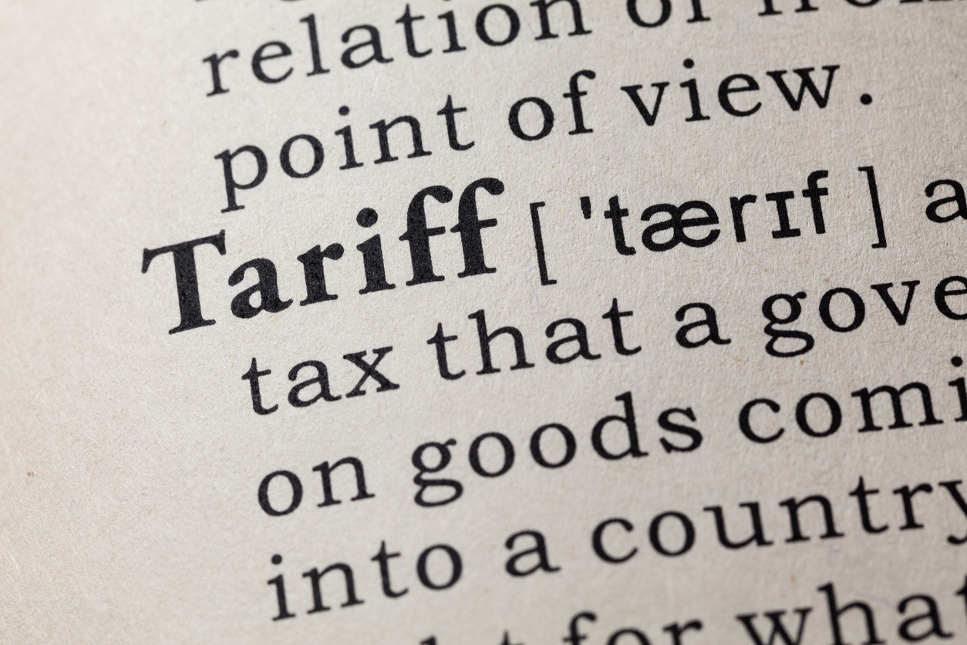
What are tariffs?

Slide 4
Tariffs: Merriam-Webster
tariff
noun
tar·iff | \ ˈter-əf , ˈta-rəf \
Definition of tariff
1a: a schedule of duties imposed by a government on imported or in some countries exported goods
b: a duty or rate of duty imposed in such a schedule
2: a schedule of rates or charges of a business or a public utility
3: PRICE, CHARGE

Slide 5
Tariffs: Merriam-Webster
Examples of tariff in a Sentence
Recent Examples on the Web: Noun
Amid concerns of a no-deal Brexit that would have resulted in the reintroduction of tariffs and tougher customs checks, the British government drew up emergency plans and even ran out of storage space to stockpile medicines and food.— Rick Noack, The Seattle Times, "Switzerland wants to declare coffee nonessential for human survival," 12 Apr. 2019
Exporters may have been rushing to beat the punitive tariffs (import taxes) that China had promised to impose (and later did) in retaliation for Trump’s proposed taxes on what the U.S. buys from China.— Brooks Jackson, Philly.com, "Trump's Numbers (Second Quarterly Update) | FactCheck," 11 July 2018
These example sentences are selected automatically from various online news sources to reflect current usage of the word 'tariff.' Views expressed in the examples do not represent the opinion of Merriam-Webster or its editors. Send us feedback.

Slide 6
Cumulative Effect
Note #1: These special tariffs are in addition to ad valorem duty rates assigned per the Harmonized Tariff Schedule of the United States (HTSUS).
Note #2: These tariffs are paid by importers, i.e., not by exporters or exporting countries.

Slide 7
What are 232 tariffs?

Slide 8
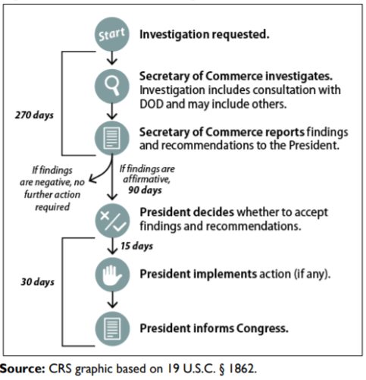
Section 232 Tariffs
Section 232: The “National Security Clause”
Allows the President to impose restrictions on imports that Commerce determines threaten to impair the national security.
Any interested party can request an investigation.
Commerce, through Bureau of Industry and Security (BIS), consults with Department of Defense and conducts investigation.
Within 270 days, issue findings and recommendations.
President decides on action to take.

Slide 9
Section 232 Tariffs:
What & Where?
Steel @ 25% Tariff
Raw Materials
Rods, Angles, Forms
All countries EXCEPT:
Australia
Argentina (quota)
Brazil (quota)
South Korea (quota)
CANADA 5/17/2019
MEXICO 5/17/2019
Turkey = 50% 25% Tariff
Aluminum @ 10% Tariff
Unwrought
Raw materials
All countries EXCEPT:
Australia
Argentina (quota)
CANADA 5/17/2019
MEXICO 5/17/2019
Note:
No Duty Drawback allowed on 232 Tariffs

Slide 10
What are 201 tariffs?

Slide 11
Section 201 Tariffs
Section 201: The “Safeguard Clause”
When: Upon receipt of a petition from a trade association, firm, union, or group of workers; a request from the President or the USTR; a resolution of the House Committee on Ways and Means or Senate Committee on Finance; or upon its own motion.
Duration: USITC injury finding within 120 days (150 days in more complicated cases) and must transmit its report to the President, together with any relief recommendations, within 180 days
Finding: If the USITC finding is affirmative, it must recommend a remedy to the President, who determines what relief, if any, will be imposed. Such relief may be in the form of a tariff increase, quantitative restrictions, or orderly marketing agreements.
Followup: If import relief is provided, the USITC periodically reports on developments within the industry, advises the President of the probable economic effect on the industry, and at the conclusion of any relief period, report to the President and Congress on the effectiveness of the relief action in facilitating the positive adjustment of the domestic industry to import competition. (For further information, see section 201 of the Trade Act of 1974, 19 U.S.C. 2251.)

Slide 12
Section 201 Tariffs:
What & Where?
Solar Cells & Modules
January 2018
Duration 4 years
30%, 25%, 20%, 15% tariffs
Tariff Rate Quotas - cells
All countries EXCEPT:
GSP Countries*
*Except Philippines and Thailand
Washing Machines/parts
Duration 3 years
Machines TRQ = 20%, 18%, 16%
>TRQ & Parts = 50%, 45%, 40%
All countries EXCEPT:
Canada
GSP Countries (except Thailand)
Note:
Turkey loses GSP eligibility; India set to lose GSP eligibility.

Slide 13
What are 301 tariffs?

Slide 14
Section 301 Tariffs
Section 301: The “China is cheating clause”
Foreign acts, policies, practices that the USTR determines either:
violate, or are inconsistent with, a trade agreement
are unjustifiable and burden or restrict U.S. commerce
Section 301 cases can be:
initiated as a result of a petition filed by an interested party
self-initiated by the USTR
USTR seeks a negotiated settlement:
compensation
elimination of the particular barrier or practice
If no settlement, the USTR determines whether or not to retaliate:
increased tariffs on selected imports at level equivalent to estimated economic losses from foreign barrier or practice

Slide 15
Section 301 Tariffs:
China Only: 12K HTS Numbers
Tranche #1
Effective July 6: 25% Tariffs
818 of 1,333 on original list implemented (1657 HTS#s @ 10 digit)
Heavy in Chapters 84 & 85 (Machinery & Equipment)
$34B in Chinese imports
Tranche #2
Effective August 23: 25% Tariffs
279 of 284 on original list implemented (405 @ 10 digit)
More in Chapters 84 & 85
Several Chapter 39 – Plastic; Chapter 27 – Oil & Lubricants
$16B in Chinese imports
Tranche #3
Effective September 24: 10% Tariffs
Effective June 2019: 25% Tariffs
5745 of 6031 on original list (approx. 9000 HTS#s @ 10 digit)
$200B in Chinese imports
Exception: Section 321 de minimis (<$800) shipments.

Slide 16
Section 301 Tariffs:
Full Boat
Tranche #4
Effective Date: TBD
3,805 full/partial HTSUS headings
$300B in Chinese imports
Apparel, footwear, food products, etc. etc. etc.
Exceptions:
Pharmaceuticals
Certain medical goods
Rare earth materials
Critical minerals
Timeline
Comments due by June 17
Requesting exclusions
Requesting additions
Public hearing June 17 – requests to appear must be submitted by June 10
Implementation – Any time after June 24, 2019

Slide 17
What can we do about it?

Slide 18
232 Exclusion Request*
*Similar process for aluminum
All exclusion requests must be in electronic form, submitted through the Federal rulemaking portal (http://www.regulations.gov)
No time limit
Only those using subject steel or aluminum articles in business (e.g., construction, manufacturing, or supplying steel /aluminum to users) in the United States may submit
Approved exclusions made on a product basis; generally limited to the organization that submitted the specific exclusion request
Paper submissions not accepted
Separate Exclusion Request per product

Slide 19
Exclusions as of March 2019
51,345 steel and aluminum tariff exclusion requests
905 firms
46 states plus Puerto Rico
Steel
45,328 exemption requests
19,543 objections by steel manufacturers
The BIS has reached a decision on 61.9 percent of the steel exclusion requests
21,464 have been approved
6,588 have been denied
Aluminum
6,017 exemption requests
935 objections by aluminum manufacturers
The BIS has reached a decision on 78.2 percent of the aluminum exclusion requests
4,069 approved
637 denied.

Slide 20
301 Exclusion Request
Initially – no exclusion process
Open window for each Tranche
Closed for Tranche 1 and Tranche 2
No exclusion process for Tranche 3 while @ 10%
Tranche 3 – Exclusion process under development
Exclusion Request Form under development
Timeline TBD – “Around June 30”
Likely more stringent than process for preceding Tranches
Exclusions granted to all importers of specific HTSUS #s OR importers of specifically described goods

Slide 21
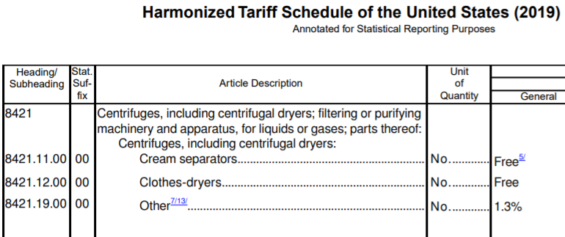
301 Exclusion Request
Salad spinners of plastics, with capacity of at least 2.4 liters but not more than 3.8 liters

Slide 22
Reclassification
Explore alternative HTS Classification
Secure Binding Ruling
Consider long-term consequences

Slide 23
Tariff Engineering
Alteration of the product for legitimate re-classification
Support Alternative HTS
Secure Binding Ruling
Cost/Benefit Analysis
Long-term Consequences

Slide 24
US Goods Returned
9802 – US Goods Returned after having been advanced in value
Components shipped overseas could qualify
Simple assembly abroad
Manufacturer’s Affidavit
Recordkeeping Requirements
Reduce dutiable value subject to 232 or 301 tariffs

Slide 25
Duty Drawback
*Not allowed for Section 232 Tariffs*
301 and 201 Tariffs, and “normal” duties
Goods subsequently exported
Goods destroyed under CBP supervision
Duty Drawback Program
99% refund
Recovery fees

Slide 26
Bonded Warehouse/FTZ
Duty Deferral
Due upon withdrawal for consumption
Positive cash flow
Duty Avoidance
Exports
Destruction
Scrap
The Catch
Increased operational costs
CBP supervision

Slide 27
Alternative Sourcing
Section 232 – Nowhere to go …
Section 301 – Anywhere but China

Slide 28
What about retaliation?

Slide 29
232 Retaliation
Comprehensive Global List – Dated 7/23/2018
https://www.trade.gov/mas/ian/build/groups/public/@tg_ian/documents/webcontent/tg_ian_005571.pdf
Canada & Mexico eliminating retaliatory tariffs

Slide 30
China’s Section 301 Retaliation
July
$34 billion
545 categories
with 25% tariffs
Agriculture
August
$16 billion
219 HTS
25%
Automotive
September
Proposed $60B
Administration’s reply: Next tranche = $257B (Total 2017 Imports = $505B
Current List: 397 Pages https://www.trade.gov/mas/ian/build/groups/public/@tg_ian/documents/webcontent/tg_ian_005574.pdf

Slide 31
What next...

Slide 32
What next?
Rumors
Rhetoric
Elections
Change

Slide 33
How is this affecting you?

Slide 34
Thank you.
Tammy Flanders Hetrick
Senior Trade Advisor
A.N. Deringer, Inc.| 173 West Service Road | Champlain, NY | 12919
Tel: 802-782-2520

