Slide 1
Governor Hunt House & Community Center
Vernon, Vermont

Slide 2
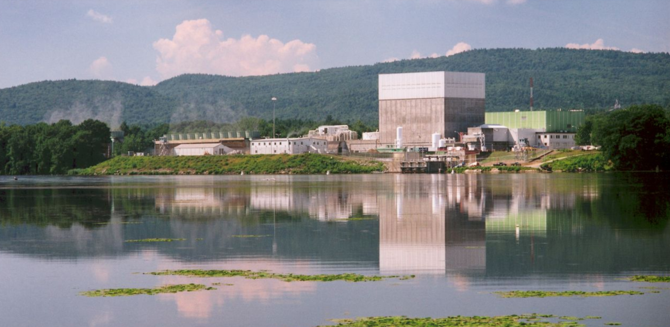
Vernon, Vermont, 1967-2014

Slide 3
Vermont Yankee Nuclear Power Plant
1967-2014:
Employment: 600-650
Average wage: $100,000+
10% of Vernon’s 900 households had a member employed at VY
VY paid over half the property taxes in Vernon, $1.1 million
Now:
A handful of local employees
$400,000 in property taxes, ending in 2026

Slide 4
VCRD Town Visit, 2016

Slide 5
VCRD Town Visit, 2016
Principal recommendations:
Create a village center, in a town that never had one
Create a community gathering place (community center, or store/café)
Improve outdoor recreational opportunities (trails, riverfront access)

Slide 6
Friends of Vernon Center, Inc.
Non-profit formed in 2017
Combination of the “Village Center” and “Gathering Place” task forces
(The outdoor recreation goal assigned to the town recreation dept.)
Added Village Center goal to the Town Plan, 2018
Obtained Vermont Village Center designation, 2018
Worked with town on Village Center plan and VY site plan
Working on Gov. Hunt House & Community Center since 2020

Slide 7
Village Center Conceptual Master Plan, 2018

Slide 9
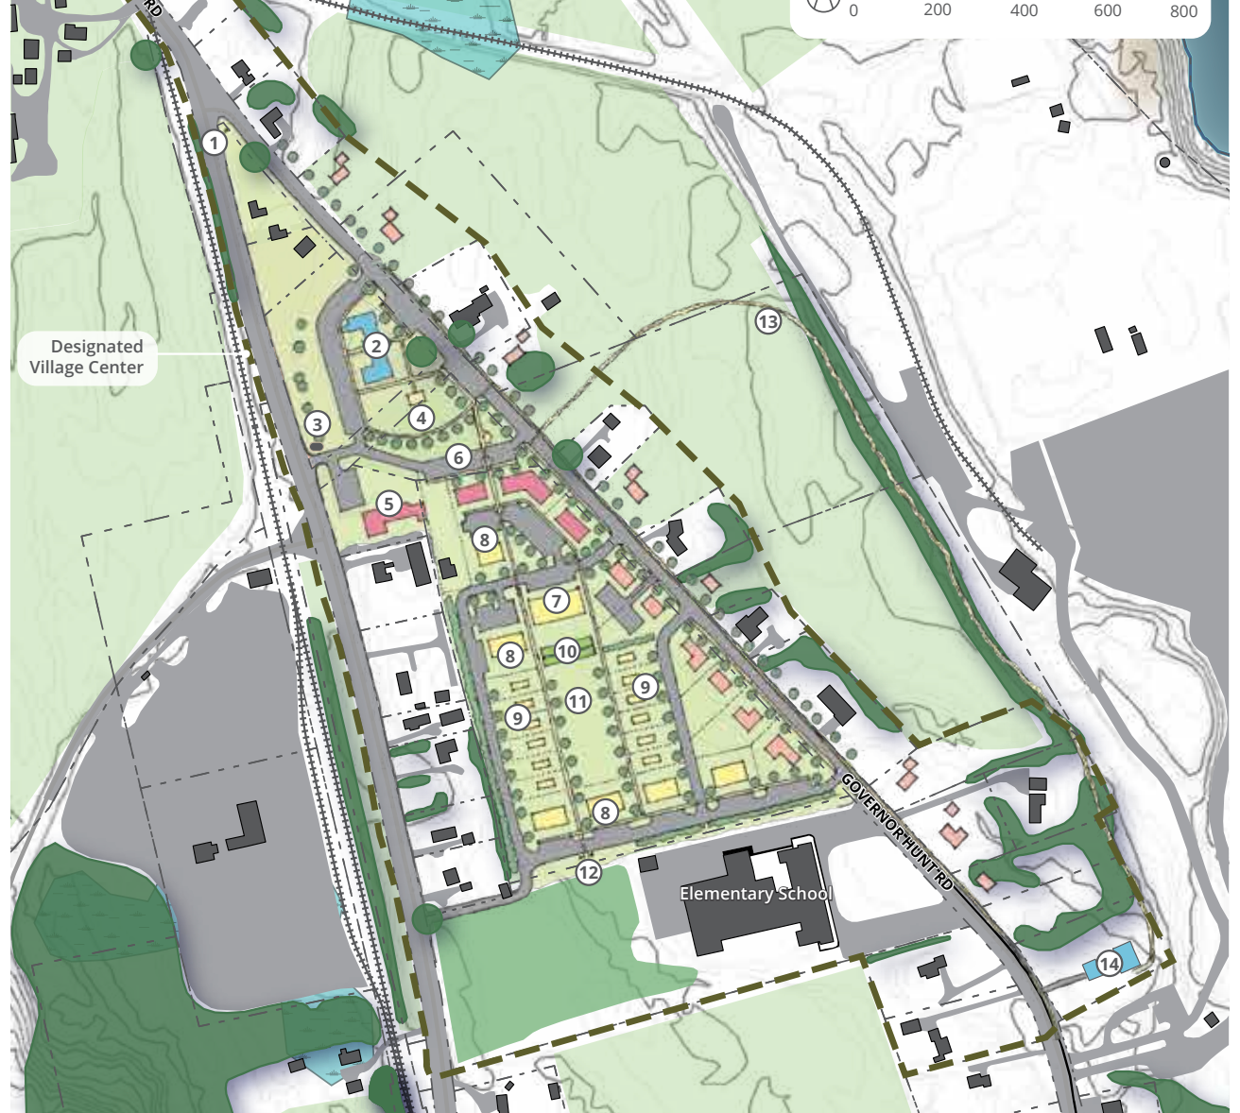

Slide 10
Vermont Yankee site plan, 2021

Slide 11
Vermont Yankee site plan, 2021
Continued farming on portion of site
Reuse of existing on-site wells and septic fields
Reuse of the existing rail spur
Industrial Development (140,000 Square Feet)
Residential Development (24 Lots)
Solar Array (15.7 Acres)
Battery Storage Facility (134,000 Square Feet)
1 mile Abenaki Cultural Interpretive / Recreational Trail
Water Access including boat launch

Slide 12
Governor Hunt House & Community Center

Slide 13
Governor Hunt House & Community Center
Original house built 1779
Fourth-oldest house in Vermont
On the National Register of Historic Places
Built by Jonathan Hunt, second Lt. Gov. of Vermont
Purchased by Vermont Yankee in 1967 as an engineering office
VY added conference center wing in 1970
Donated to the Friends of Vernon Center by Entergy in 2020
An anchor to both the future Village Center and redeveloped VY site

Slide 14
Governor Hunt House & Community Center
MISSION AND VISION
To preserve and care for Vernon’s historic Governor Hunt House, the Friends of Vernon Center seeks to promote it and the attached Community Center and grounds as gathering places for activities that foster community spirit, honor our community heritage, and support creative ways to enhance and serve the well-being of the residents of Vernon, now and for future generations.

Slide 15
Governor Hunt House & Community Center
WHAT CAN HAPPEN HERE:
Gatherings & celebratrions: families, organizations, businesses, town functions
Exhibits: Art, history, Abenaki culture
Performances: music, drama, dance
Education: school trips, school garden, historic tours, lectures, seminars

Slide 16
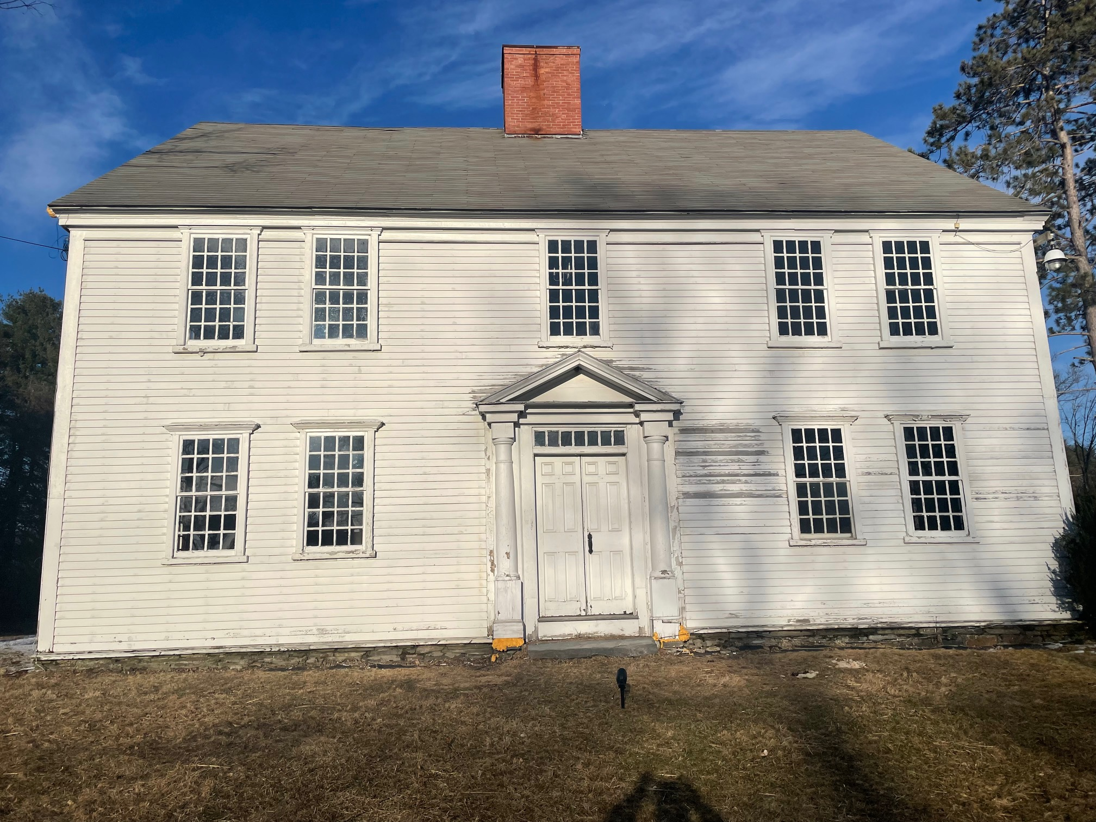

Slide 17
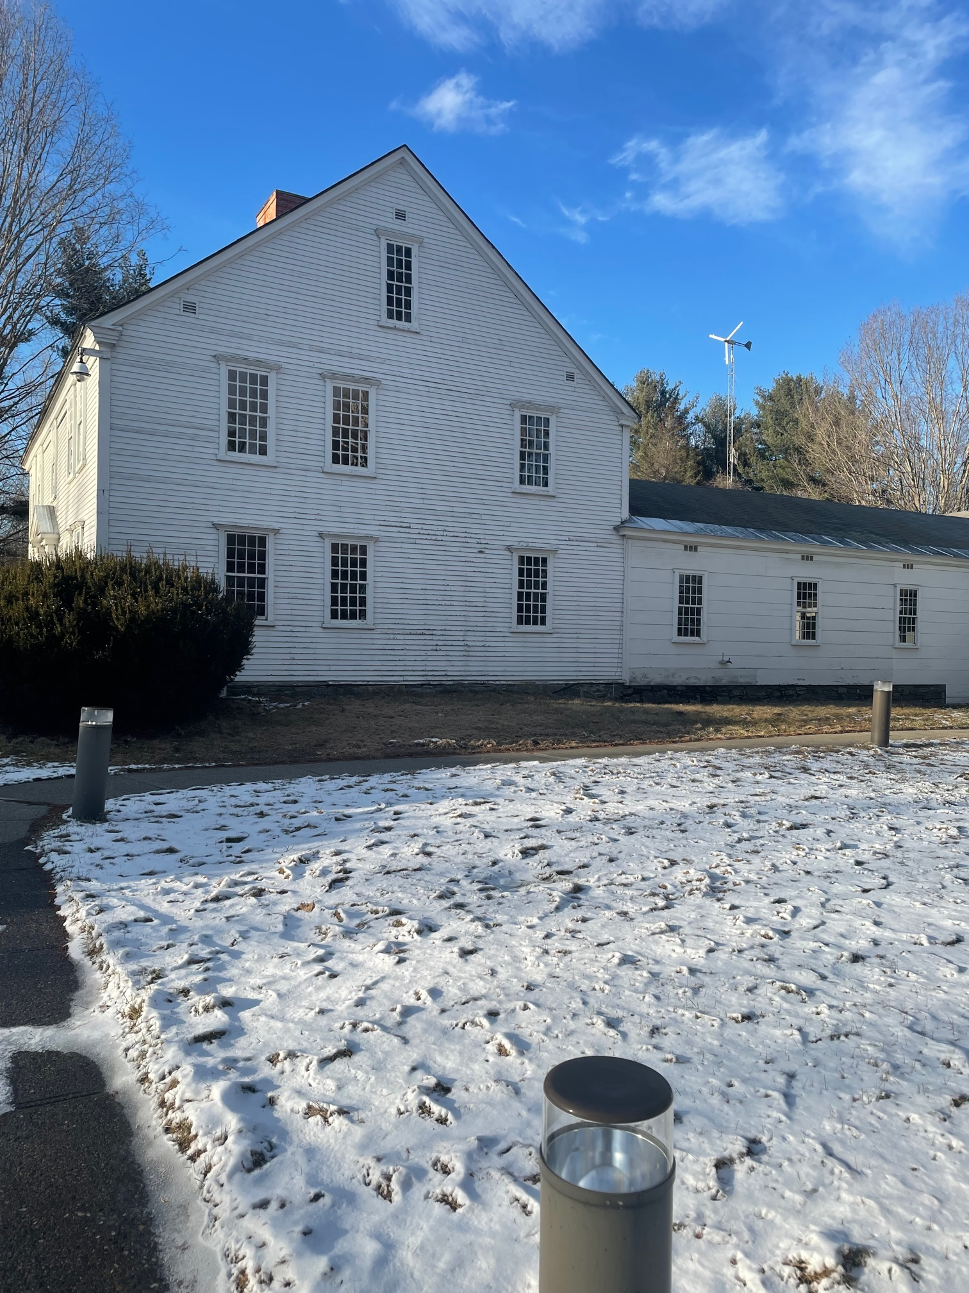

Slide 18
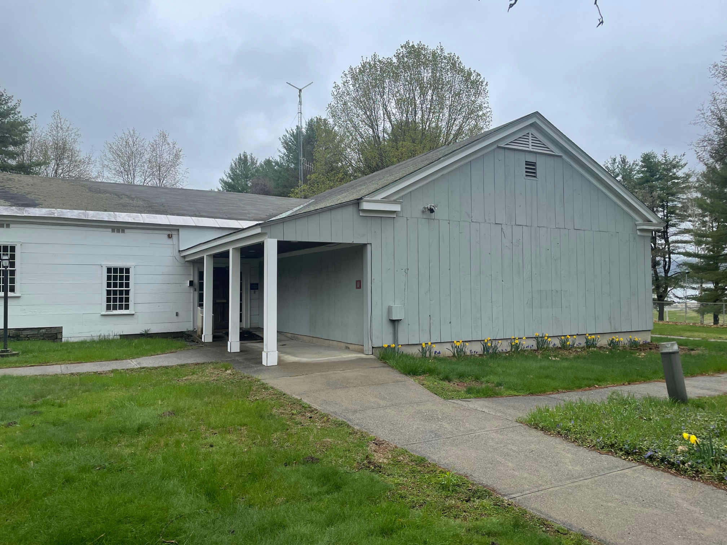

Slide 19
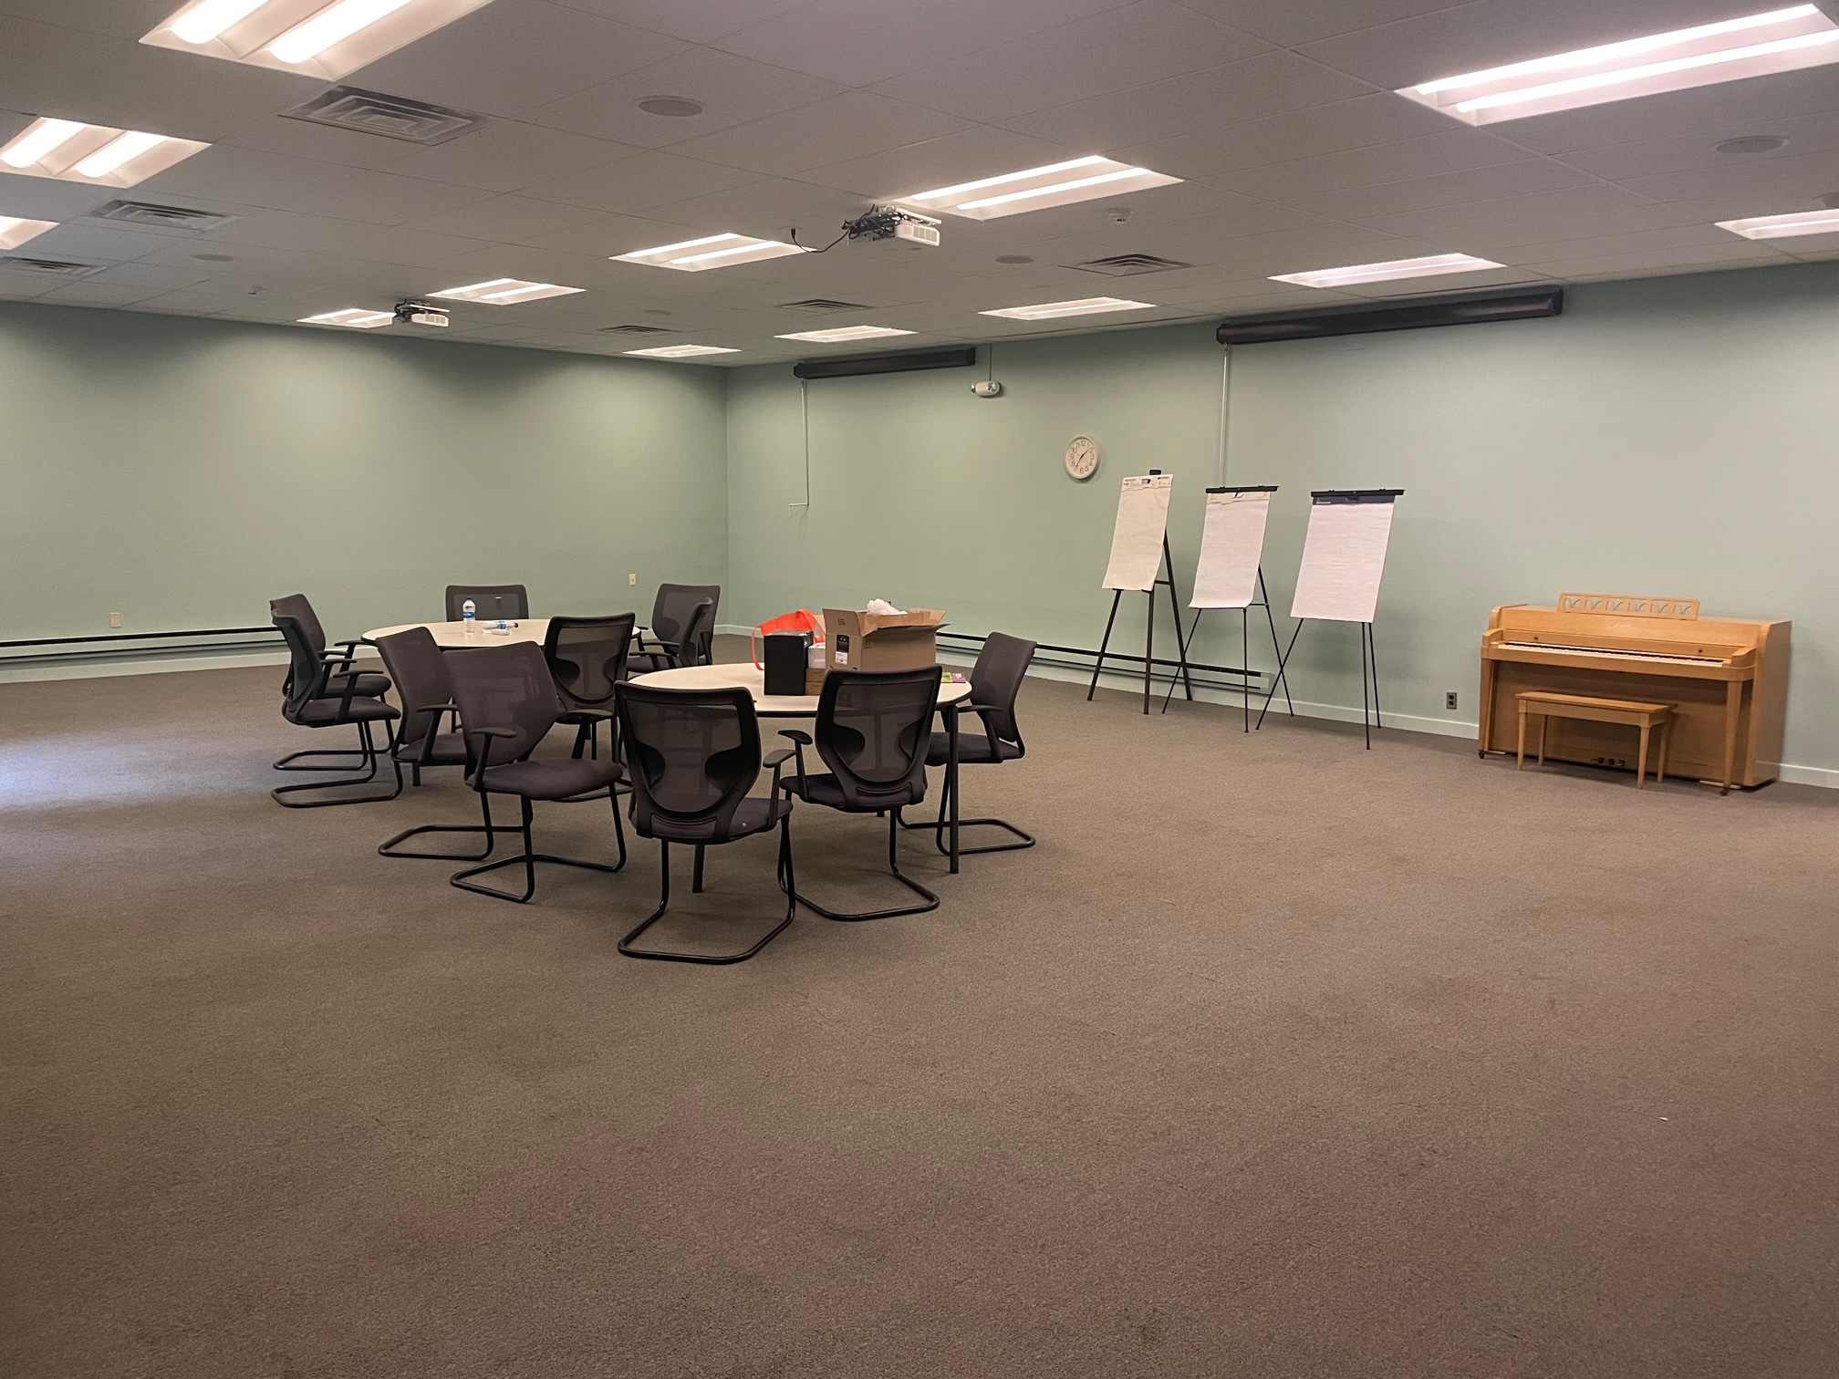

Slide 20
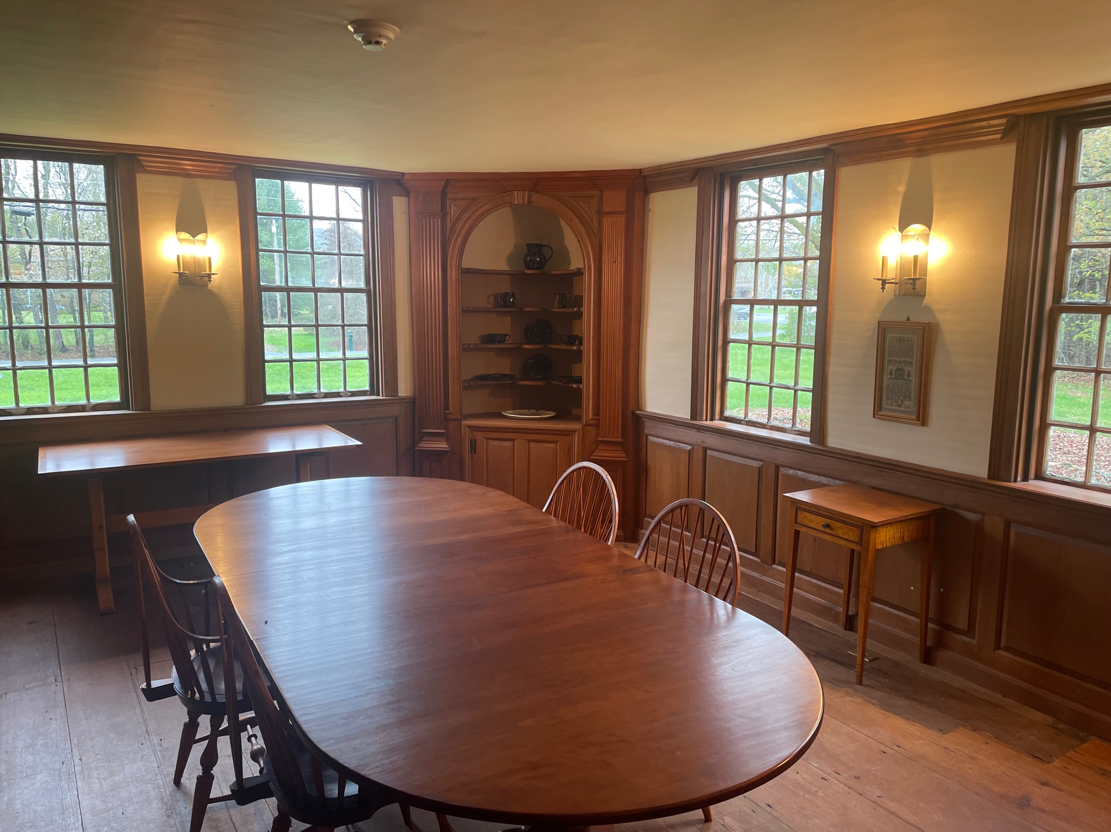

Slide 21
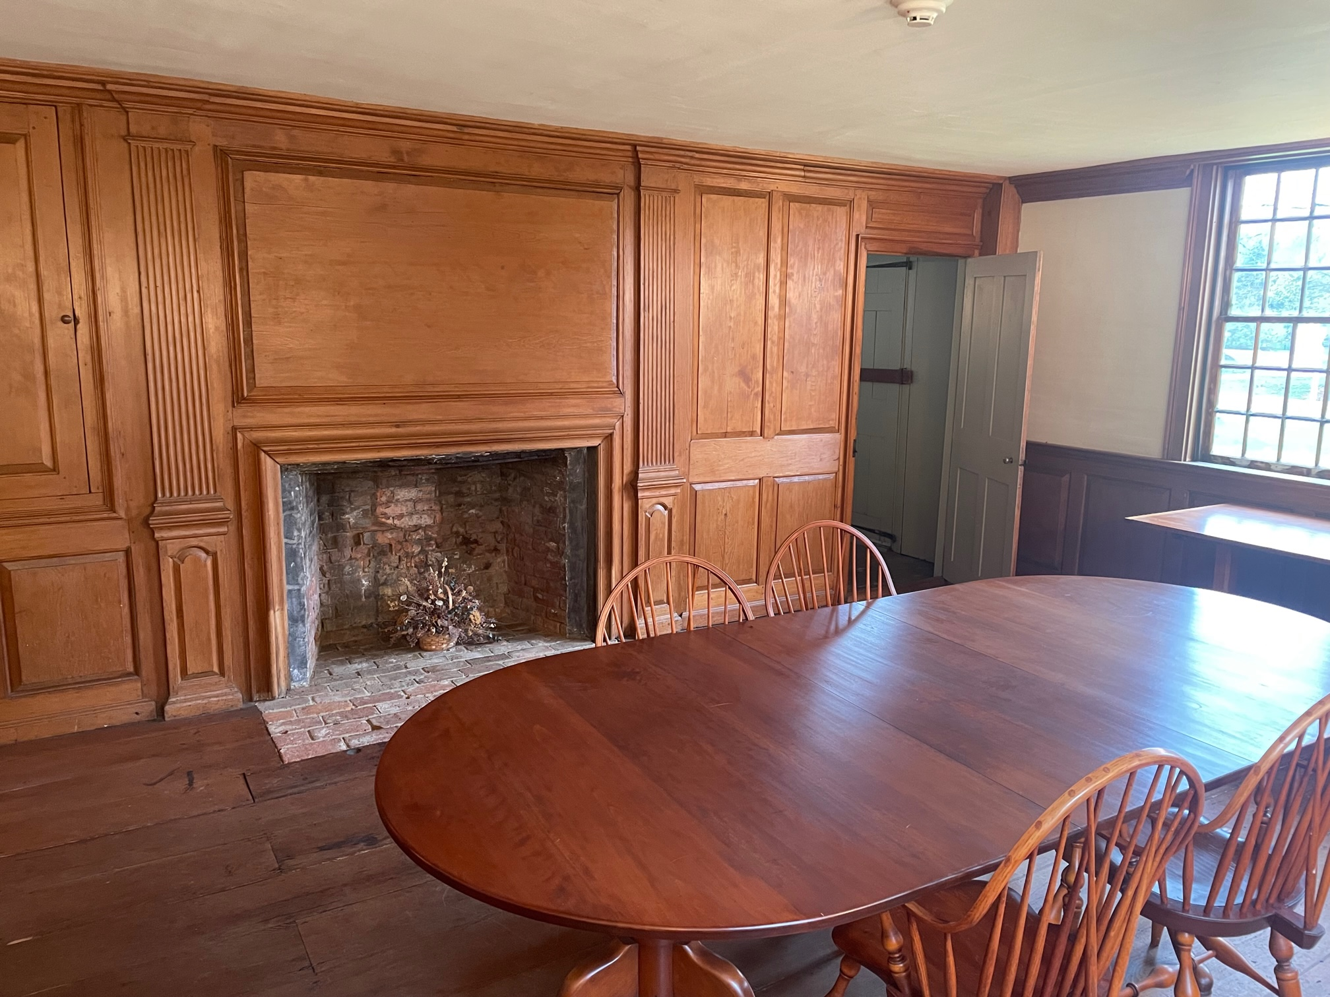

Slide 22
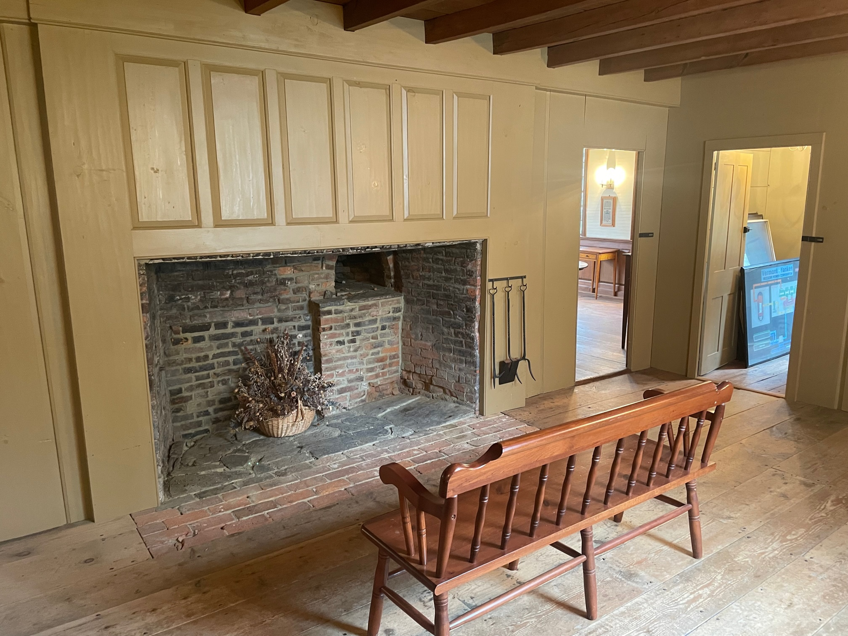

Slide 23
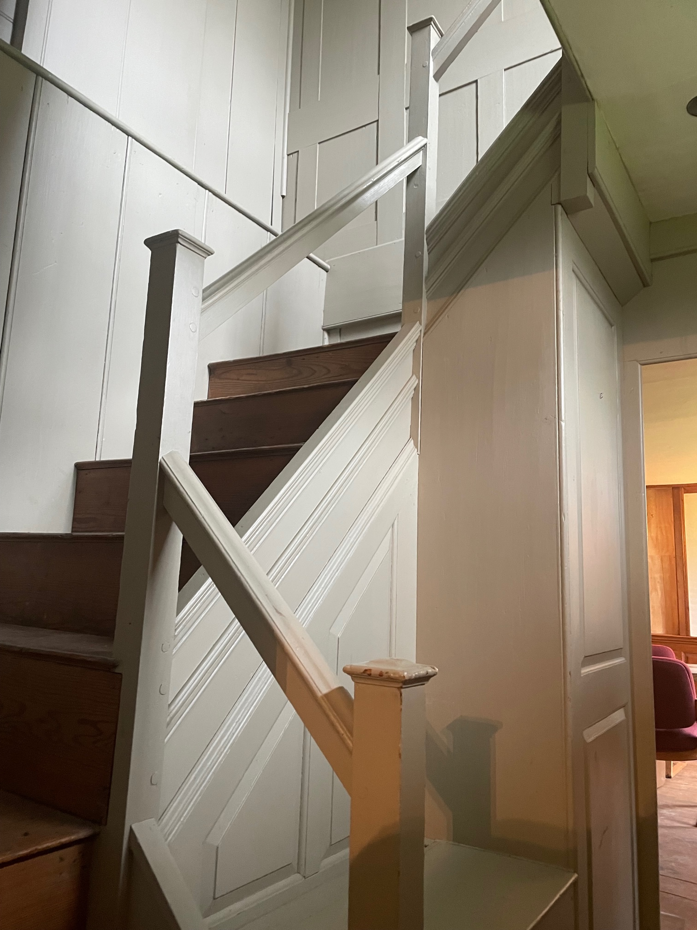

Slide 24
Governor Hunt House & Community Center
FUNDING:
$10,000 seed money via VCRD
$50,000 contributed by Vernon residents and businesses
Includes $10,000 challenge grant
70+ unduplicated donors out of 650 solicited
$10,500+ in-kind contributions from businesses and individuals
$50,000 Paul Bruhn Historic Revitalization Grant (PVT)
$318,000 Congressionally-directed spending grant (Sen. Leahy)
$2,000 in small grants
TOTAL TO DATE: $441,445

Slide 25
Governor Hunt House & Community Center
NEEDS:
Exterior trim repairs, glazing, painting
New roof
Grounds, garden, exterior performance space
HVAC total replacement
Insulation upgrades
New kitchen
Bathroom upgrades
Furnishings, equipment

Slide 26
Governor Hunt House & Community Center
PARTNERS
Town of Vernon
Vernon Recreation Department
Vernon Elementary School
Vernon Historians, Inc.
Northstar
Various other local businesses and organizations

Slide 27
Governor Hunt House & Community Center
TIMELINE
2022 — major exterior projects
2023 — interior insulation, HVAC, kitchen, restrooms
EVENTS
2019: Community open house
2021: Community picnic and celebration + tours
2021: Community Halloween celebration
2022: MORE!!!

