Slide 1
The Southern Vermont Economy
Trends in the labor market and demographics

Slide 2
The Economic & Labor Market Information Division
Housed in the Vermont Department of Labor
State partner to the Federal Government
100% federally funded
Thank you to the USDOL Employment & Training Administration!
Purpose: to produce, explain and disseminate economic data for the benefit of the State of Vermont, educational institutes, employers, students, job-seekers, researchers, and the general public.

Slide 3
Agenda
Top Line indicators
Changes in Labor Force
Population Dynamics

Slide 4
Top Line Indicators
Economic Overview of Southern Vermont

Slide 5
Median Household Income, 2009 – 2017
American Community Survey 5-year estimates

Slide 6
American Community Survey 2013 - 2017 5-year estimates
Notes:
14.6 20.3 national

Slide 7
Local Area Unemployment Statistics / VDoL

Slide 8
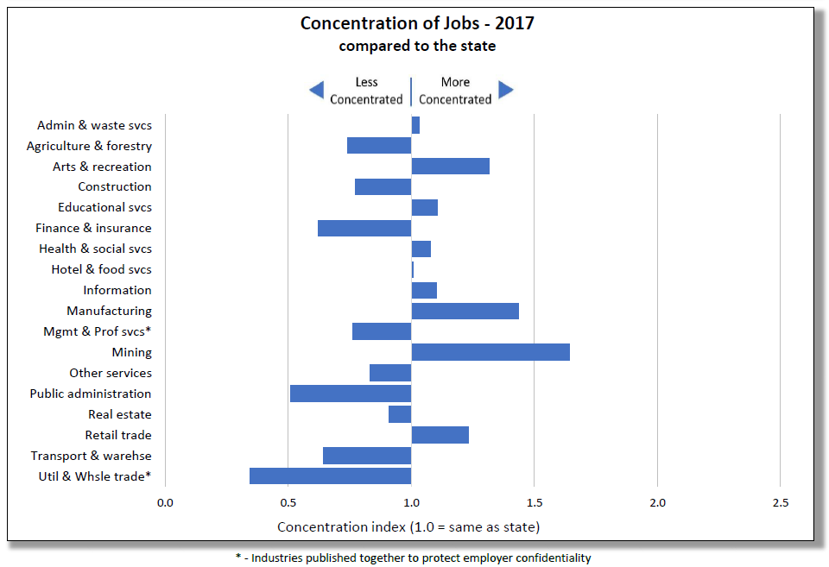
Southwest Vermont
Quarterly Census of Employment & Wages / VDoL

Slide 9
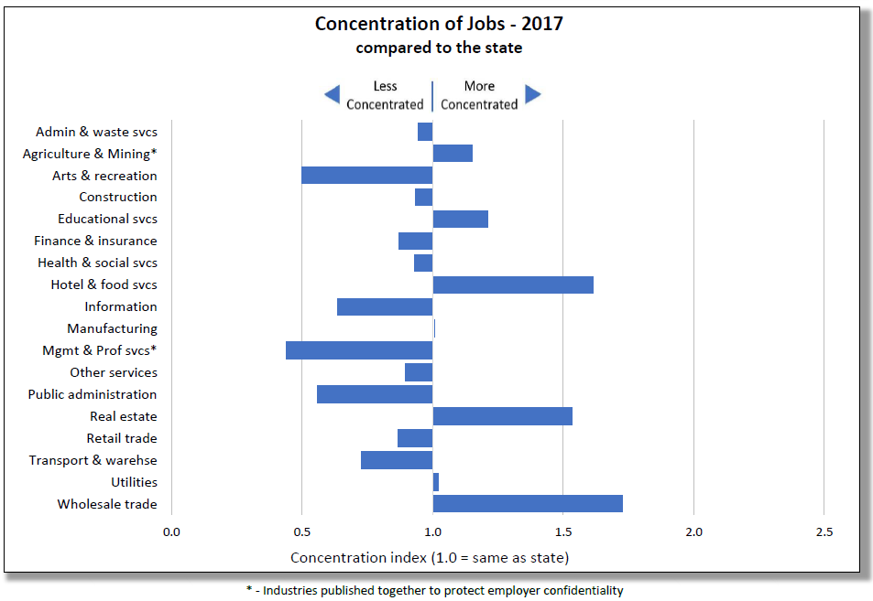
Windham
Quarterly Census of Employment & Wages / VDoL

Slide 10
Local Area Unemployment Statistics / VDoL

Slide 11
Change in Labor Force from Modern Peak
County | Recent Peak Labor Force | Percent Change from Peak
Essex | 2009 | -19.23
Rutland | 2006 | -14.35
Caledonia | 2006 | -13.17
Bennington | 2009 | -10.6
Windsor | 2009 | -12.15
Lamoille | 2009 | -10.15
Windham | 2010 | -9.76
Grand Isle | 2008 | -6.51
Orleans | 2009 | -5.94
Addison | 2009 | -4.88
Orange | 2010 | -4.73
Washington | 2011 | -2.12
Franklin | 2011 | -1.71
Chittenden | 2012 | -0.2
Local Area Unemployment Statistics / VDoL

Slide 12
Source: Bureau of Labor Statistics, Local Area Unemployment Statistics Program

Slide 13
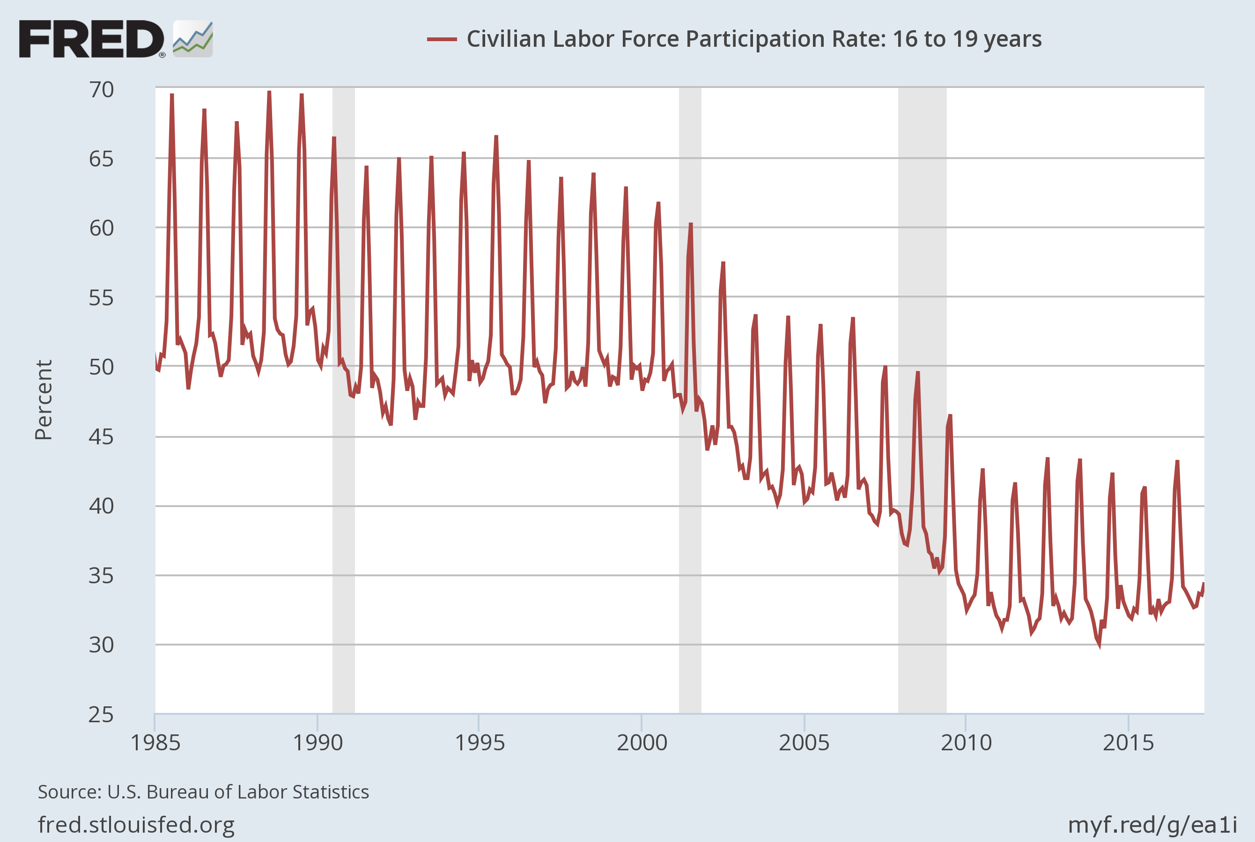
U.S. Labor Force Participation: 16-19
Notes:
Source: U.S. Bureau of Labor Statistics Release: Employment Situation Units: Percent, Not Seasonally Adjusted Frequency: Monthly The series comes from the 'Current Population Survey (Household Survey)'The source code is: LNU01300012 U.S. Bureau of Labor Statistics, Civilian Labor Force Participation Rate: 16 to 19 years [LNU01300012], retrieved from FRED, Federal Reserve Bank of St. Louis; https://fred.stlouisfed.org/series/LNU01300012, June 20, 2017.

Slide 14
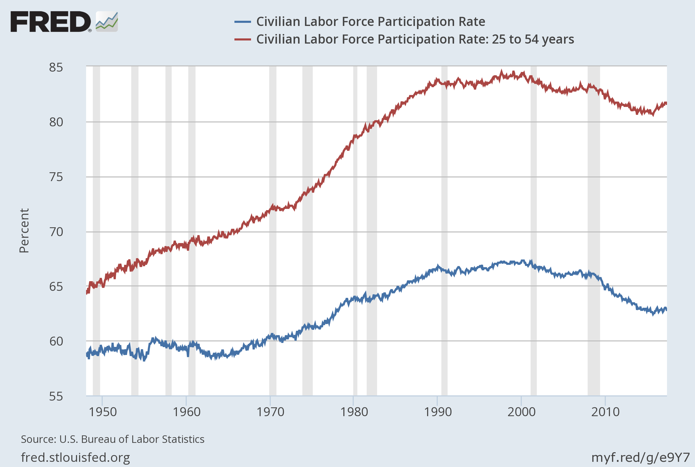
U.S .Labor Force Participation: 25-54 Years

Slide 18
Thanks!
Kevin Stapleton
Vermont Department of Labor
5 Green Mountain Drive Montpelier VT
802 828 3868
Kevin.Stapleton@Vermont.gov

