Slide 1

REGIONAL ECONOMICS 201: MASTER CLASS
Kevin Stapleton, Vermont Department of Labor
Jonathan Cooper, BCRC & BCIC

Slide 2
Private-sector data
Growing in prominence
Multiple access options
  Subscription
  Single project
  On-the-clock
Powered by Big Data
Focus on UX
  Visuals
  Customizable templates
  Projections and analysis

Slide 3
About the audience
Economic Developers
  Consultants/Site selectors
  Regional & non-profit groups
Employers
  HR offices
  Training providers
State & Federal Agencies
  Labor
  Workforce
  Education
  Researchers

Slide 4
Real-time labor market information
Job posting analytics
  Inputs employment postings on job websites
  Tracks demand by industry, occupation, geography, skills, wage, and certification
Three advantages
  Timeliness of daily updates
  Flexibility of data search
  Compatibility with O*NET-SOC and NAICS
“Tools like Burning Glass help us tell the story. Everybody, at the highest level, comes to us for that data. It’s so baked into our system now that we don’t even question it. We will always have demand now that we can show what it can do.”
Alan Spell
Research Manager, Missouri Department of Economic Development

Slide 5
Real-time labor market information
Key limitations
  Online-only sources favor higher-paying professional jobs in urban areas
  Informal and non-public searches (internal hiring) unaccounted for
  Hard to infer skill priorities
  Only tracks job listings
    Not all listings are openings
    Doesn’t track job hires!
      Discounts interview skills

Slide 6
Real-time labor market information
High-value scenario
  Workforce Innovation and Opportunity Act (WIOA) provides program funding but emphasizes sector-driven approaches
  Plant closure is announced: DOL Rapid Response teams are deployed, and use RTLMI to identify best matches for affected workers

Slide 7
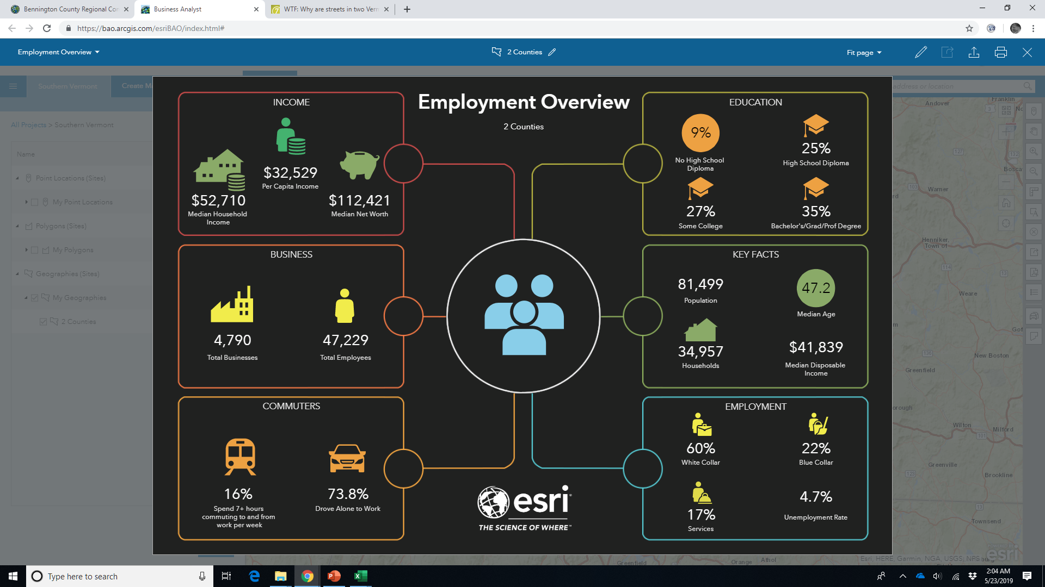
GIS & Spatial analysis
Public & private data
  ACS, Bureau of Labor Statistics, State agencies
  National GfK MRI consumer and household surveys for lifestyle and spending data
Prioritizes visual dynamism
Spatial first: project area

Slide 9
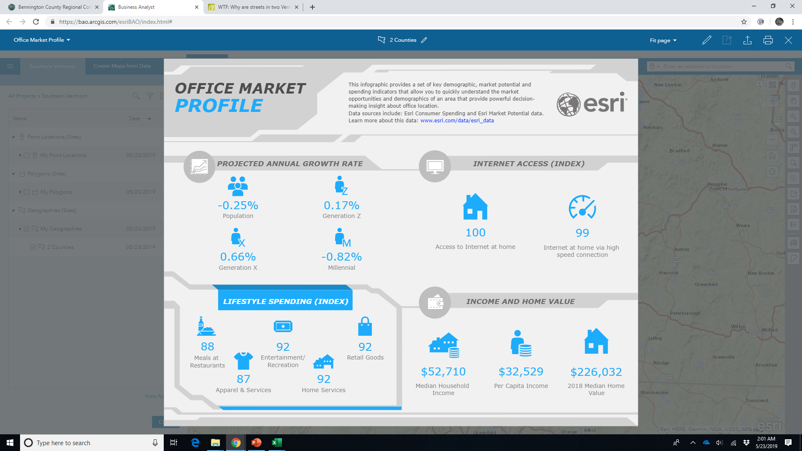

Slide 10
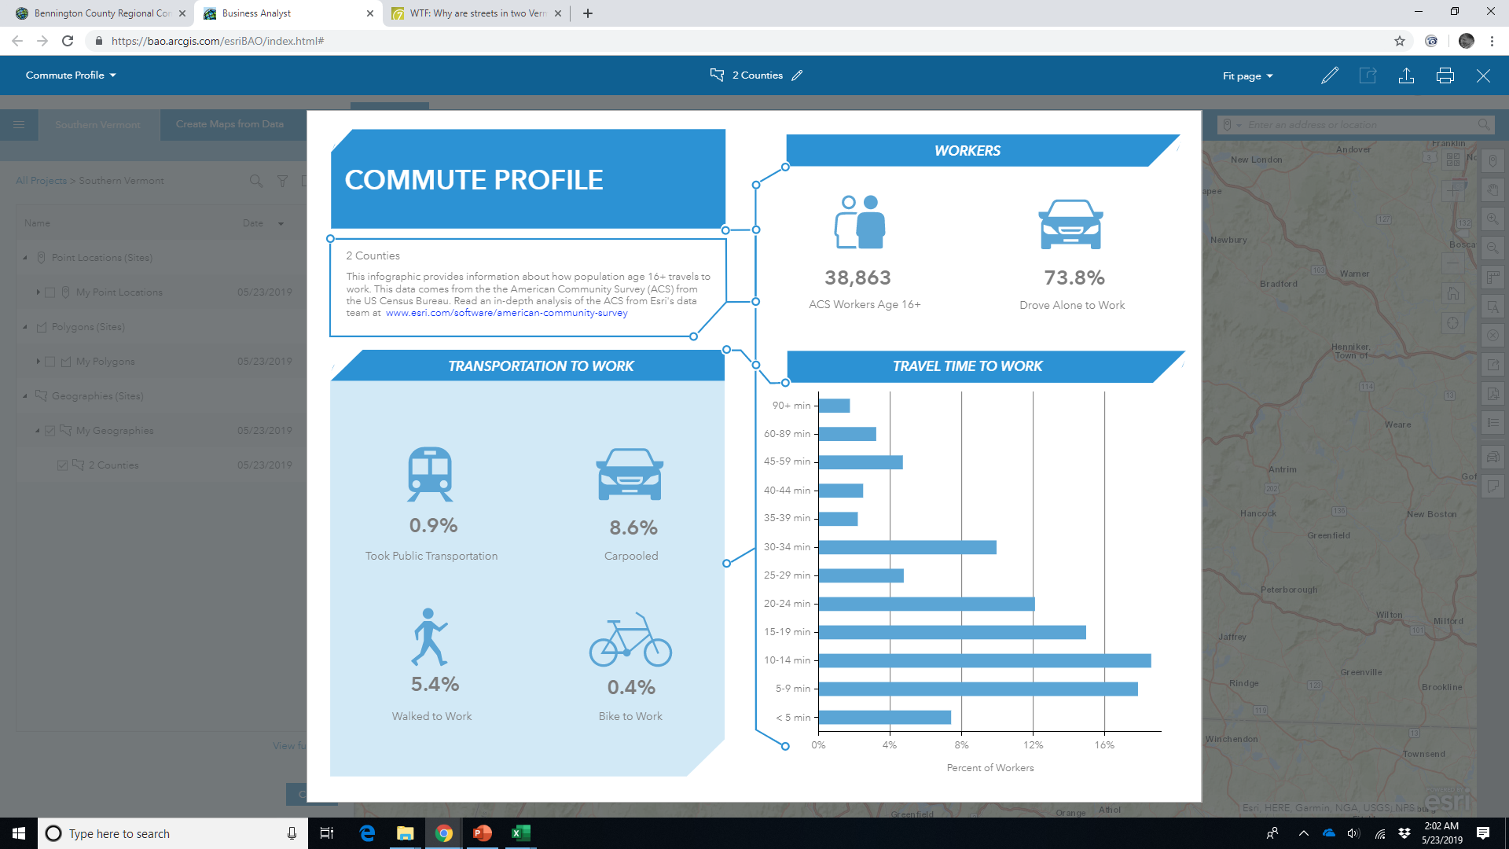

Slide 12
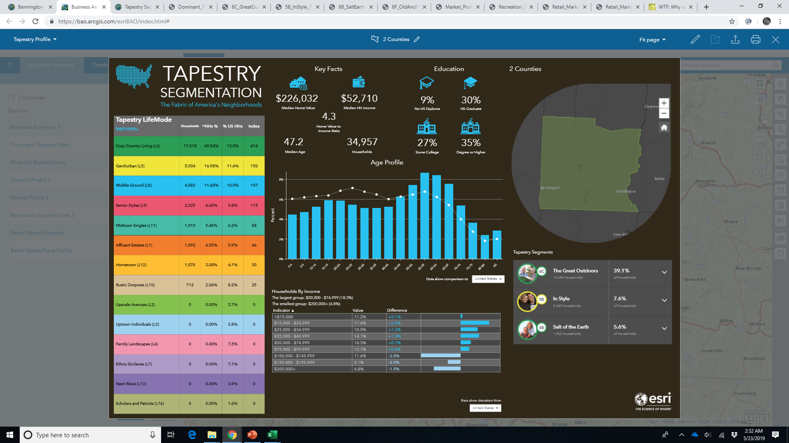

Slide 13
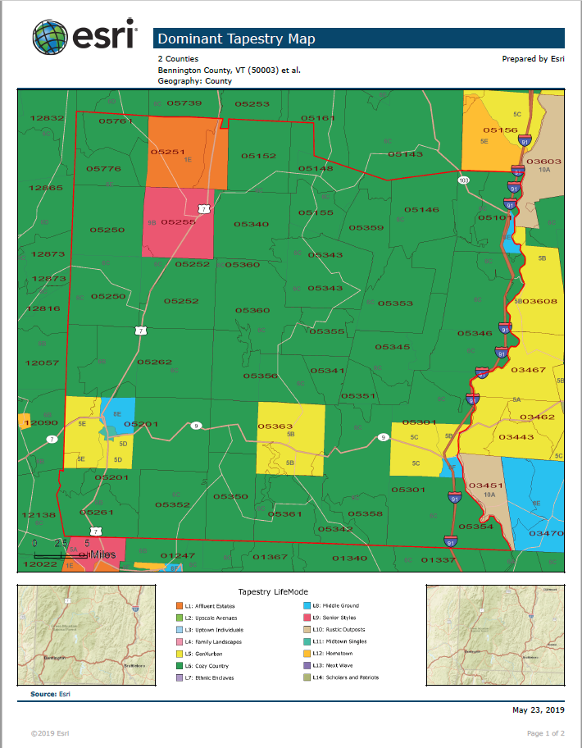
Demographic inferences

Slide 14
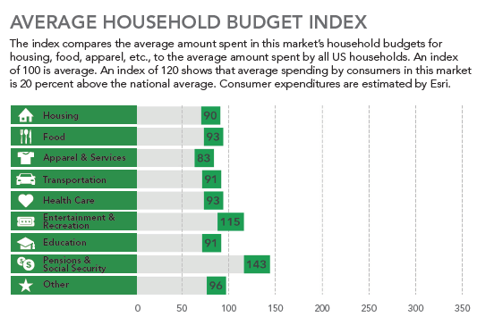
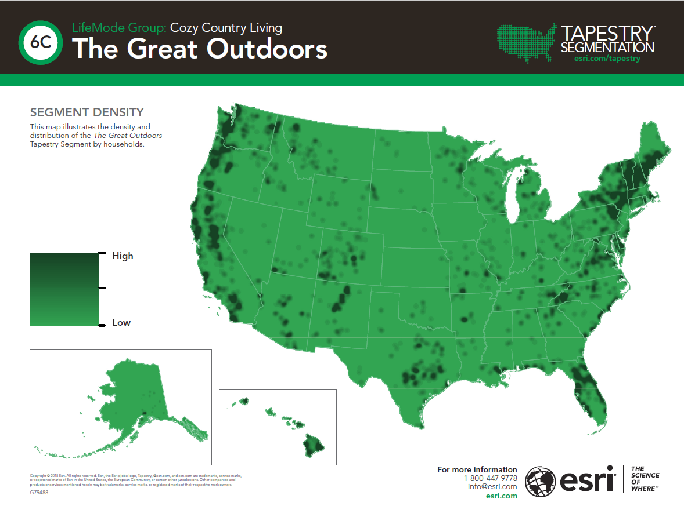
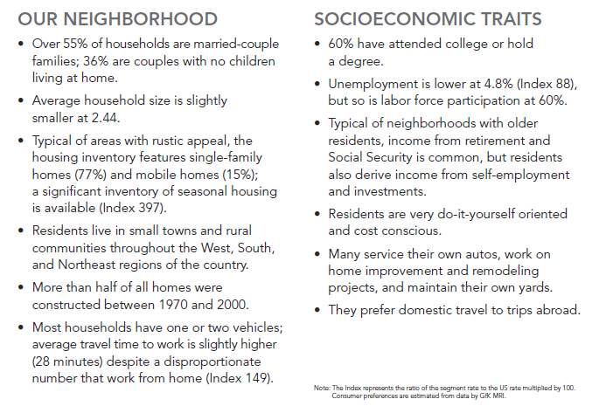

Slide 15
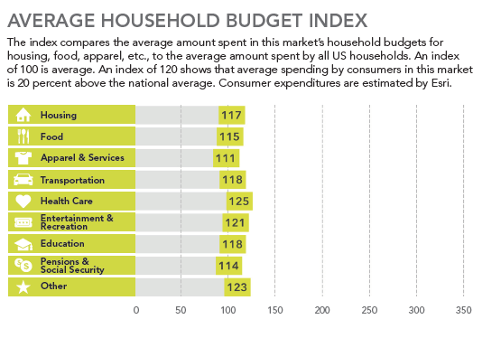
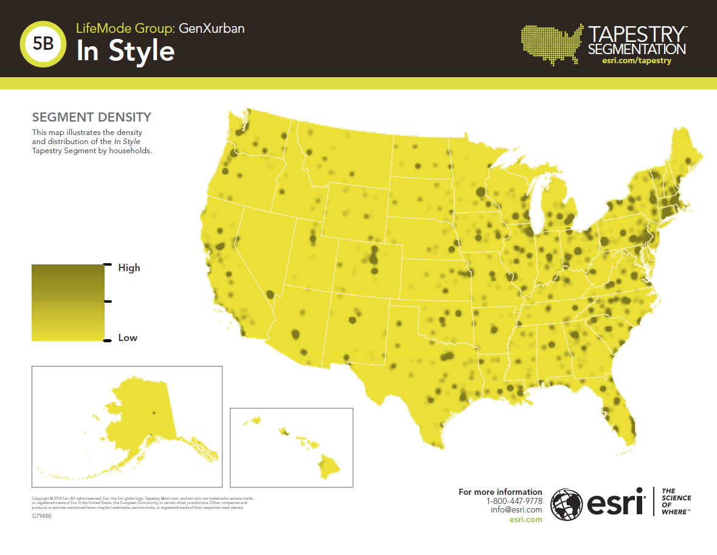
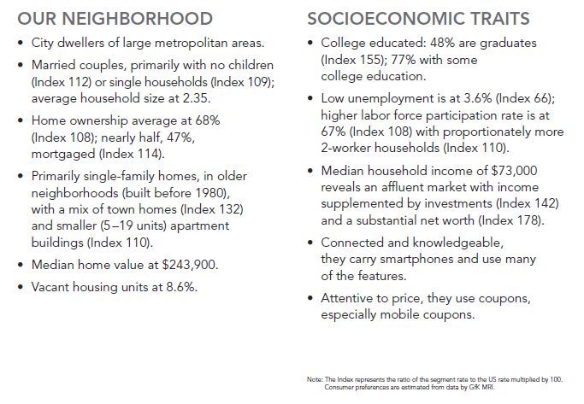

Slide 16

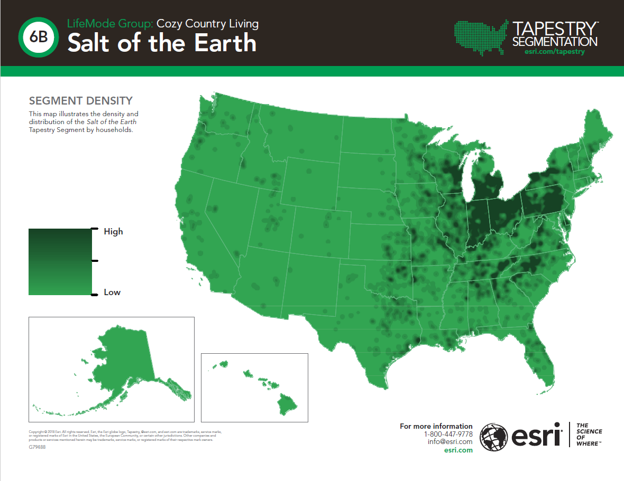
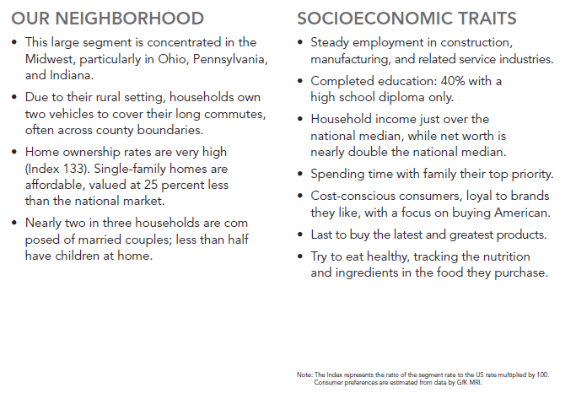

Slide 17
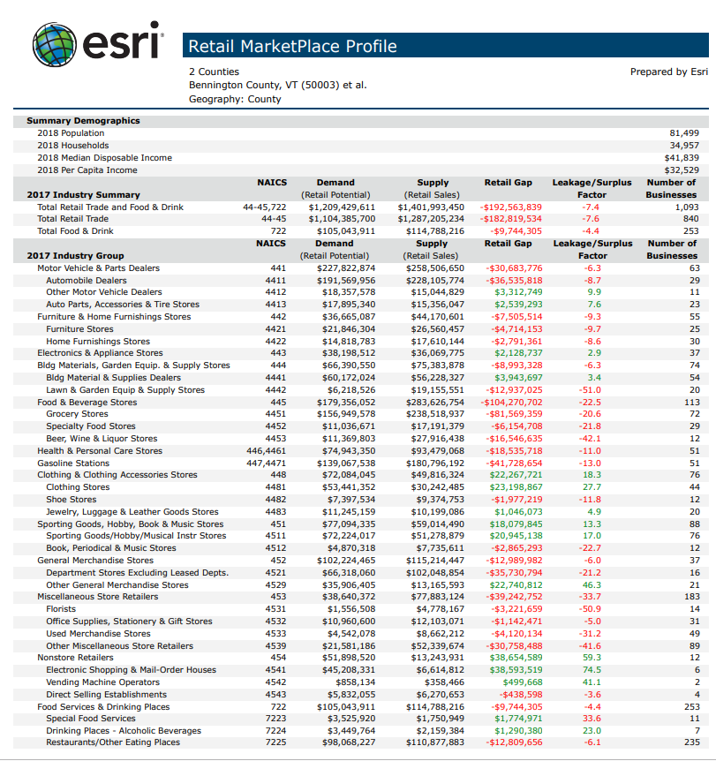
Spending Inferences

